Slide 1

PDOOH Recommendations
For Diwali

Slide 2




Advantages
Dynamic Audience Targeting
Trigger Targeting
P-DOOH analyzes location data, creating audiences from consumer movements for targeted ads.
Optimize messaging for weather's impact on consumer behavior in real-time.
Live Data-Led Dynamic Creative
Live Data Feeds
Customize creative in real-time based on all types of local data
Weather, traffic, flight data.
Local data sets for targeting e.g. demographic postcode data

Slide 3
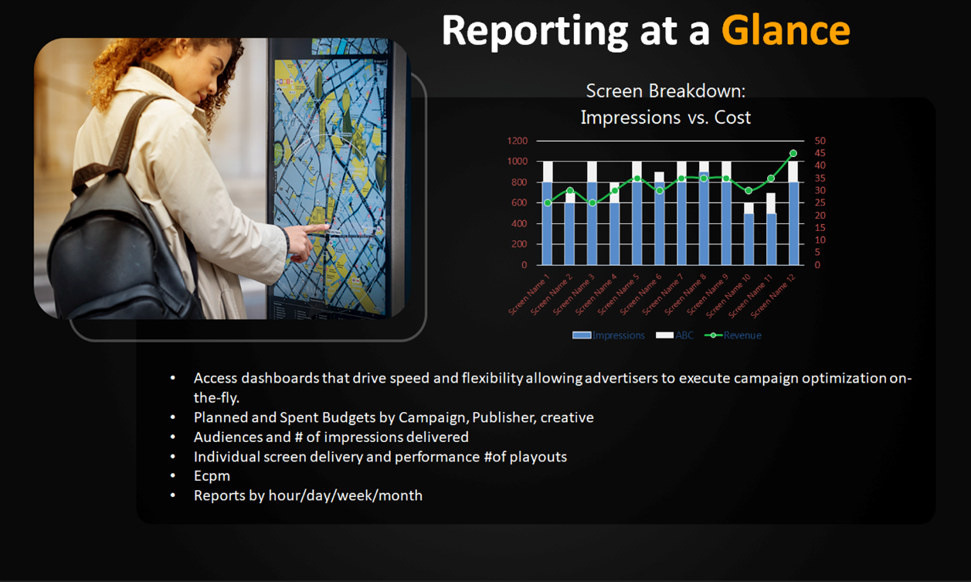

Slide 4
Total Budget
Total No of Screens
Forecasted Impressions
3,00,000 USD
3116
10733329

Slide 5
Locations
Countries and Airports | No: of Screens | Planned Budget | Forecasted Impressions
Singapore Changi Airport | 18 | 20000 USD | 561167
JFK Airport USA | 159 | 20000 USD | 745459
USA | 1718 | 20000 USD | 1305830
Dallas Fort Worth International Airport | 269 | 20000 USD | 827152
Chicago O'Hare International Airport | 8 | 20000 USD | 582400
Bahrain International Airport | 40 | 20000 USD | 606060
United Arab Emirates | 13 | 20000 USD | 419084
Malaysia OOH | 19 | 20000 USD | 871660
Hartsfield Jackson Atlanta International Airport (ATL) | 230 | 20000 USD | 675973
Washington Dulles airport | 34 | 20000 USD | 688452
Los Angeles international airport | 284 | 20000 USD | 799444
Abu Dhabi International Airport (AUH) | 34 | 20000 USD | 606060
Dubai International Airport | 154 | 20000 USD | 404040
San Francisco International Airport | 9 | 20000 USD | 519480
Singapore | 127 | 20000 USD | 1121061

Slide 6
United States of America​
​
​
Venue Type
Venue types | Number of Screens
Outdoor - Urban Panels | 1665
Transit - Airports | 637
Transit - Airports - Departures Hall | 409
Transit - Airports - Gates | 175
Outdoor - Billboards | 84
Retail - Mall | 59
Office Buildings - Office Buildings | 33
Transit - Airports - Lounges | 15
Residential - Apartment Buildings and Condominiums | 11
Retail - Mall - Concourse | 11
Outdoor - Billboards - Roadside | 4
Outdoor - Bus Shelters | 3
Outdoor - Billboards - Highway | 3
Transit - Taxi & Rideshare Top | 2
Outdoor - Billboards - Spectacular | 2
Retail - Mall - Spectacular | 1
Transit - Airports - Shopping Area | 1
Leisure - Casual Dining | 1

Slide 7
United States of America
Airports

Slide 8
San Francisco International Airport, USA

Slide 9
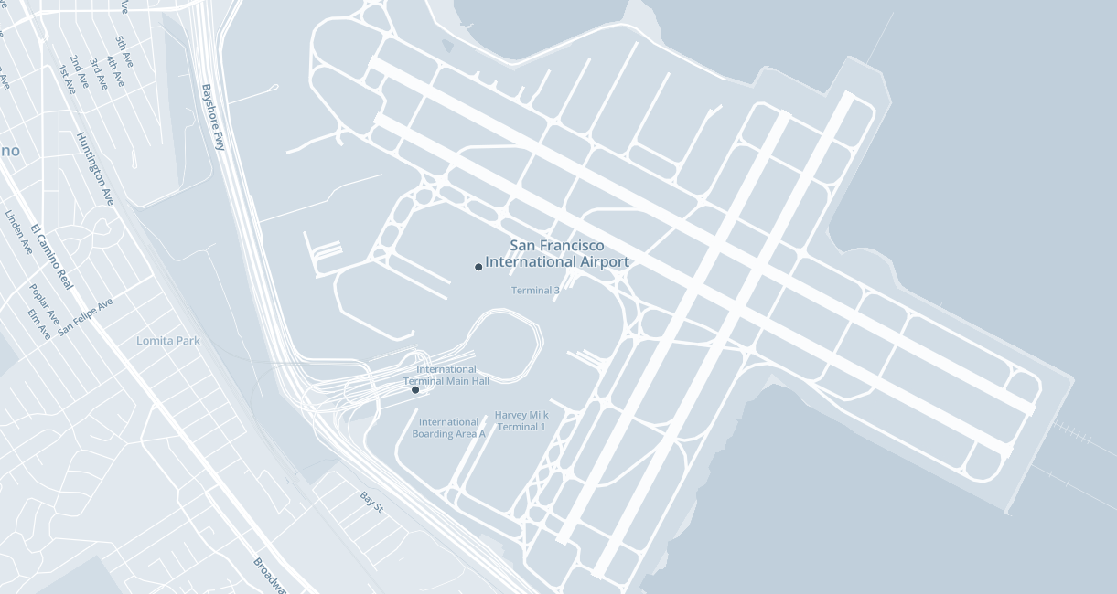
San Francisco International Airport, USA Map view

Slide 10
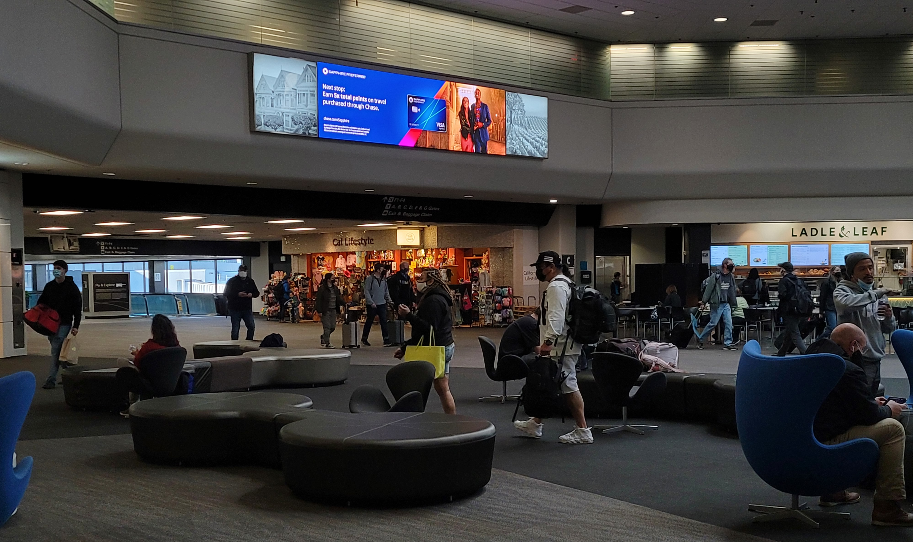
Recommended Sites at San Francisco International Airport, USA
No of screens 09

Slide 11
JFK Airport, USA

Slide 12
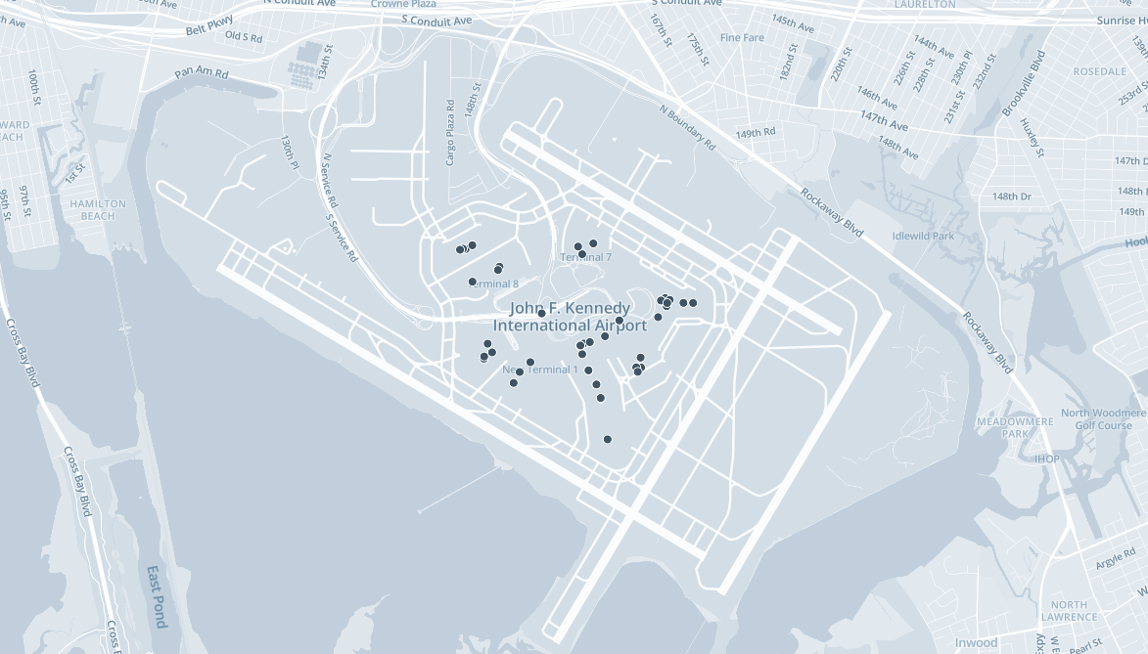
JFK Airport (USA), Map view
No of screens 159

Slide 13
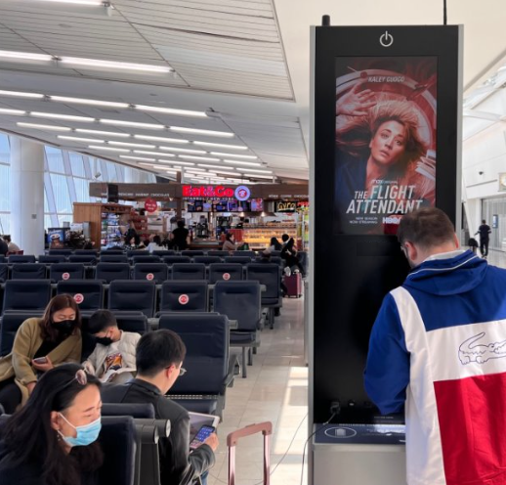
Recommended Sites at JFK Airport (USA)

Slide 14
Dallas Fort Worth International Airport, USA

Slide 15
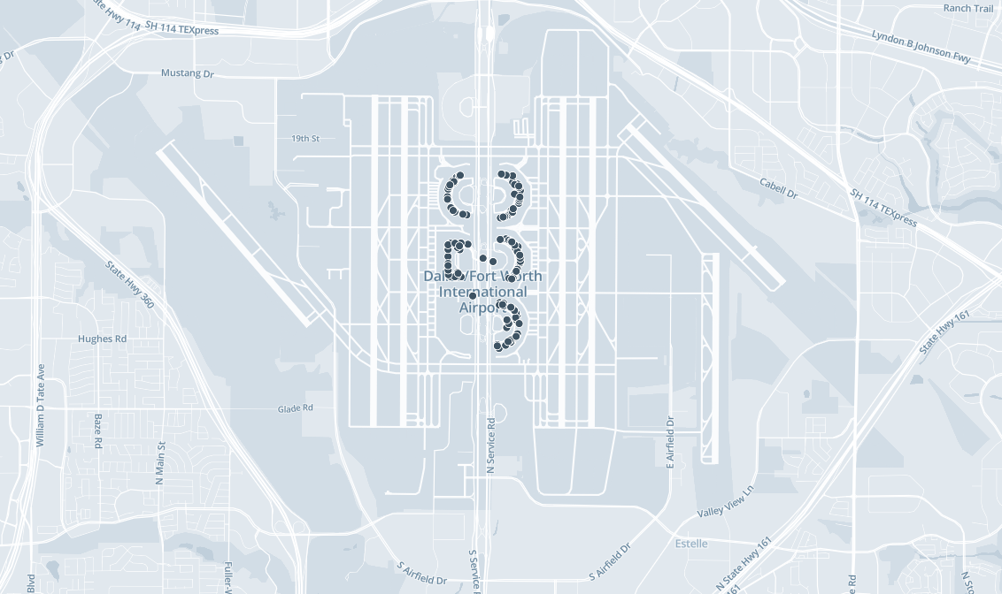
Dallas Fort Worth International Airport, Map view
No of screens 269

Slide 16
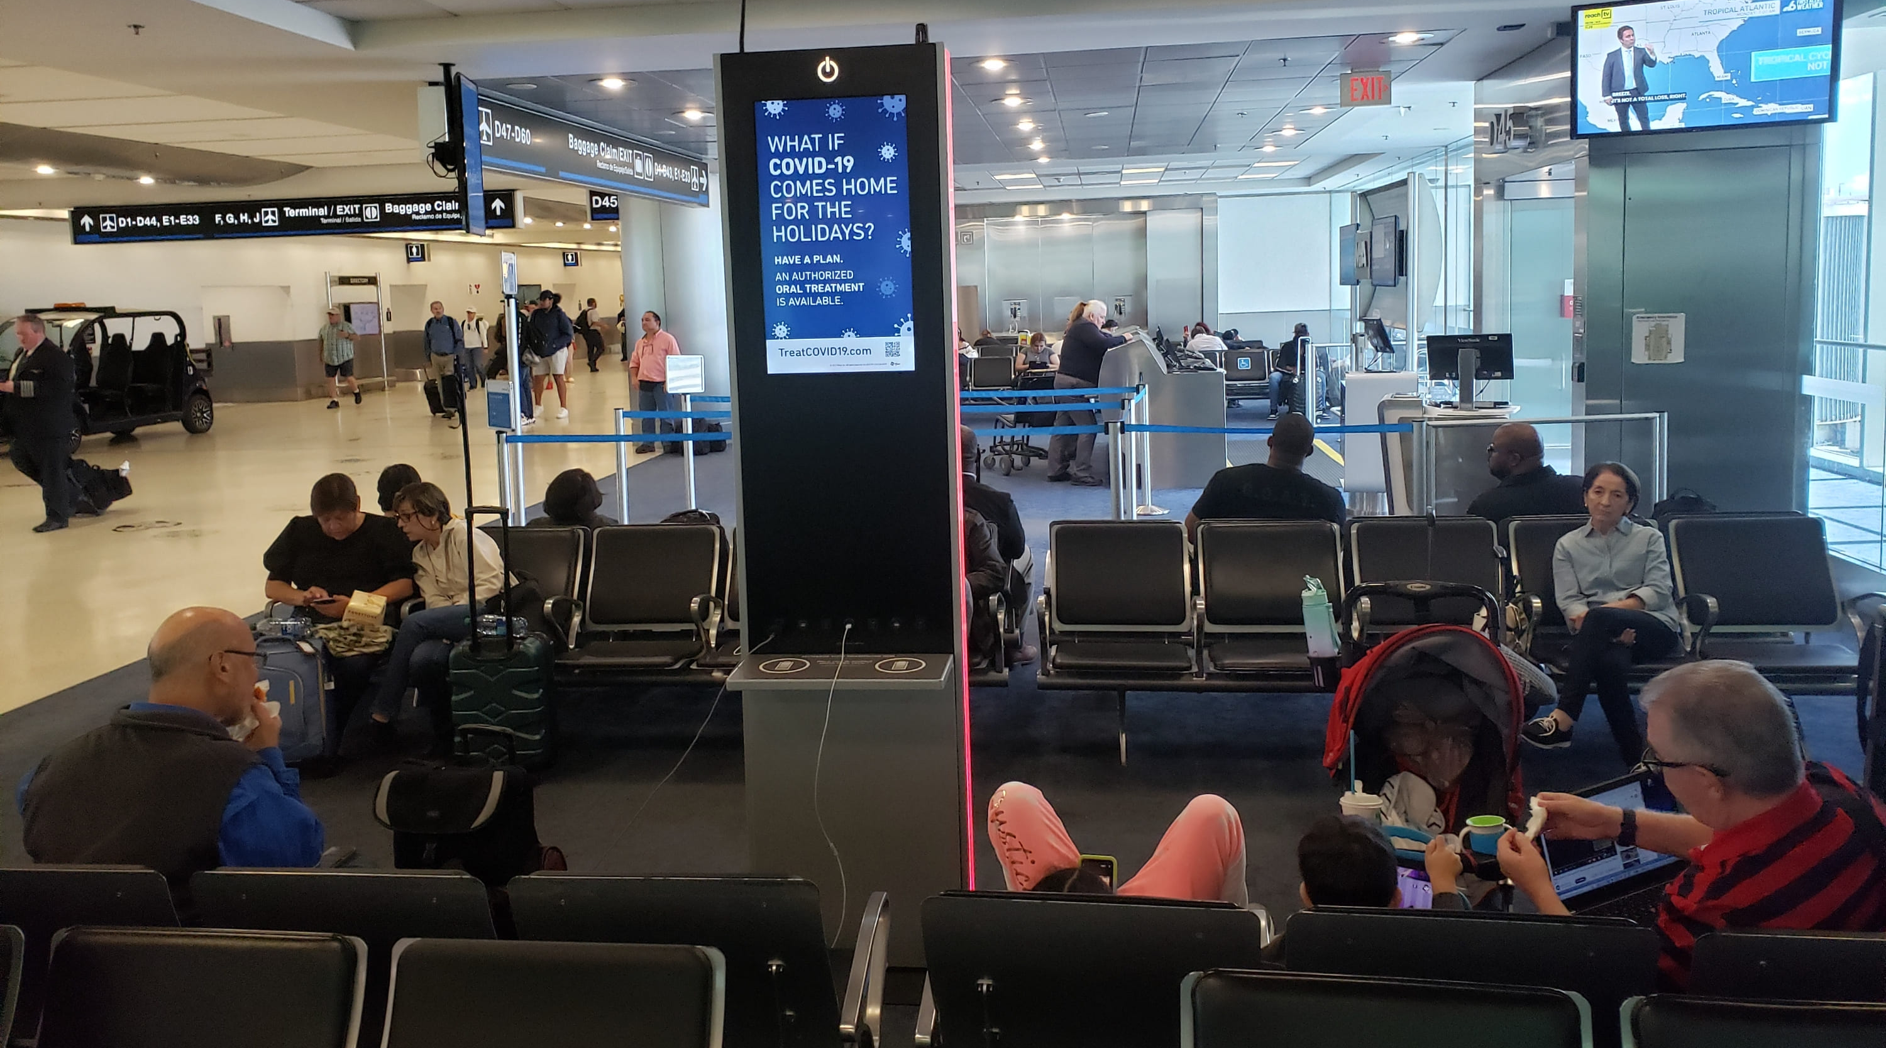
Recommended Sites at Dallas Fort Worth International Airport

Slide 17
Chicago O'Hare International Airport, USA

Slide 18
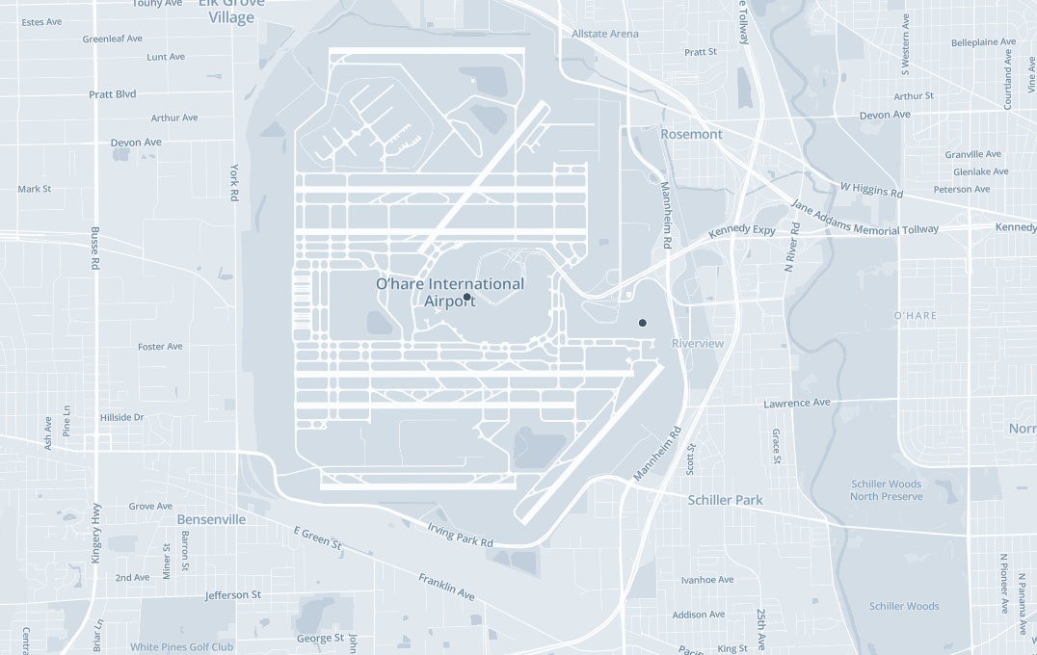
Chicago O'Hare International Airport, Map view
No of screens 8

Slide 19
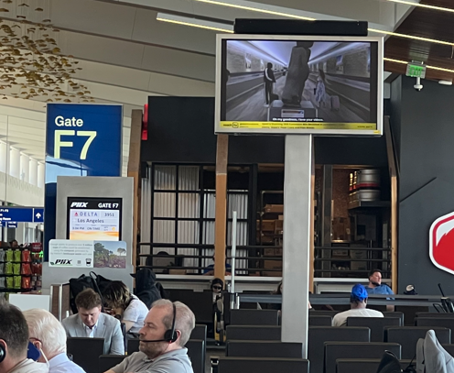
Recommended Sites at Chicago O'Hare International Airport

Slide 20
Hartsfield-Jackson Atlanta International Airport, USA

Slide 21
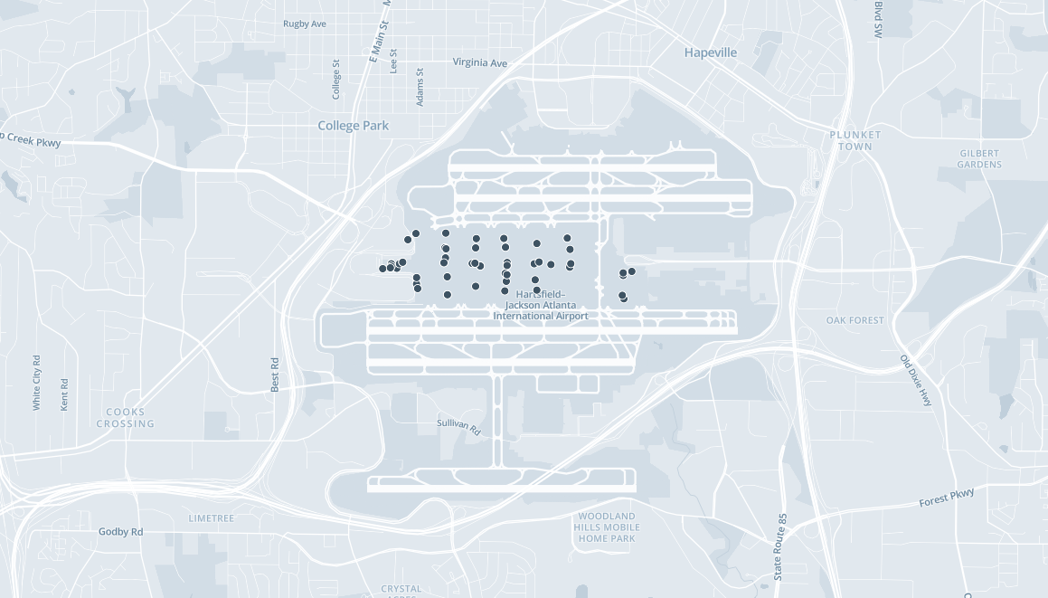
Hartsfield-Jackson Atlanta International Airport, Map view
No of screens 230

Slide 22
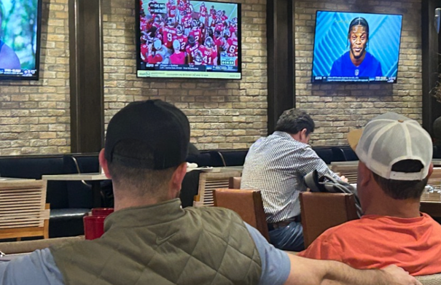
Recommended Sites at Hartsfield-Jackson Atlanta International Airport

Slide 23
Washington Dulles Airport, USA

Slide 24
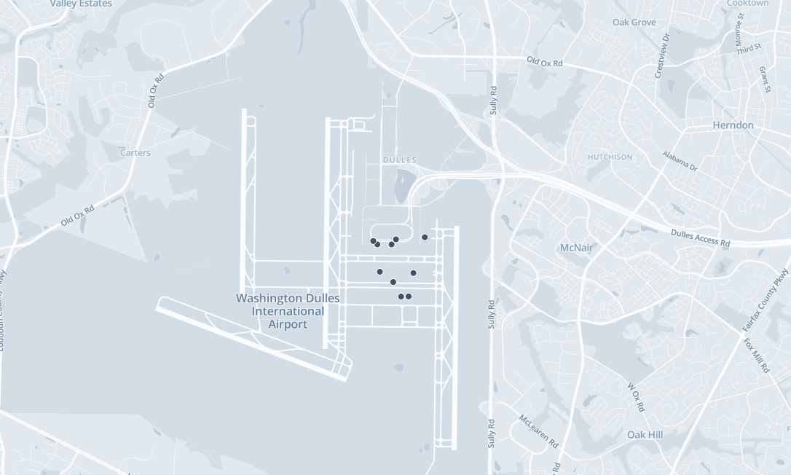
Washington Dulles Airport, Map view
No of screens 34

Slide 25
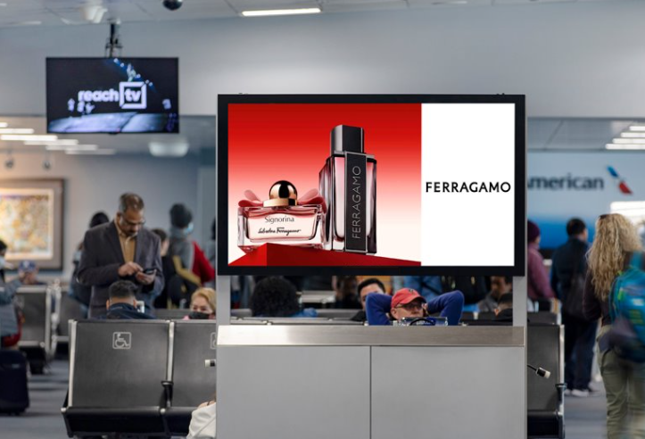
Recommended Sites at Washington Dulles Airport

Slide 26
Los Angeles International Airport, USA

Slide 27
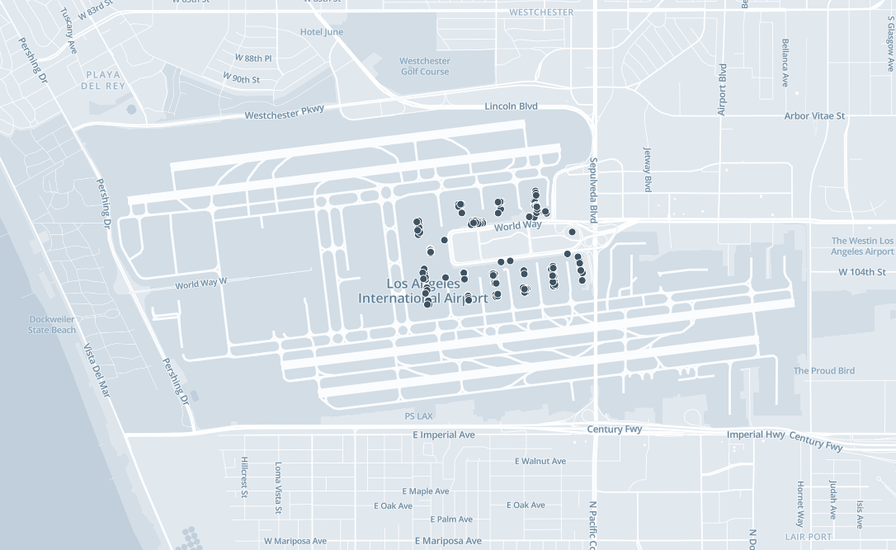
Los Angeles International Airport, Map view
No of screens 284

Slide 28
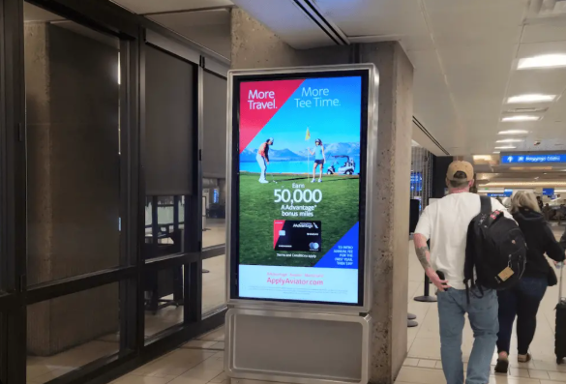
Recommended Sites at Los Angeles International Airport

Slide 29
United States of America
OOH

Slide 30
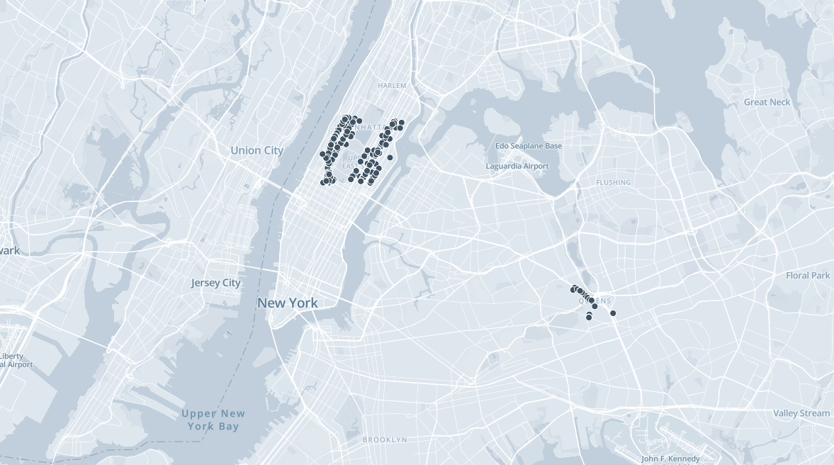
United states of America, Map view
No of screens 1718

Slide 31
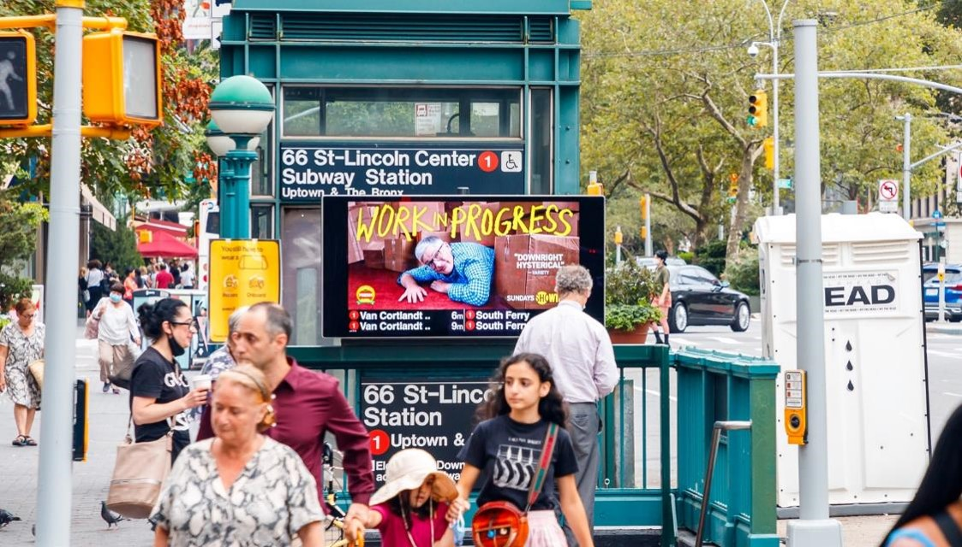
Recommended Sites at United States of America

Slide 32
Bahrain International Airport

Slide 33
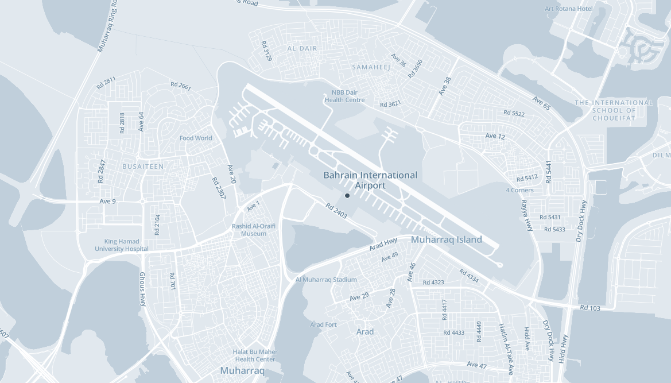
Bahrain International Airport Map view
No of screens 40

Slide 34
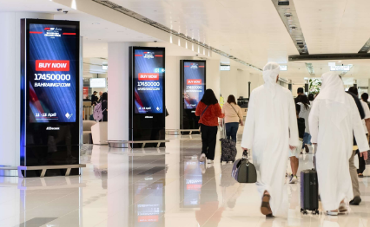
Recommended Sites at Bahrain International Airport

Slide 35
Singapore
Airports

Slide 36
Singapore Changi Airport

Slide 37
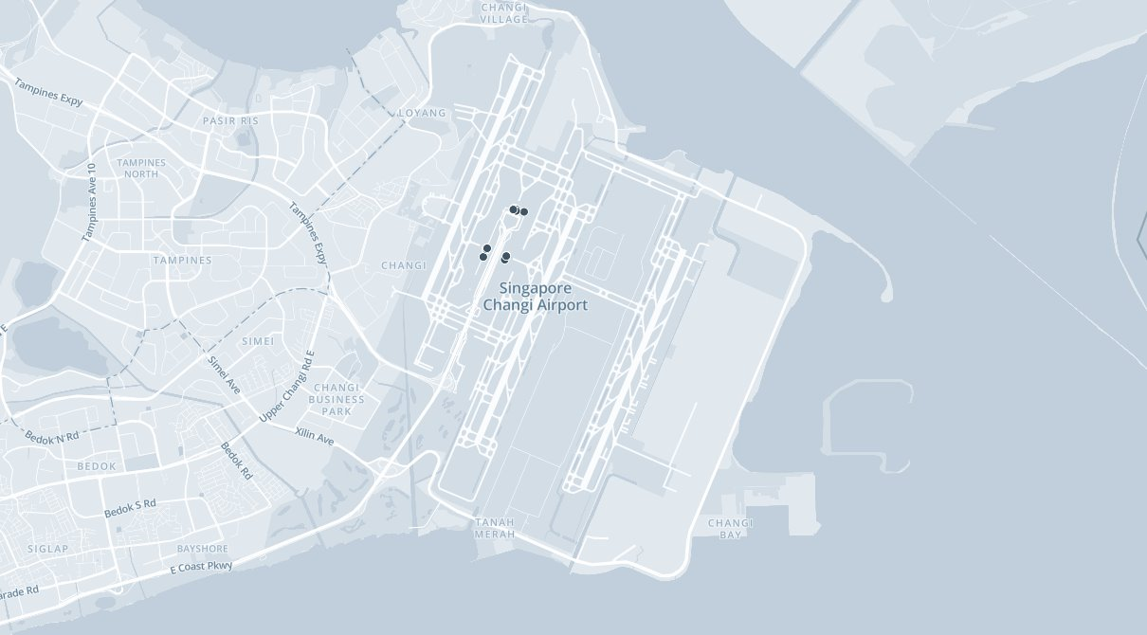
Changi International Airport, Singapore Map view
No of screens 18

Slide 38

Recommended Sites at Changi International Airport, Singapore

Slide 39
Singapore
OOH

Slide 40
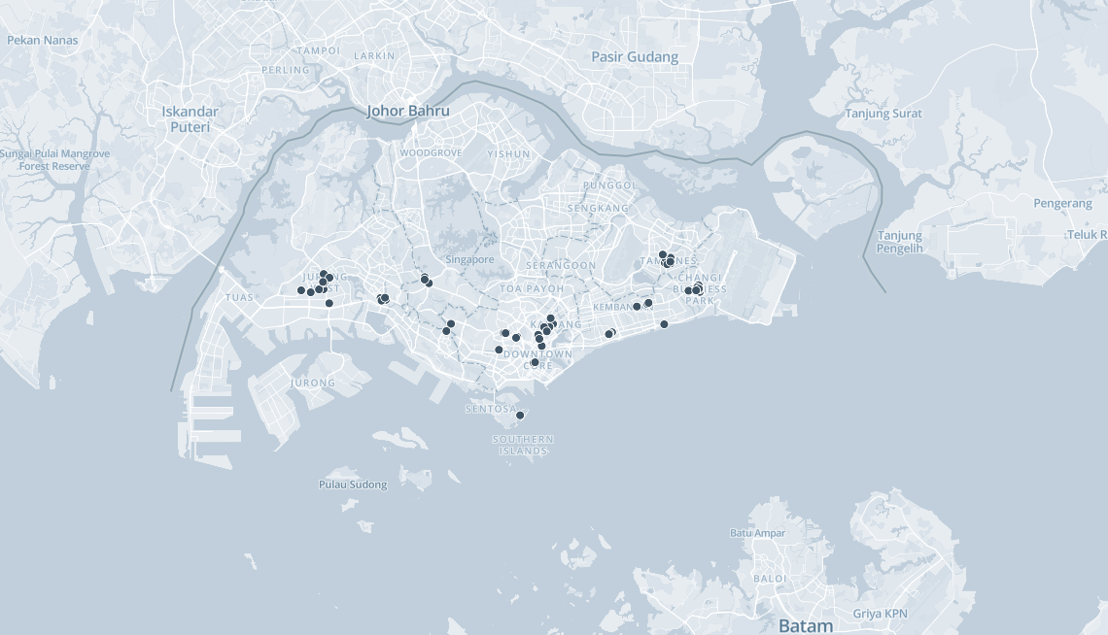
Singapore out of home recommendations Map view
No of screens 127

Slide 41
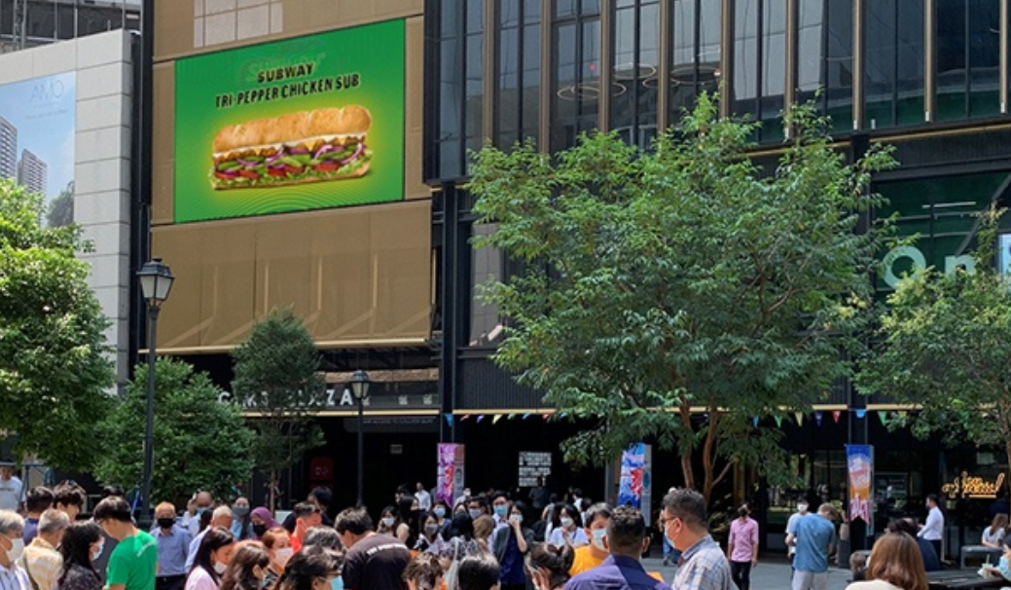
Recommended Sites at Singapore

Slide 42
United Arab Emirates
Airports

Slide 43
Dubai International Airport, UAE

Slide 44
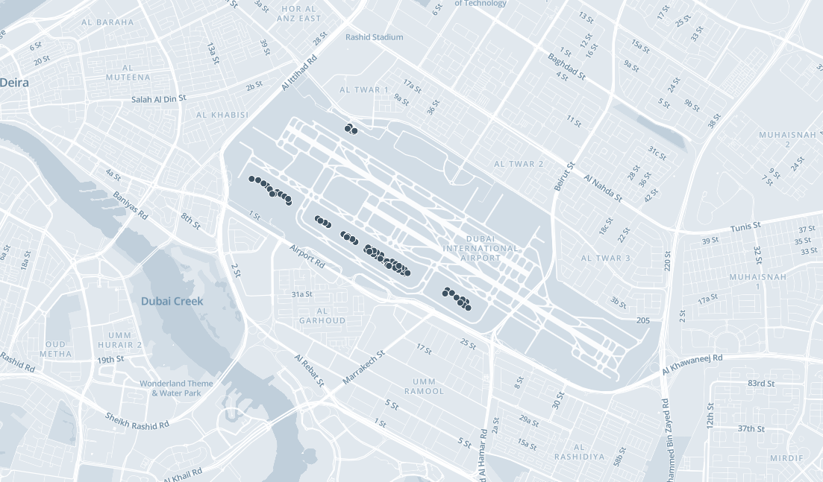
Dubai International Airport, Map view
No of screens 154

Slide 45
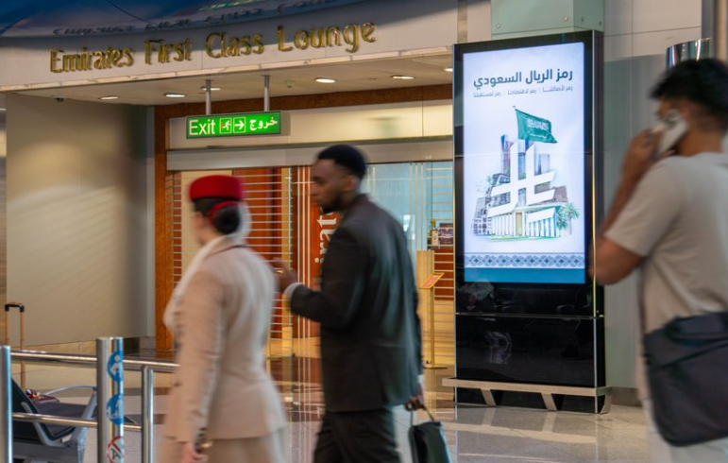
Recommended Sites at Dubai International Airport

Slide 46
Abu Dhabi International Airport, UAE

Slide 47
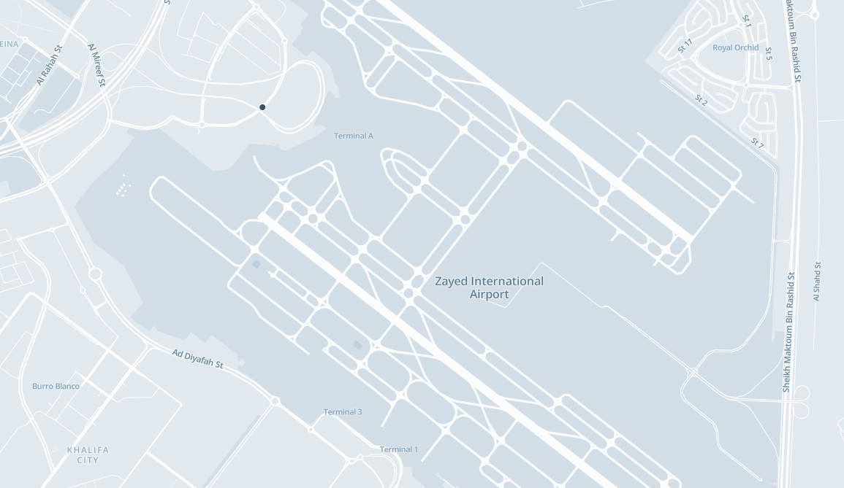
Abu Dhabi International Airport, Map view
No of screens 34

Slide 48
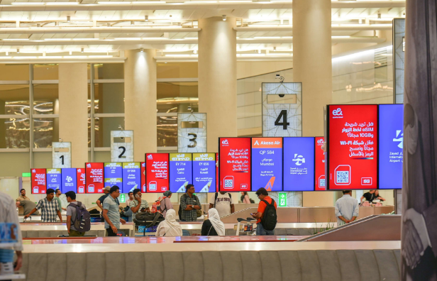
Recommended Sites at Los Angeles International Airport

Slide 49
United Arab Emirates
OOH

Slide 50
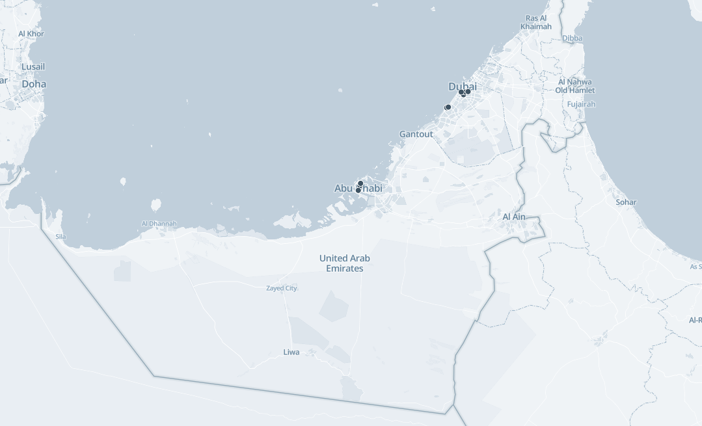
United Arab Emirates out of home recommendations, Map view
No of screens 13

Slide 51
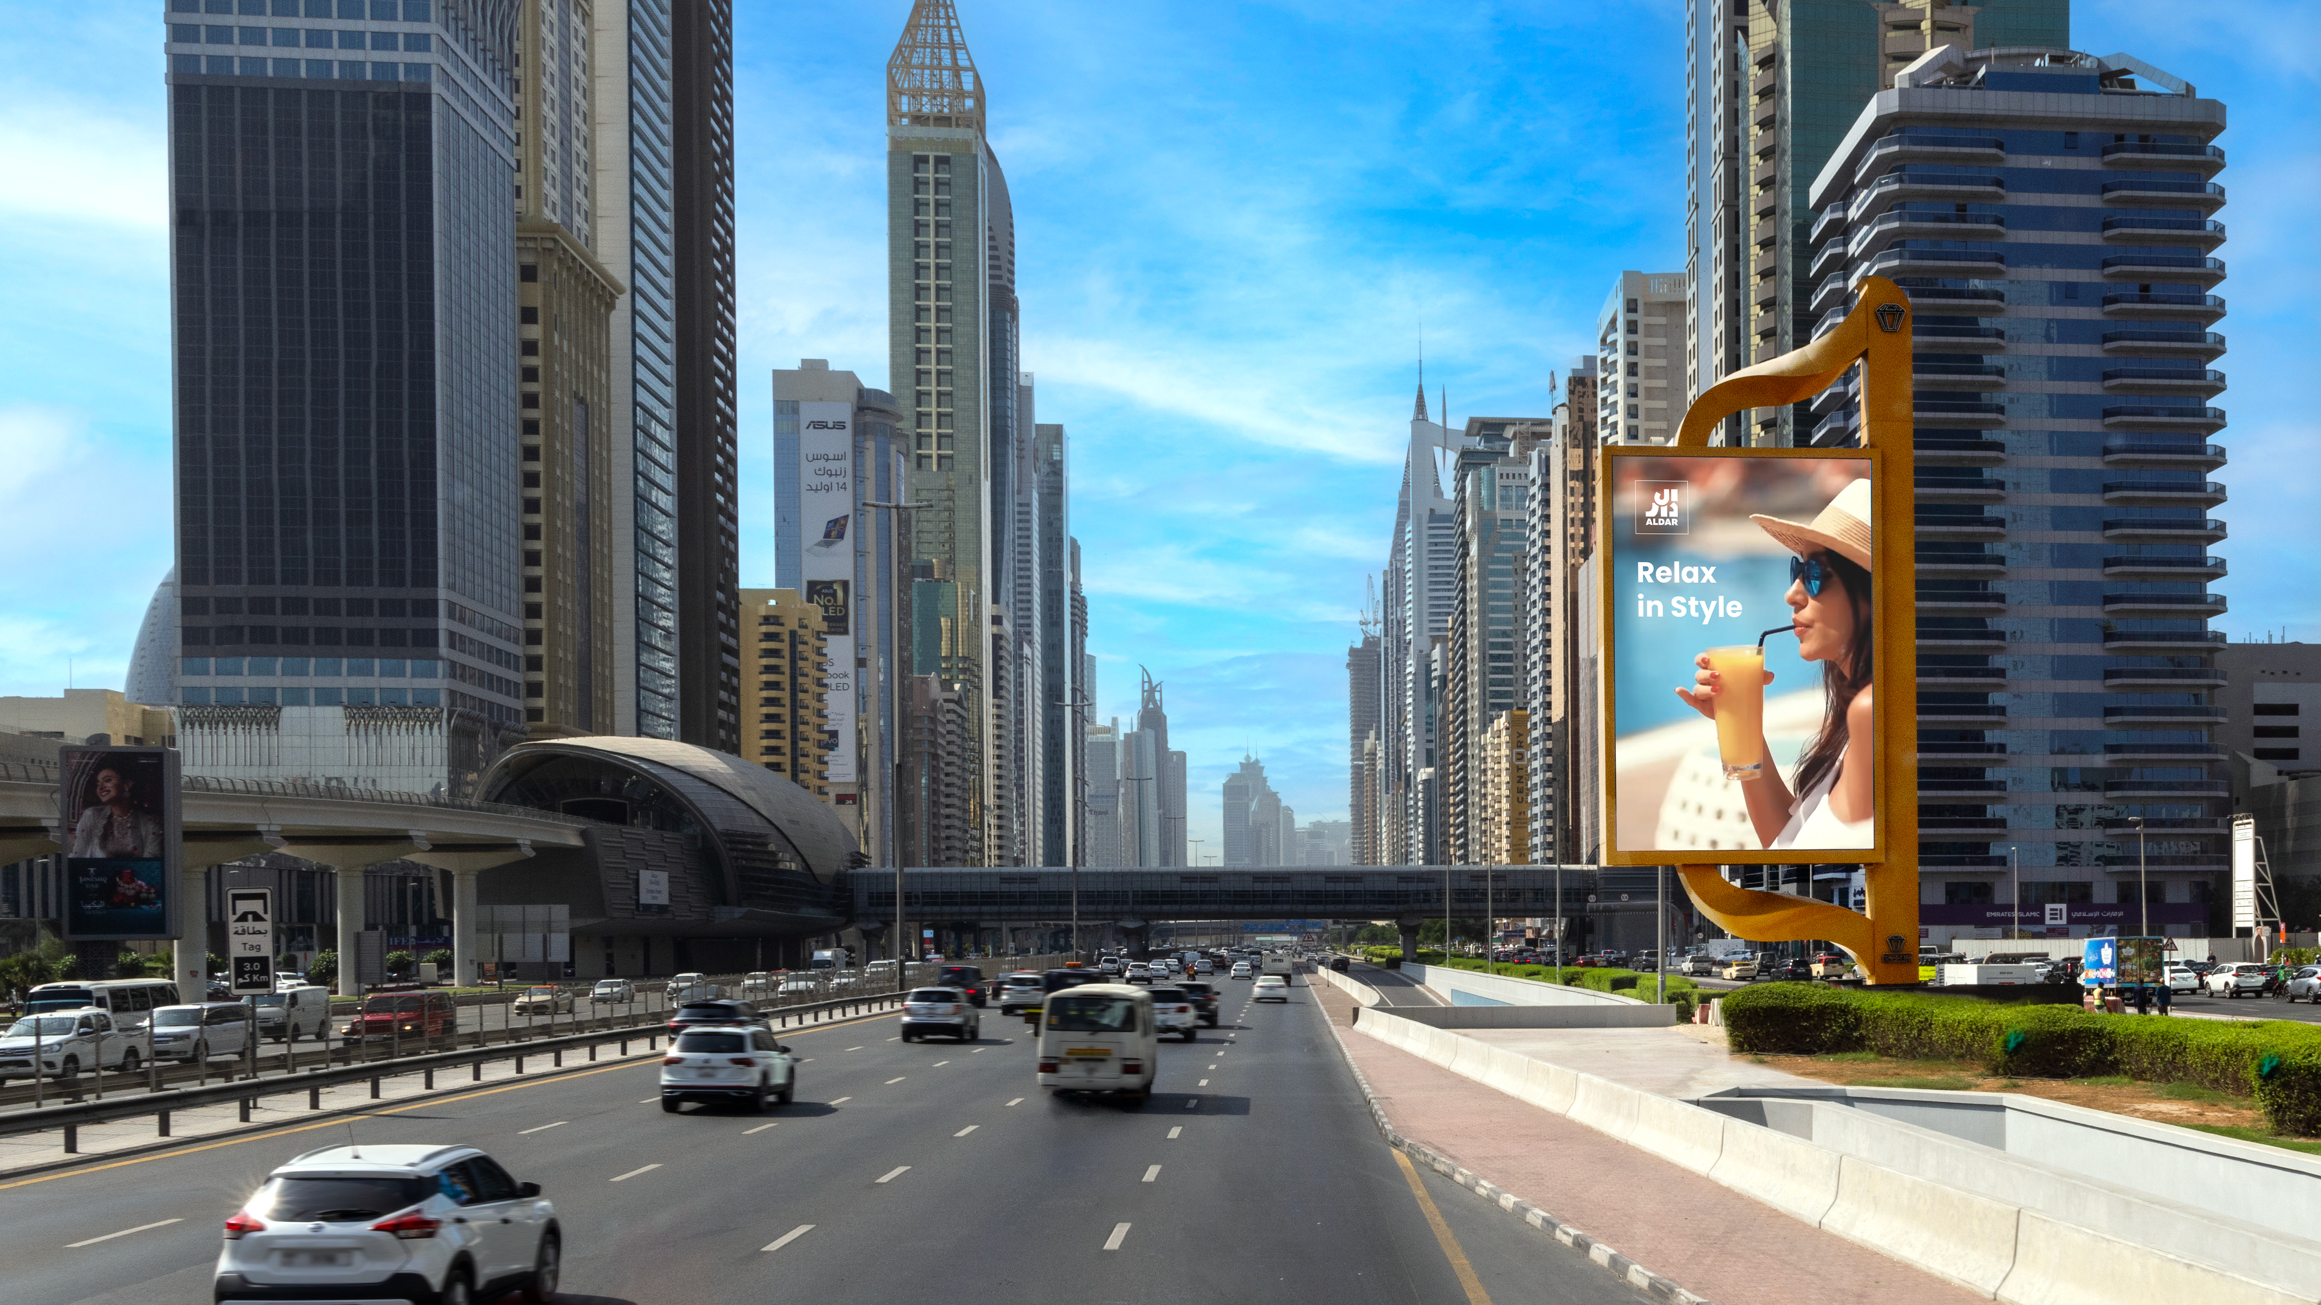
Recommended Sites at United Arab Emirates

Slide 52
Malaysia
OOH

Slide 53
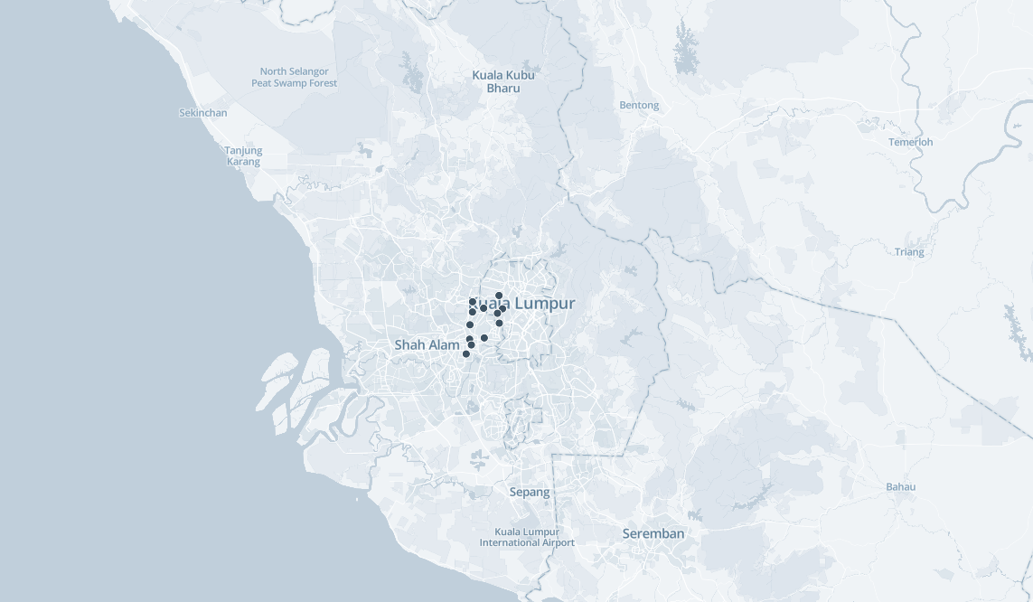
Malaysia out of home recommendations, Map view
No of screens 19

Slide 54
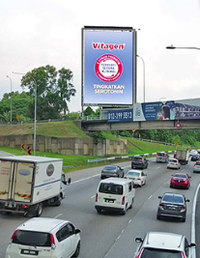
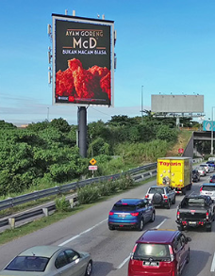
Recommended Sites at Malaysia

Slide 55


