Slide 1
Fashion Month Sept 2025 –
Global OOH Domination

Slide 2
London Fashion Week

Slide 3
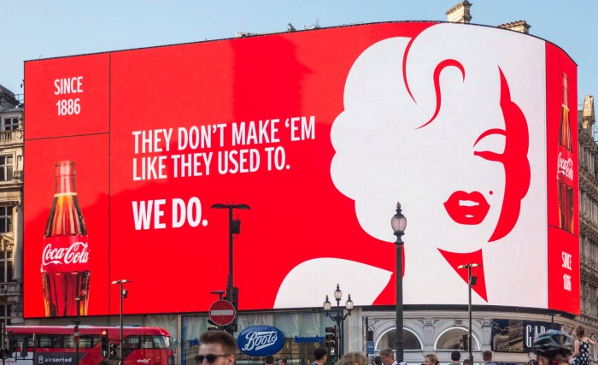
Piccadilly Circus, London, United Kingdom - London - Digital Screen Ad at Piccadilly Lights, London

Slide 4
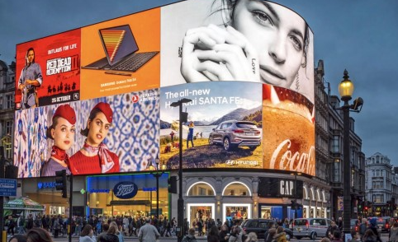

Slide 5
Piccadilly Circus, London, United Kingdom - London - Digital Screen Ad at Piccadilly Lights, London
Details
Number of Screens: 1

Slide 6
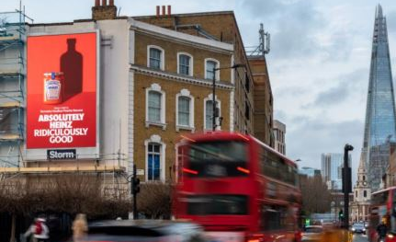
Borough High Street, London, United Kingdom - London - Wall Banner at Borough High Street, London

Slide 7
Borough High Street, London, United Kingdom - London - Wall Banner at Borough High Street, London
Details
Number of Screens: 1

Slide 8
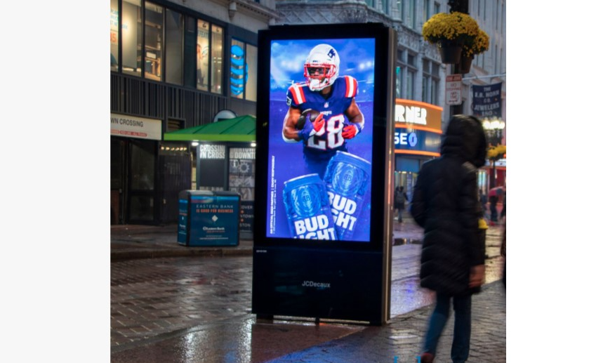
Oxford Street, London, United Kingdom - London - Digital Screen at Oxford Street, London

Slide 9
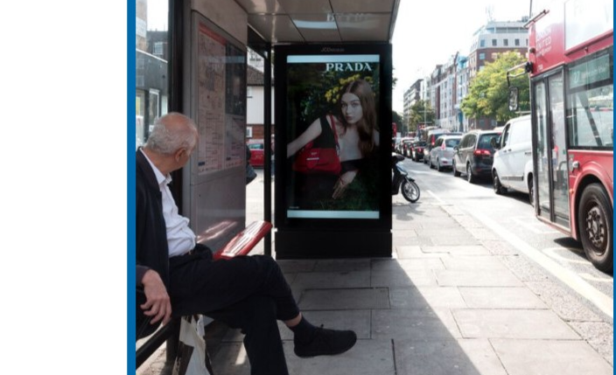

Slide 10
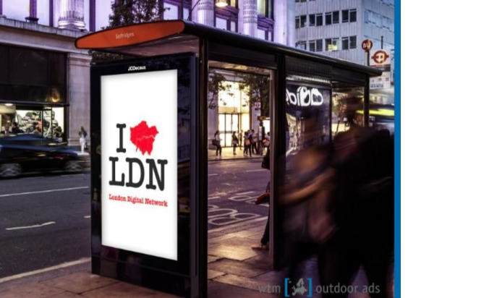

Slide 11
Oxford Street, London, United Kingdom - London - Digital Screen at Oxford Street, London
Details
Number of Screens: 44
Lighting type: Lit
Size: 72''
Duration of creative in seconds: 10

Slide 12
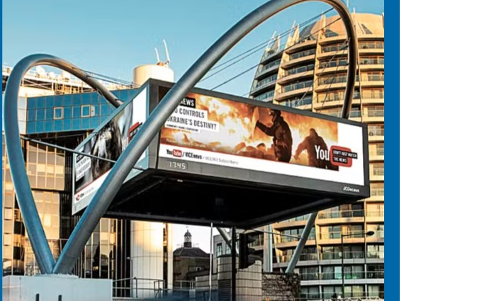
Old Street Roundabout - London, United Kingdom - London - Digital Screens on Old Street Roundabout

Slide 13
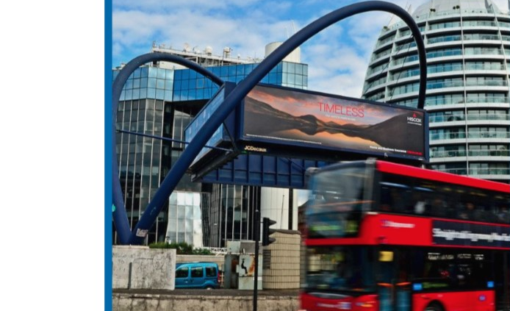

Slide 14
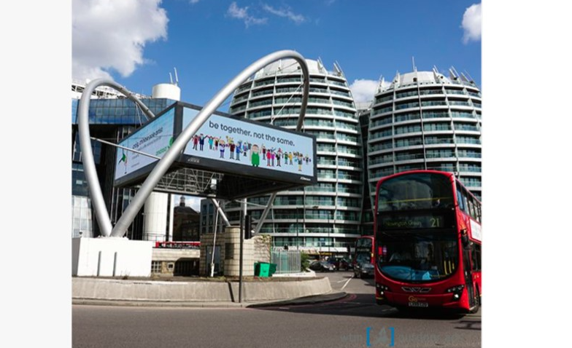

Slide 15
Old Street Roundabout - London, United Kingdom - London - Digital Screens on Old Street Roundabout
Details
Number of Screens: 4
Lighting type: Lit
Duration of creative in seconds: 10

Slide 16
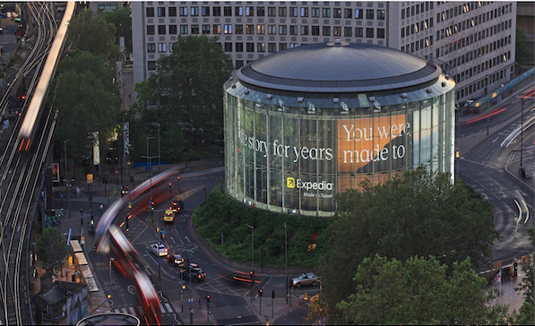
The Imax, Waterloo London, Static Banner Ad at I Max, Waterloo London

Slide 17
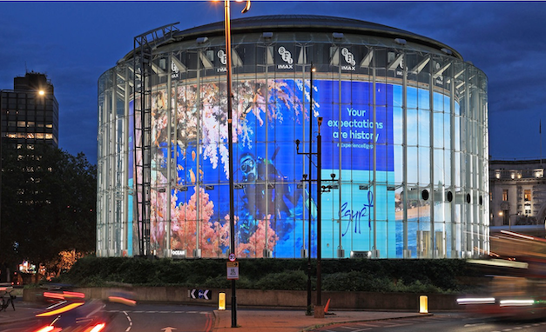

Slide 18
The Imax, Waterloo London, Static Banner Ad at I Max, Waterloo London
Rates and details
Number of Screens: 1

Slide 19
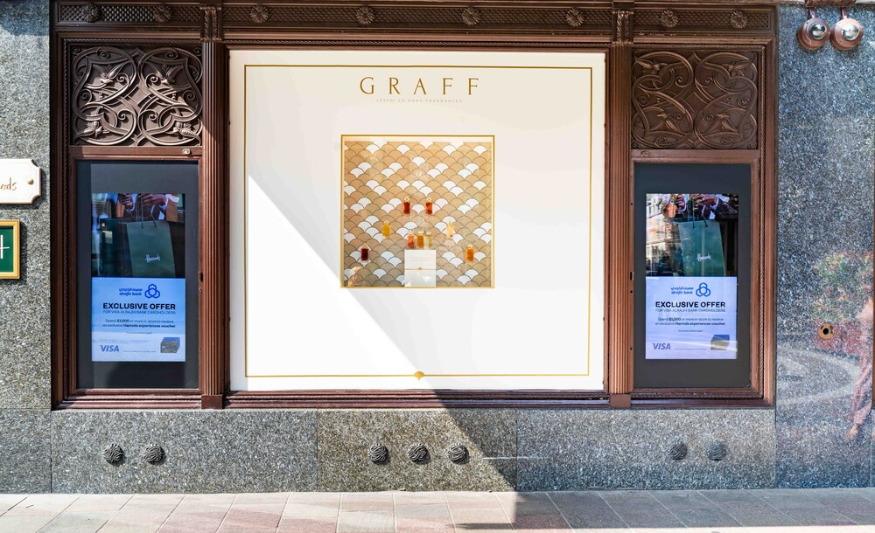
Harrods, London, United Kingdom - London - External Screens Hans Crescent Screens

Slide 20
Harrods, London, United Kingdom - London - External Screens Hans Crescent Screens
Details
Number of Screens: 1

Slide 21
Milan Fashion Week

Slide 22
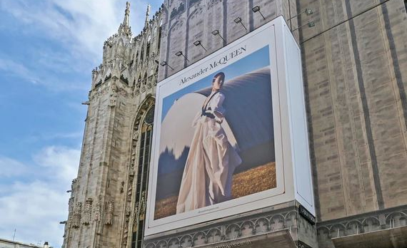
Piazza Duomo Milan, Italy - Milan - Billboard at Piazza Duomo

Slide 23
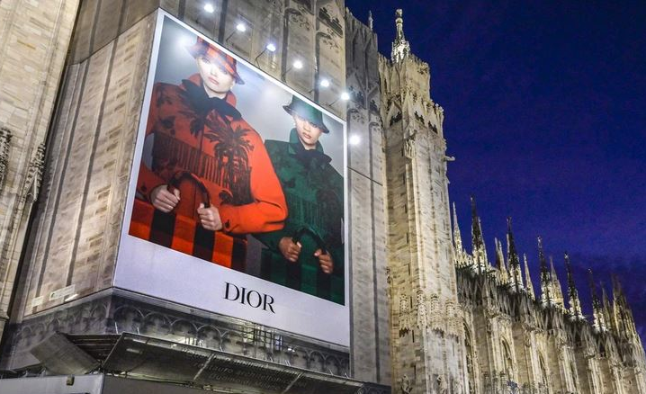

Slide 24
Piazza Duomo Milan, Italy - Milan - Billboard at Piazza Duomo
Details
Number of Screens: TBC

Slide 25
Paris Fashion Week

Slide 26
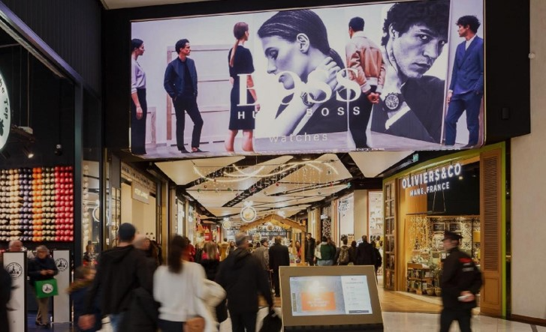
Westfield Forum des Halles - Paris - Digital Screens Ad

Slide 27
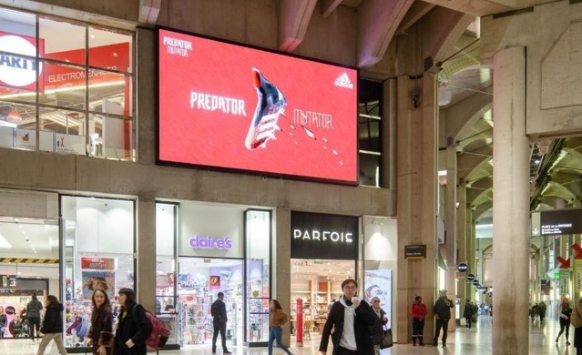

Slide 28
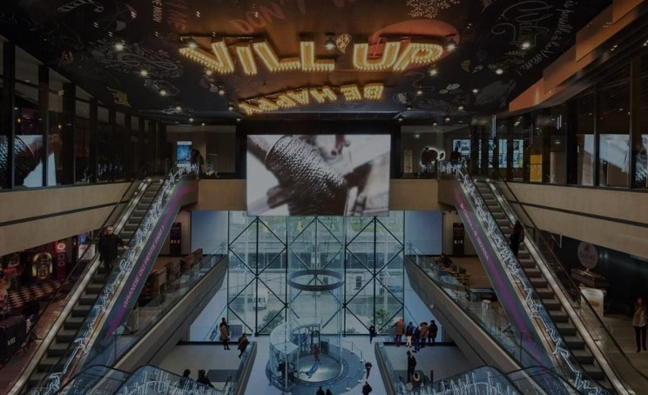

Slide 29
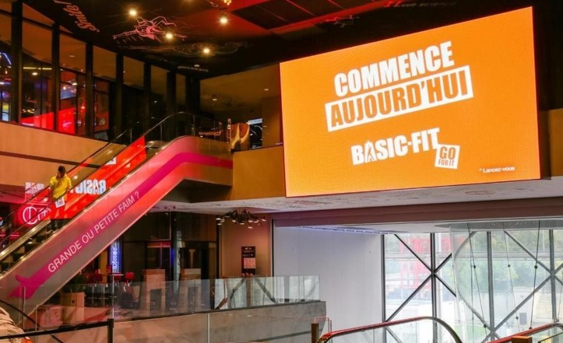

Slide 30
Westfield Forum des Halles - Paris - Digital Screens Ad
Details
Number of Screens: 6

Slide 31
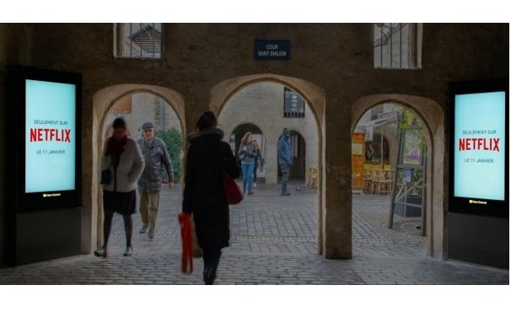
Westfield Forum des Halles - Paris - Digital Carrousel Screen Ad

Slide 32
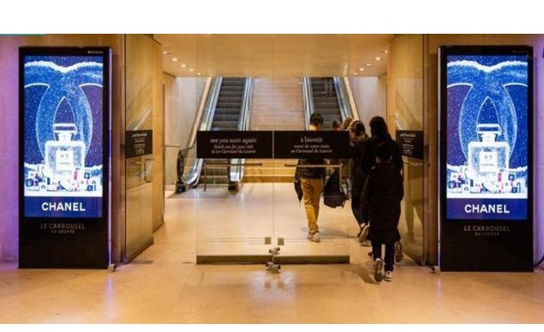

Slide 33
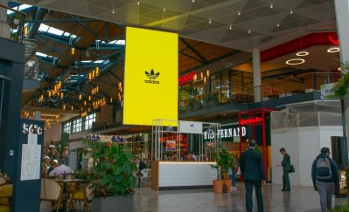

Slide 34
Westfield Forum des Halles - Paris - Digital Carrousel Screen Ad
Details
Number of Screens: 7

Slide 35
New York Fashion Week

Slide 36
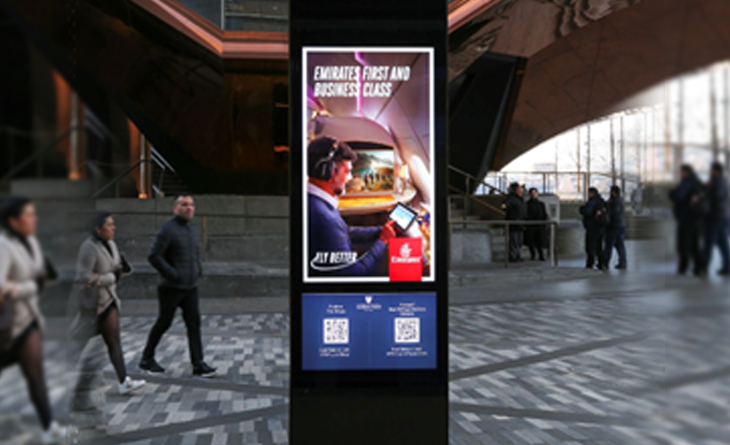
Hudson Yards, New York, United States of America - New York - Digital Networks at Hudson Yards

Slide 37
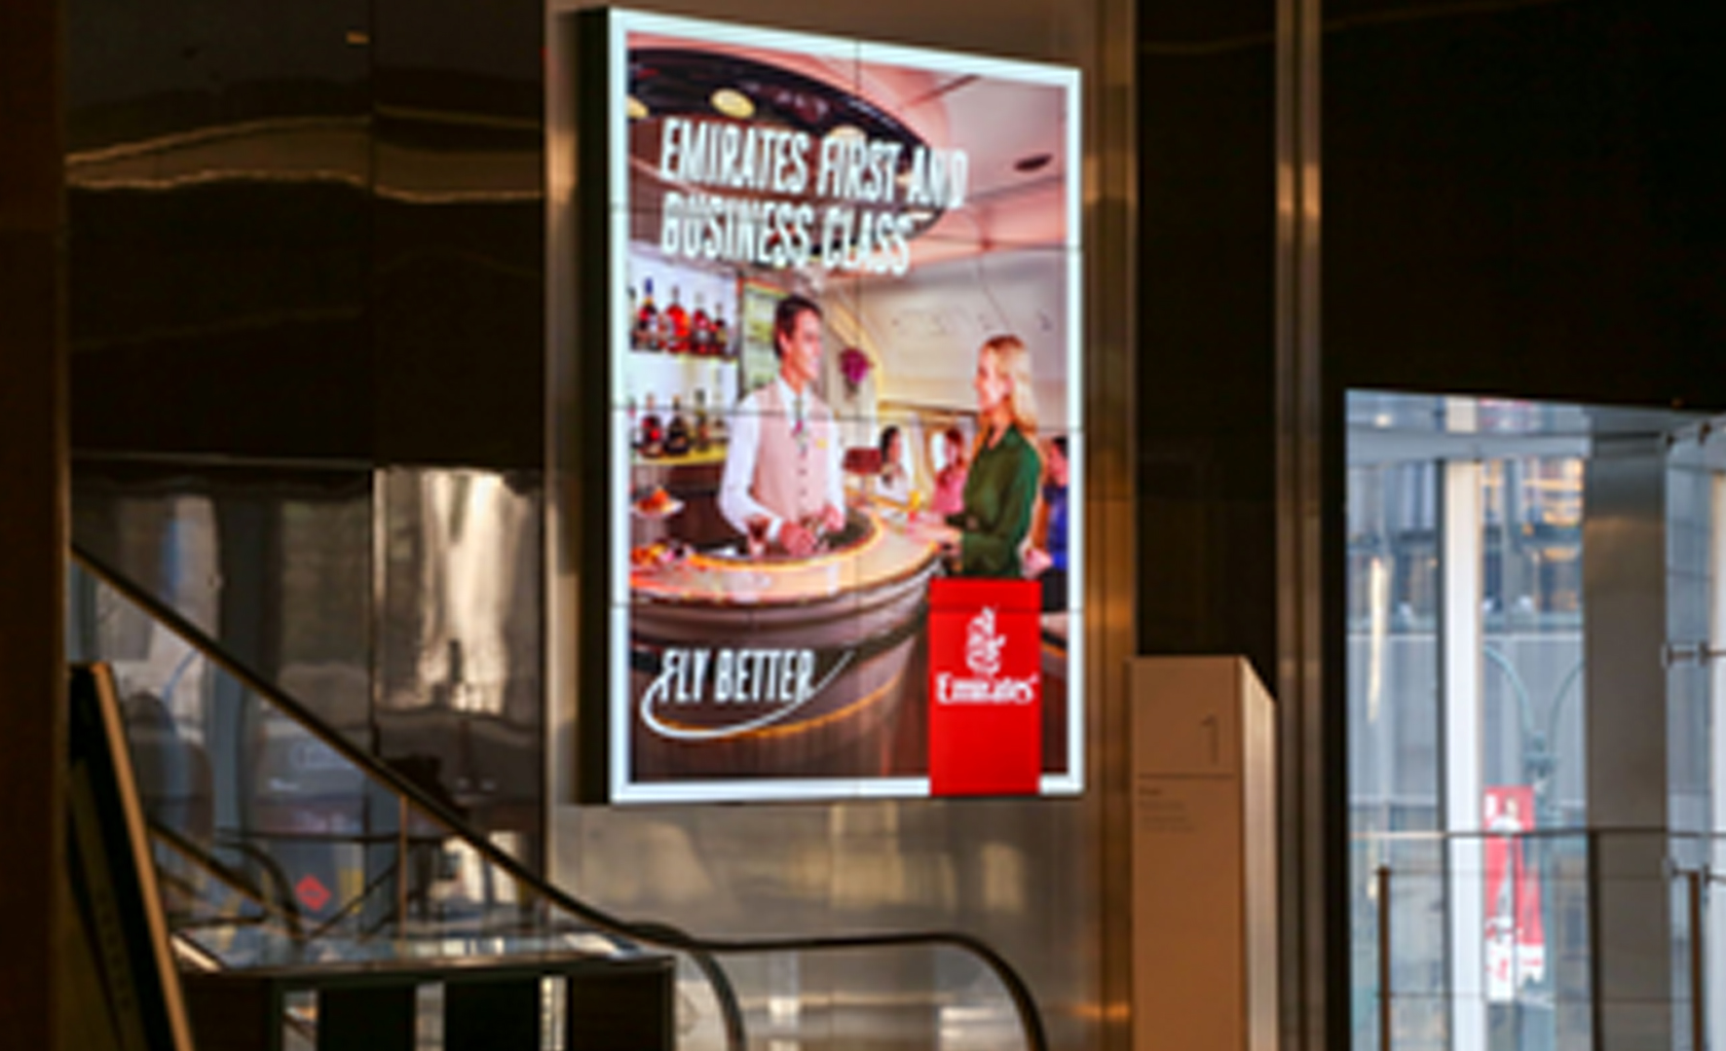

Slide 38
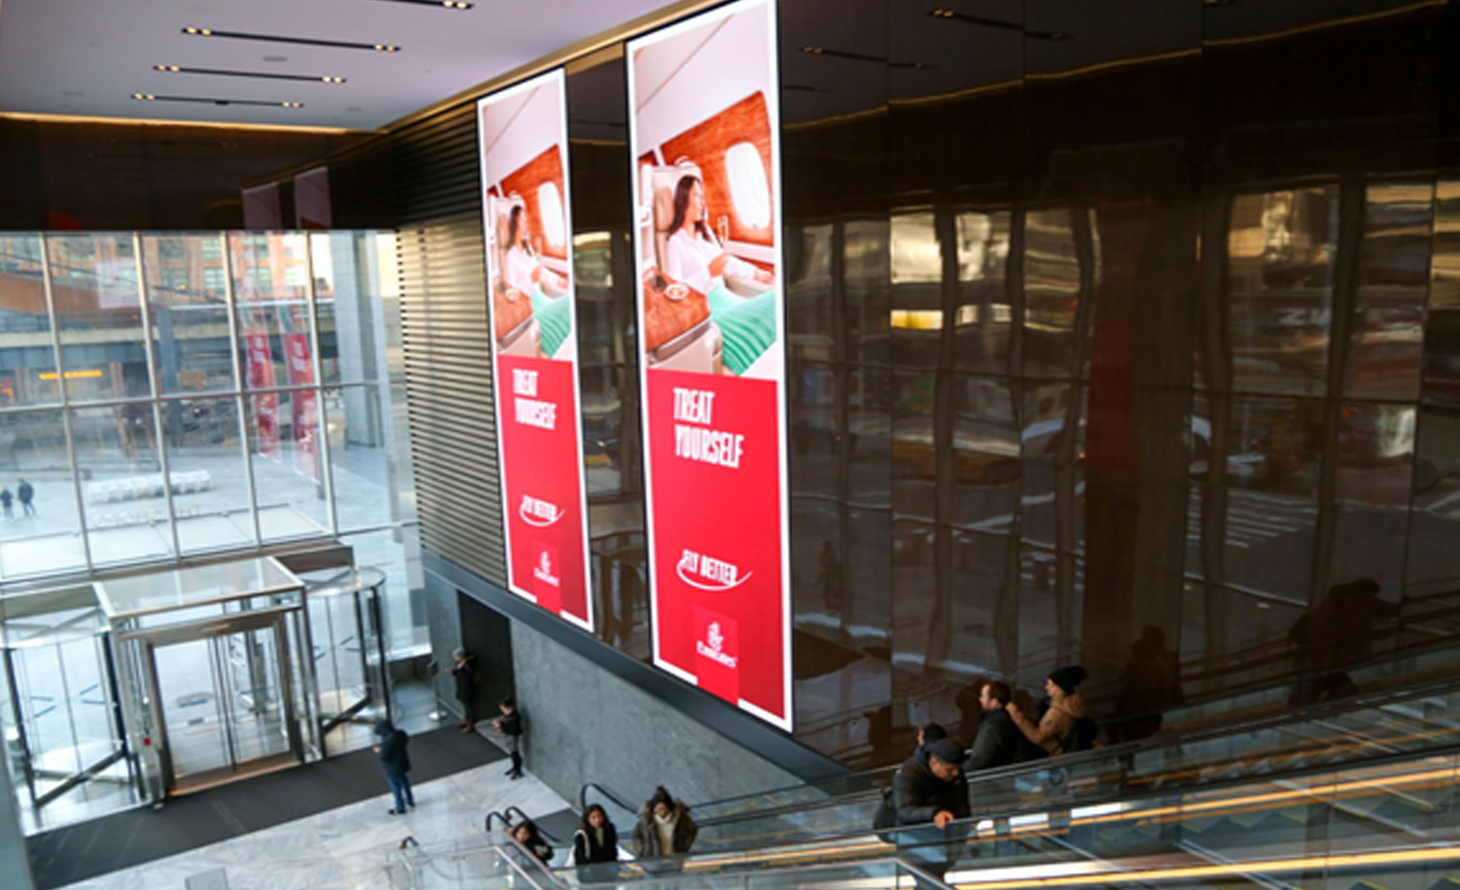

Slide 39
Hudson Yards, New York, United States of America - New York - Digital Networks at Hudson Yards
Details
Number of Screens: 58
Lighting type: Lit
Size: Various
Duration of creative in seconds: 15

Slide 40
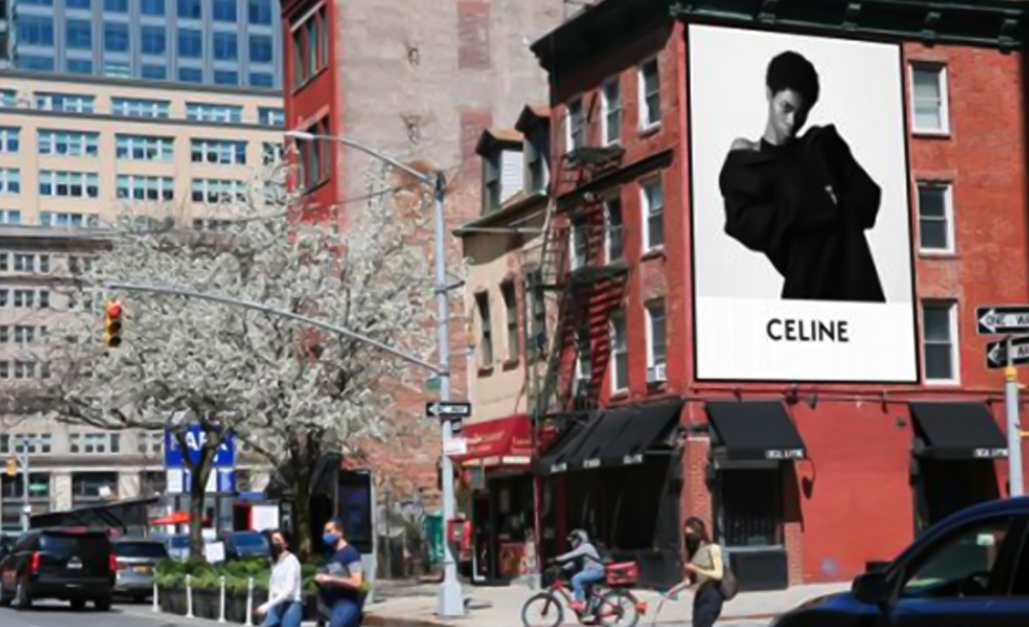
Hudson St & Dominick St, New York, United States of America - New York - Wall Banner at Hudson St & Dominick St

Slide 41
Hudson St & Dominick St, New York, United States of America - New York - Wall Banner at Hudson St & Dominick St
Details
Number of Screens: 1
Lighting type: Non-Lit
Size: 23' 6"H x 17'W

Slide 42
Thank You

