Slide 1
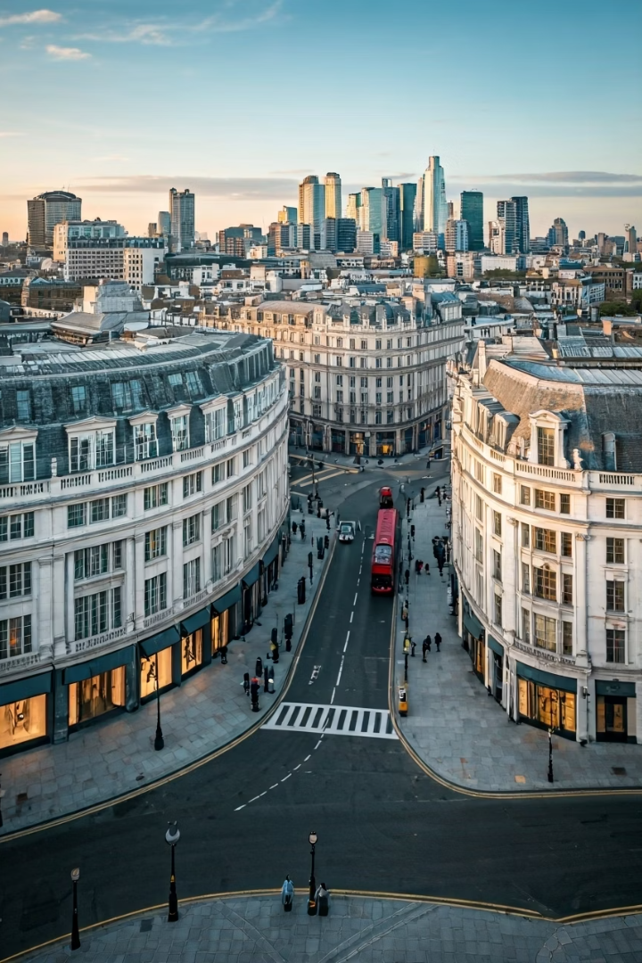
GCC HNI Travelers: Luxury OOH Advertising in London
GCC high-net-worth individuals seek premium experiences and luxury goods when visiting London. They spend three times the global average per trip and stay longer than typical tourists.

Slide 2
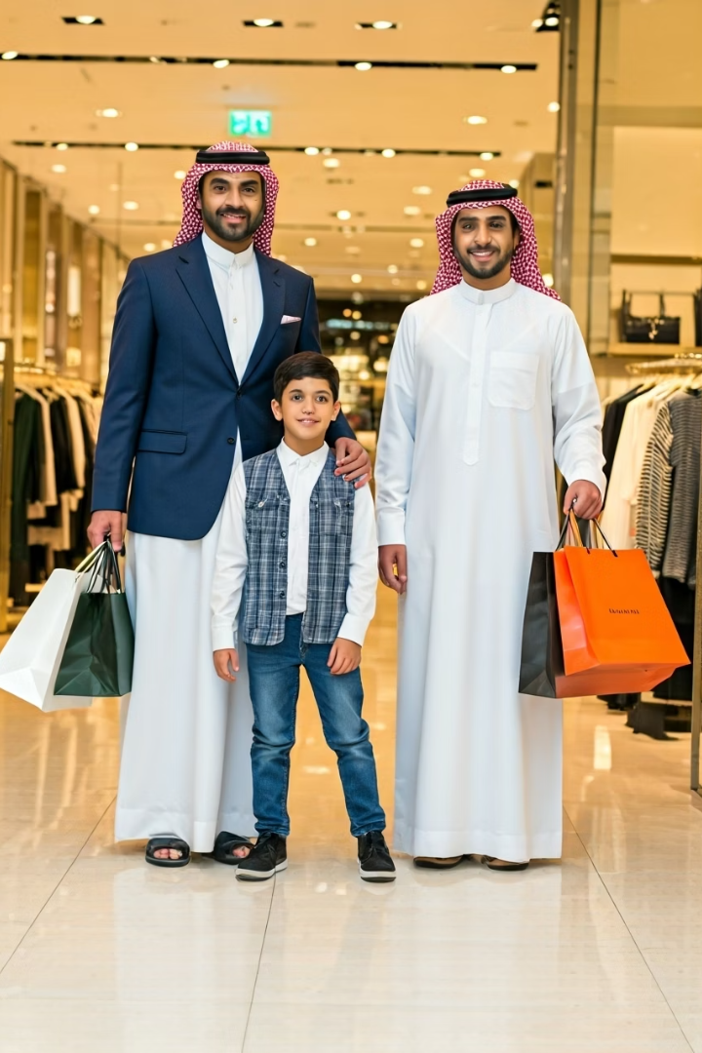
Understanding the GCC HNI Traveler
£2,578
16
76%
Average Spend
Nights
Mobile Usage
Triple the global average of £860 per trip
Extended stays compared to global average of 7
High engagement with products seen in OOH ads

Slide 3
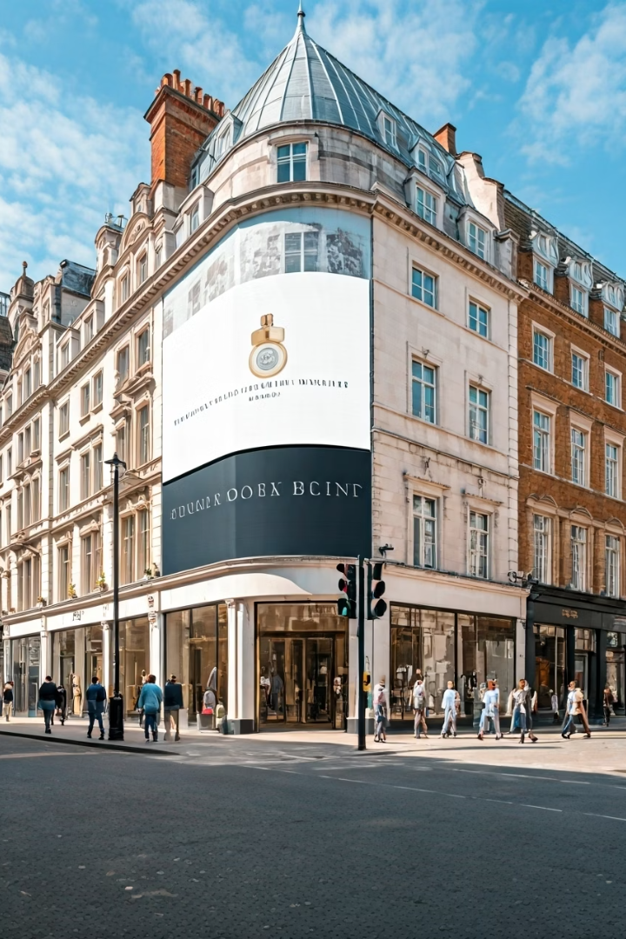
Prime OOH Locations in London
Knightsbridge
Bond Street
Highest concentration of high-revenue visitors in Europe. 43% classified as high-income demographics. Premium rates but unparalleled access to target audience.
Over 200,000 daily summer visitors. 38% of GCC luxury transactions occur here. Offers scalable investment options with standard and premium digital screens.
Heathrow (T3 & T5)
Handles majority of Emirates and Etihad premium arrivals. Premium digital screens provide immediate brand exposure to fresh arrivals.

Slide 4
Optimal Campaign Timing
Late June
Post-Eid Al Adha
Launch campaigns 2-4 weeks in advance to capture pre-arrival awareness.
40% increase in travel volume as schools close for summer holidays.
July 11-19
Prime time with busiest travel days for UAE residents to London.

Slide 5
Knightsbridge: Premium Audience Hub
43% High-Income
70% Activity
Highest concentration of wealthy visitors in Europe.
GCC travelers concentrate shopping and dining here.
Premium Rates
Harrods Proximity
Higher costs justified by exceptional demographic access.
Near luxury stores and high-end residential properties.

Slide 6
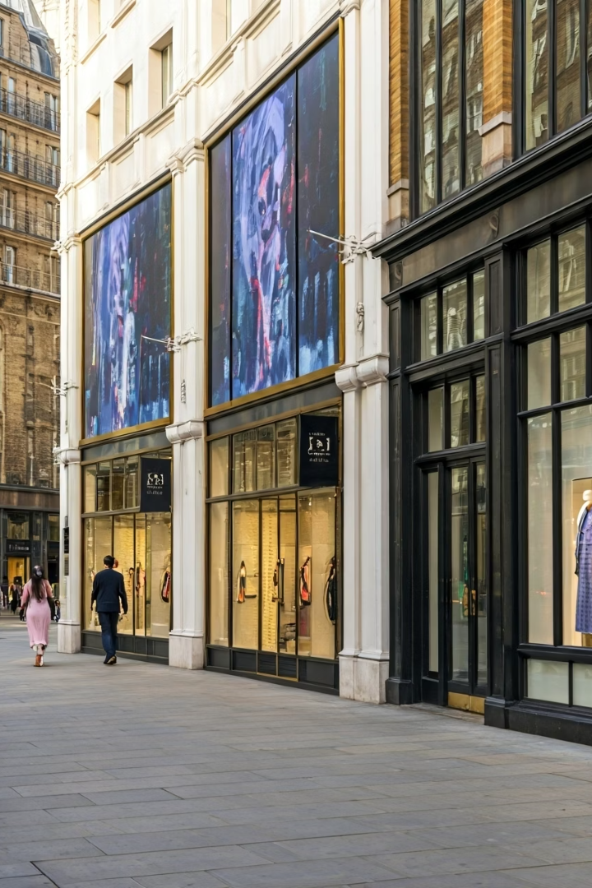
Bond Street: Massive Reach & Performance
200,000+ Daily Visitors
38% GCC Transactions
Premium Retailers
High foot traffic during summer months ensures maximum exposure.
Significant portion of luxury purchases occur at Bond Street retailers.
Home to Chanel, Louis Vuitton, and Tiffany & Co.

Slide 7
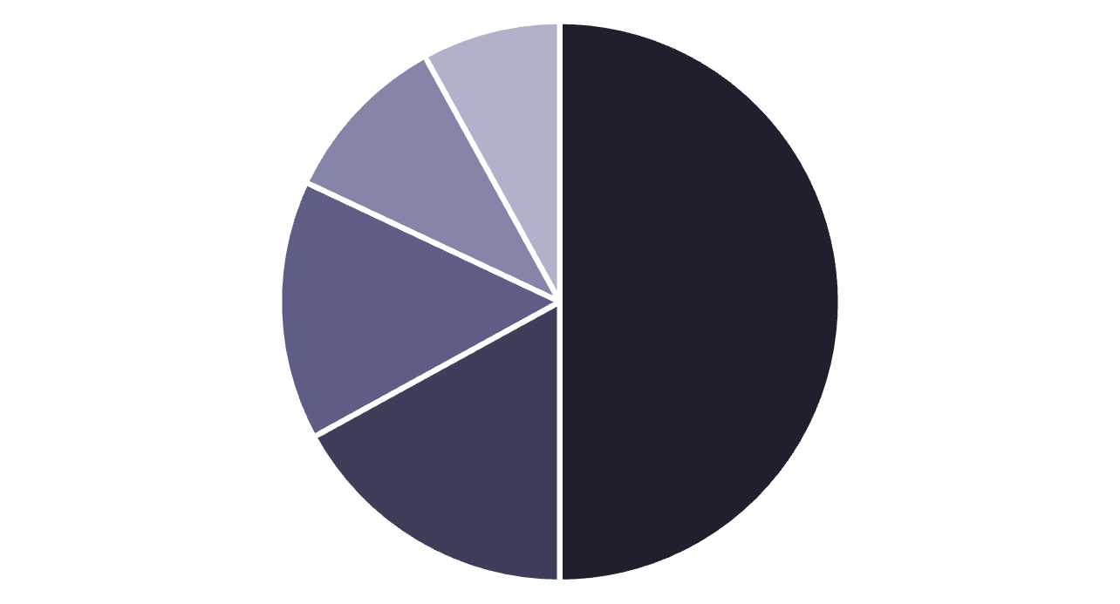
Exceptional Spending Power
Fashion
Leather Goods
Jewelry
Dining
Other
GCC travelers spend £2,578 per trip on average, three times the global average. This spending power justifies premium OOH placement costs.

Slide 8
Extended Stay Advantage
Frequency Building
Extended Exposure
Repeated exposure significantly improves brand recall and engagement.
Longer Visits
Enables 4-6 week campaign durations for maximum impact.
16-night average stay vs. global 7-night average.

Slide 9
Digital OOH Effectiveness
90% Engagement
Luxury brands see exceptional consumer engagement with OOH
76% Mobile Exploration
Viewers use devices to explore products seen in OOH ads
Real-time Optimization
Programmatic capabilities enable weather triggers and audience targeting

Slide 10
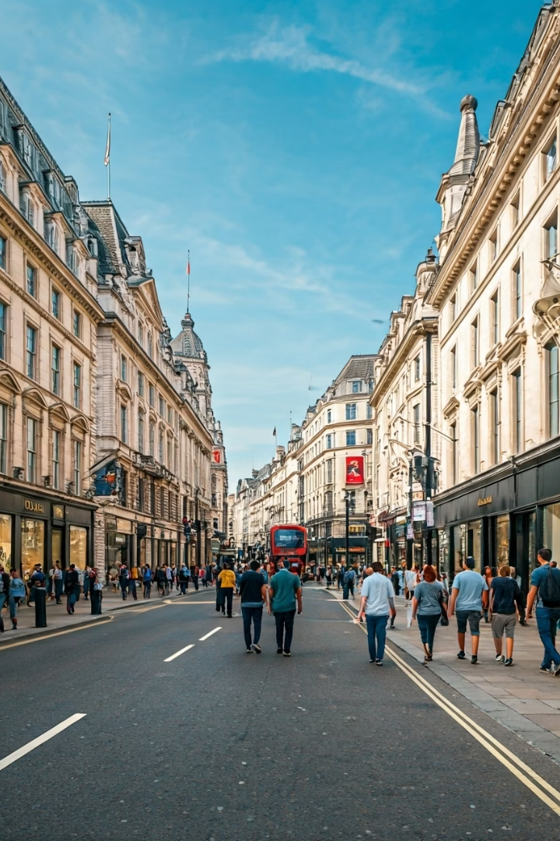
West End Growth Momentum
£10 Billion
Projected annual turnover by 2025.
109% Growth
Sales increase compared to 2021 levels.
500,000+ Daily
Visitors processed on Oxford Street alone.
13% More Visitors
Expected from Elizabeth Line expansion by 2025.

