Slide 1
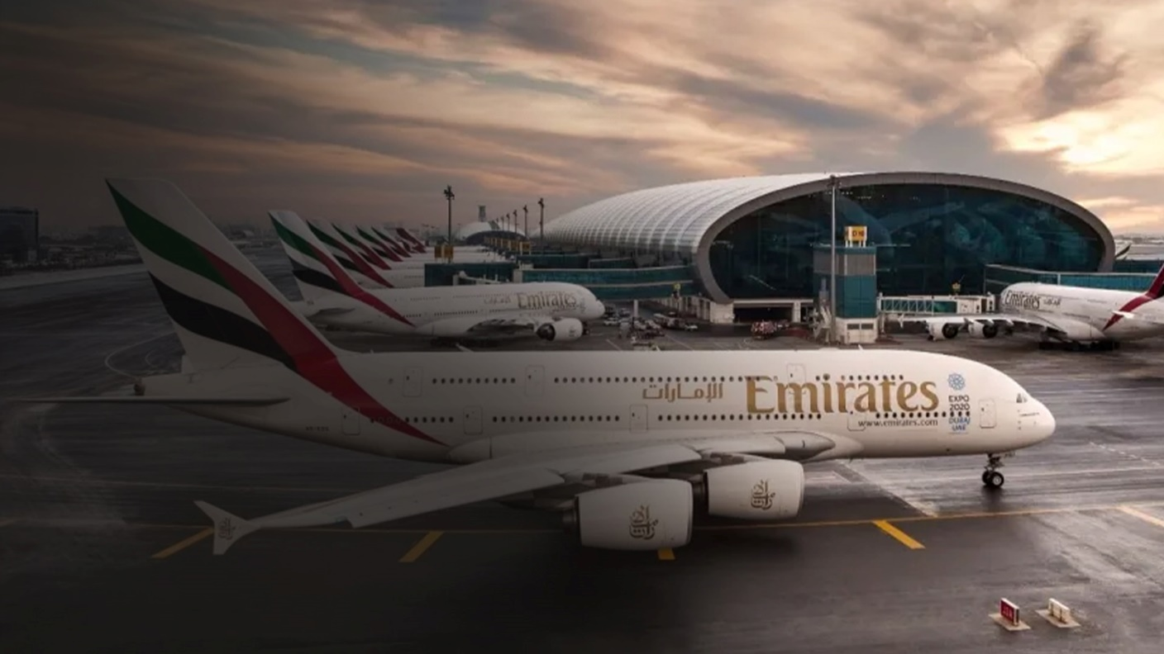
Dubai
International Airport Programmatic Digital Out of home
Recommendations

Slide 2


Why
Programmatic DOOH in Dubai Intl Airport for Premium Ice-Cream Brands: Capturing the Palate of High-Income Consumers
Benefits
of programmatic DOOH
Programmatic Advertising: Tailor your digital out-of-home (DOOH) campaigns with precision, targeting high-traffic areas near convention centres in real-time
Culturally Smart and Data-Driven: Seamlessly integrate diverse datasets to deliver content that resonates with the High-Income Consumers at the right moment.
Dynamic Campaign Activation: Data feeds initiate context-aware displays based on busy times, community events, and cultural celebrations, enhancing relevance and engagement.
Flexibility, Speed, and Modularity
Quick Campaign Setup
Dynamic Campaign Management
Unlike traditional methods, it enables real-time adaptation to external conditions and personalized ad delivery.
Benefits include increased efficiency, precise audience targeting, and improved ROI.

Slide 3




Advantages
Dynamic Audience Targeting
Trigger Targeting
P-DOOH analyzes location data, creating audiences from consumer movements for targeted ads.
Optimize messaging for weather's impact on consumer behavior in real-time.
Live Data-Led Dynamic Creative
Live Data Feeds
Customize creative in real-time based on all types of local data
Weather, traffic, flight data.
Local data sets for targeting e.g. demographic postcode data

Slide 4
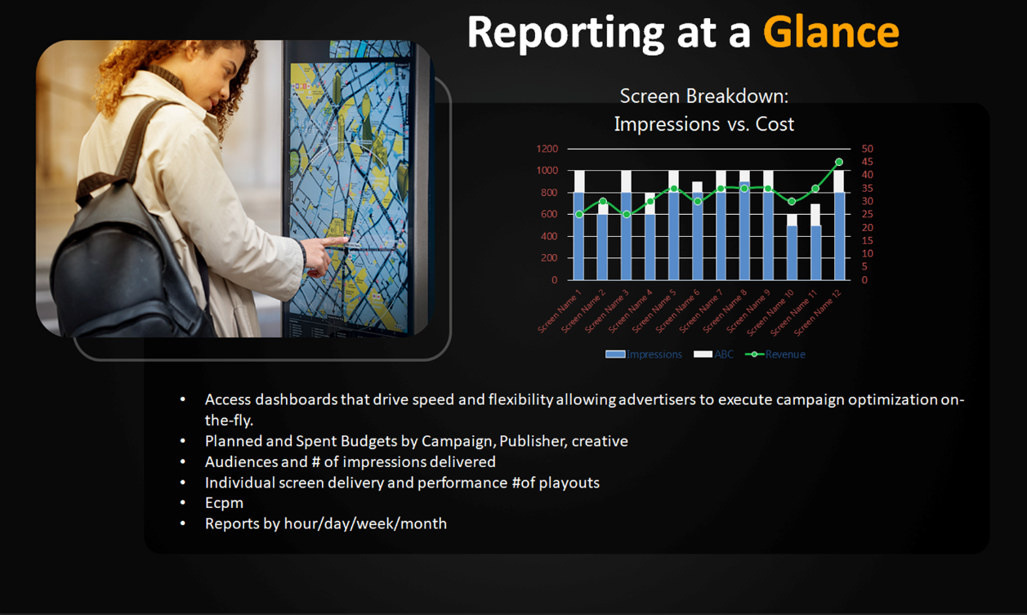

Slide 5
Total Budget
5000 USD
Dubai international Airport
Total No of Screens
150
Audience Per Week
144 Million

Slide 6

Dubai
international Airport

Slide 7

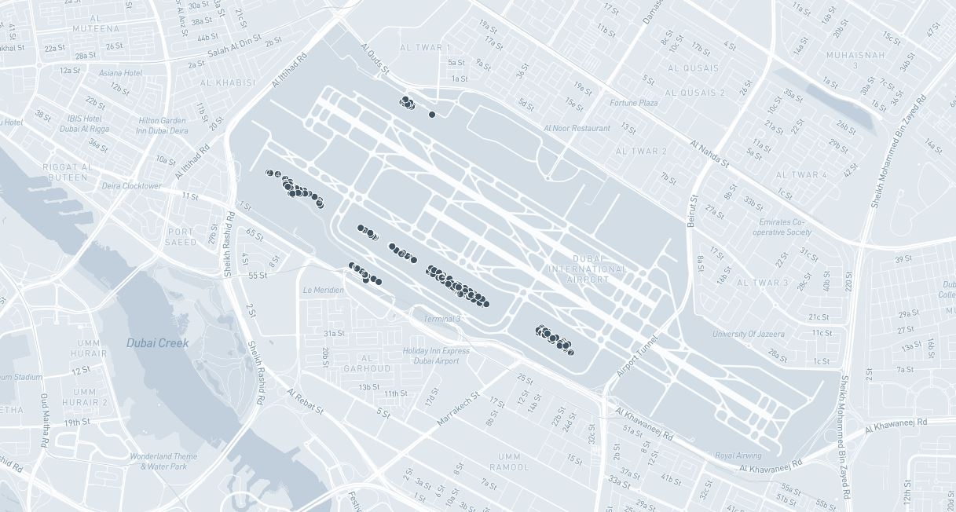
P – DOOH – Dubai International Airport, Recommended Sites Map View
No of screen :385

Slide 8
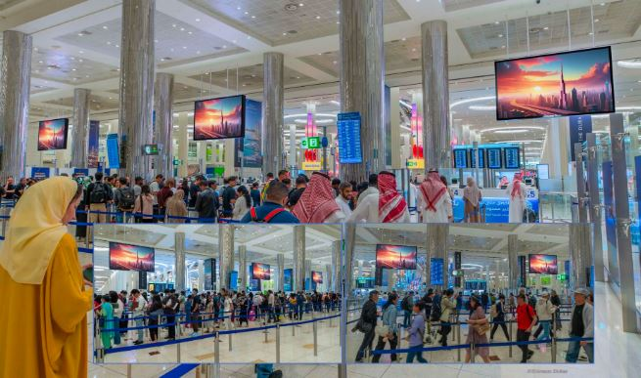
P – DOOH – Dubai International Airport, Recommended Sites

Slide 9
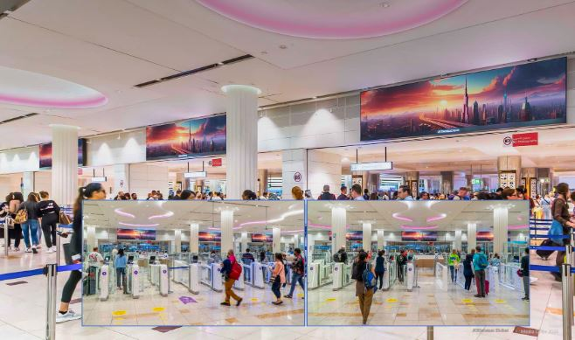
P – DOOH – Dubai International Airport, Recommended Sites

Slide 10
P – DOOH – Dubai International Airport, Recommended Sites

Slide 11
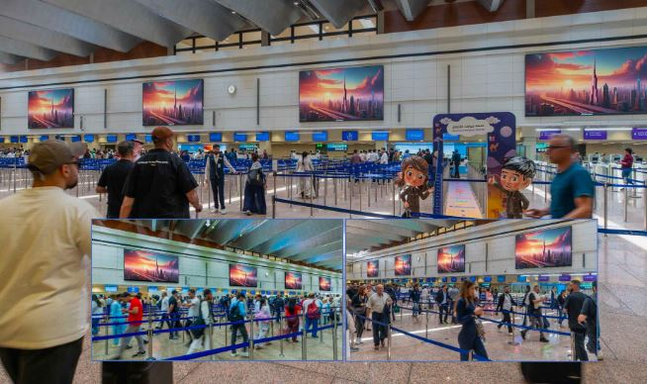
P – DOOH – Dubai International Airport, Recommended Sites

Slide 12
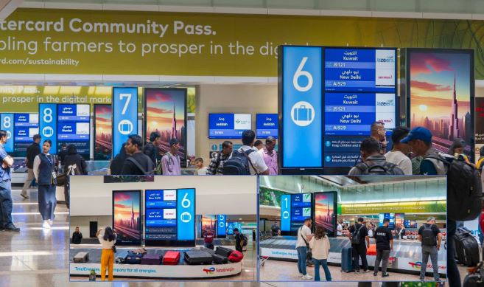
P – DOOH – Dubai International Airport, Recommended Sites

Slide 13


