Slide 1
Recommended Airports Prime OOH

Slide 2
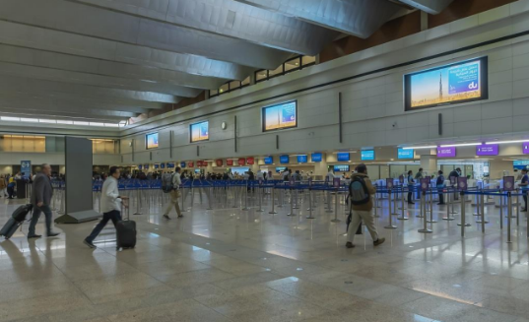
Dubai International Airport, United Arab Emirates - Dubai - Digital Screens at Arrival Passport Control, Dubai International Airport, United Arab Emirates

Slide 3
Dubai International Airport, United Arab Emirates - Dubai - Digital Screens at Arrival Passport Control, Dubai International Airport, United Arab Emirates
Rates and details
Start Date: 2025-05-04
Number of Screens: 4
Lighting type: Back-Lit
Size: 4m (W) X 2m (H)
Single Rotation Time in Seconds:
Duration of creative in seconds:
Number of production: 1
One time production cost: USD 2722.54
Rental Cost/Month: USD 58534.59
Discounted rate/Month (Rental): USD 52681.13
Total number of months required: 1
Sub Total (Rental+ One Time Production): USD 55403.67

Slide 4
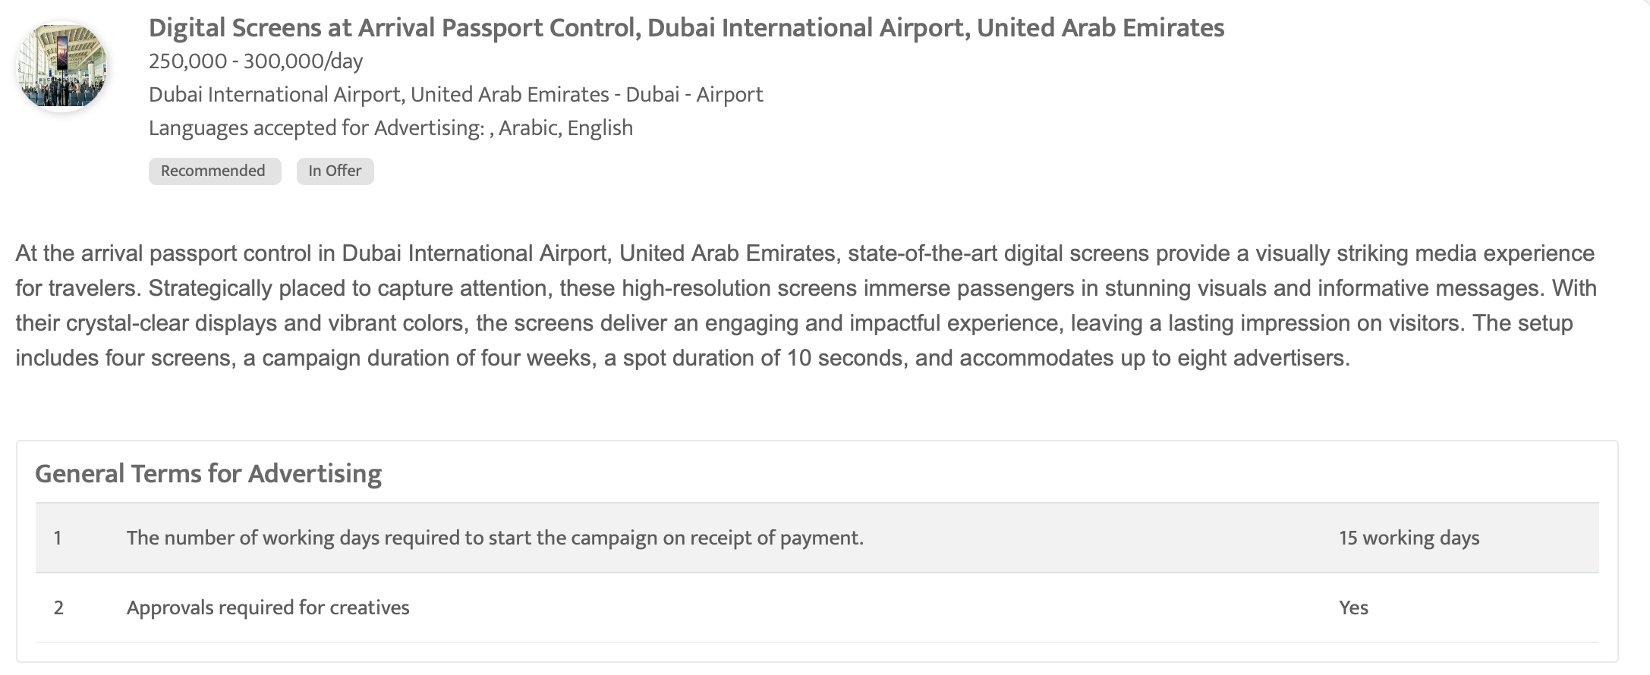

Slide 5
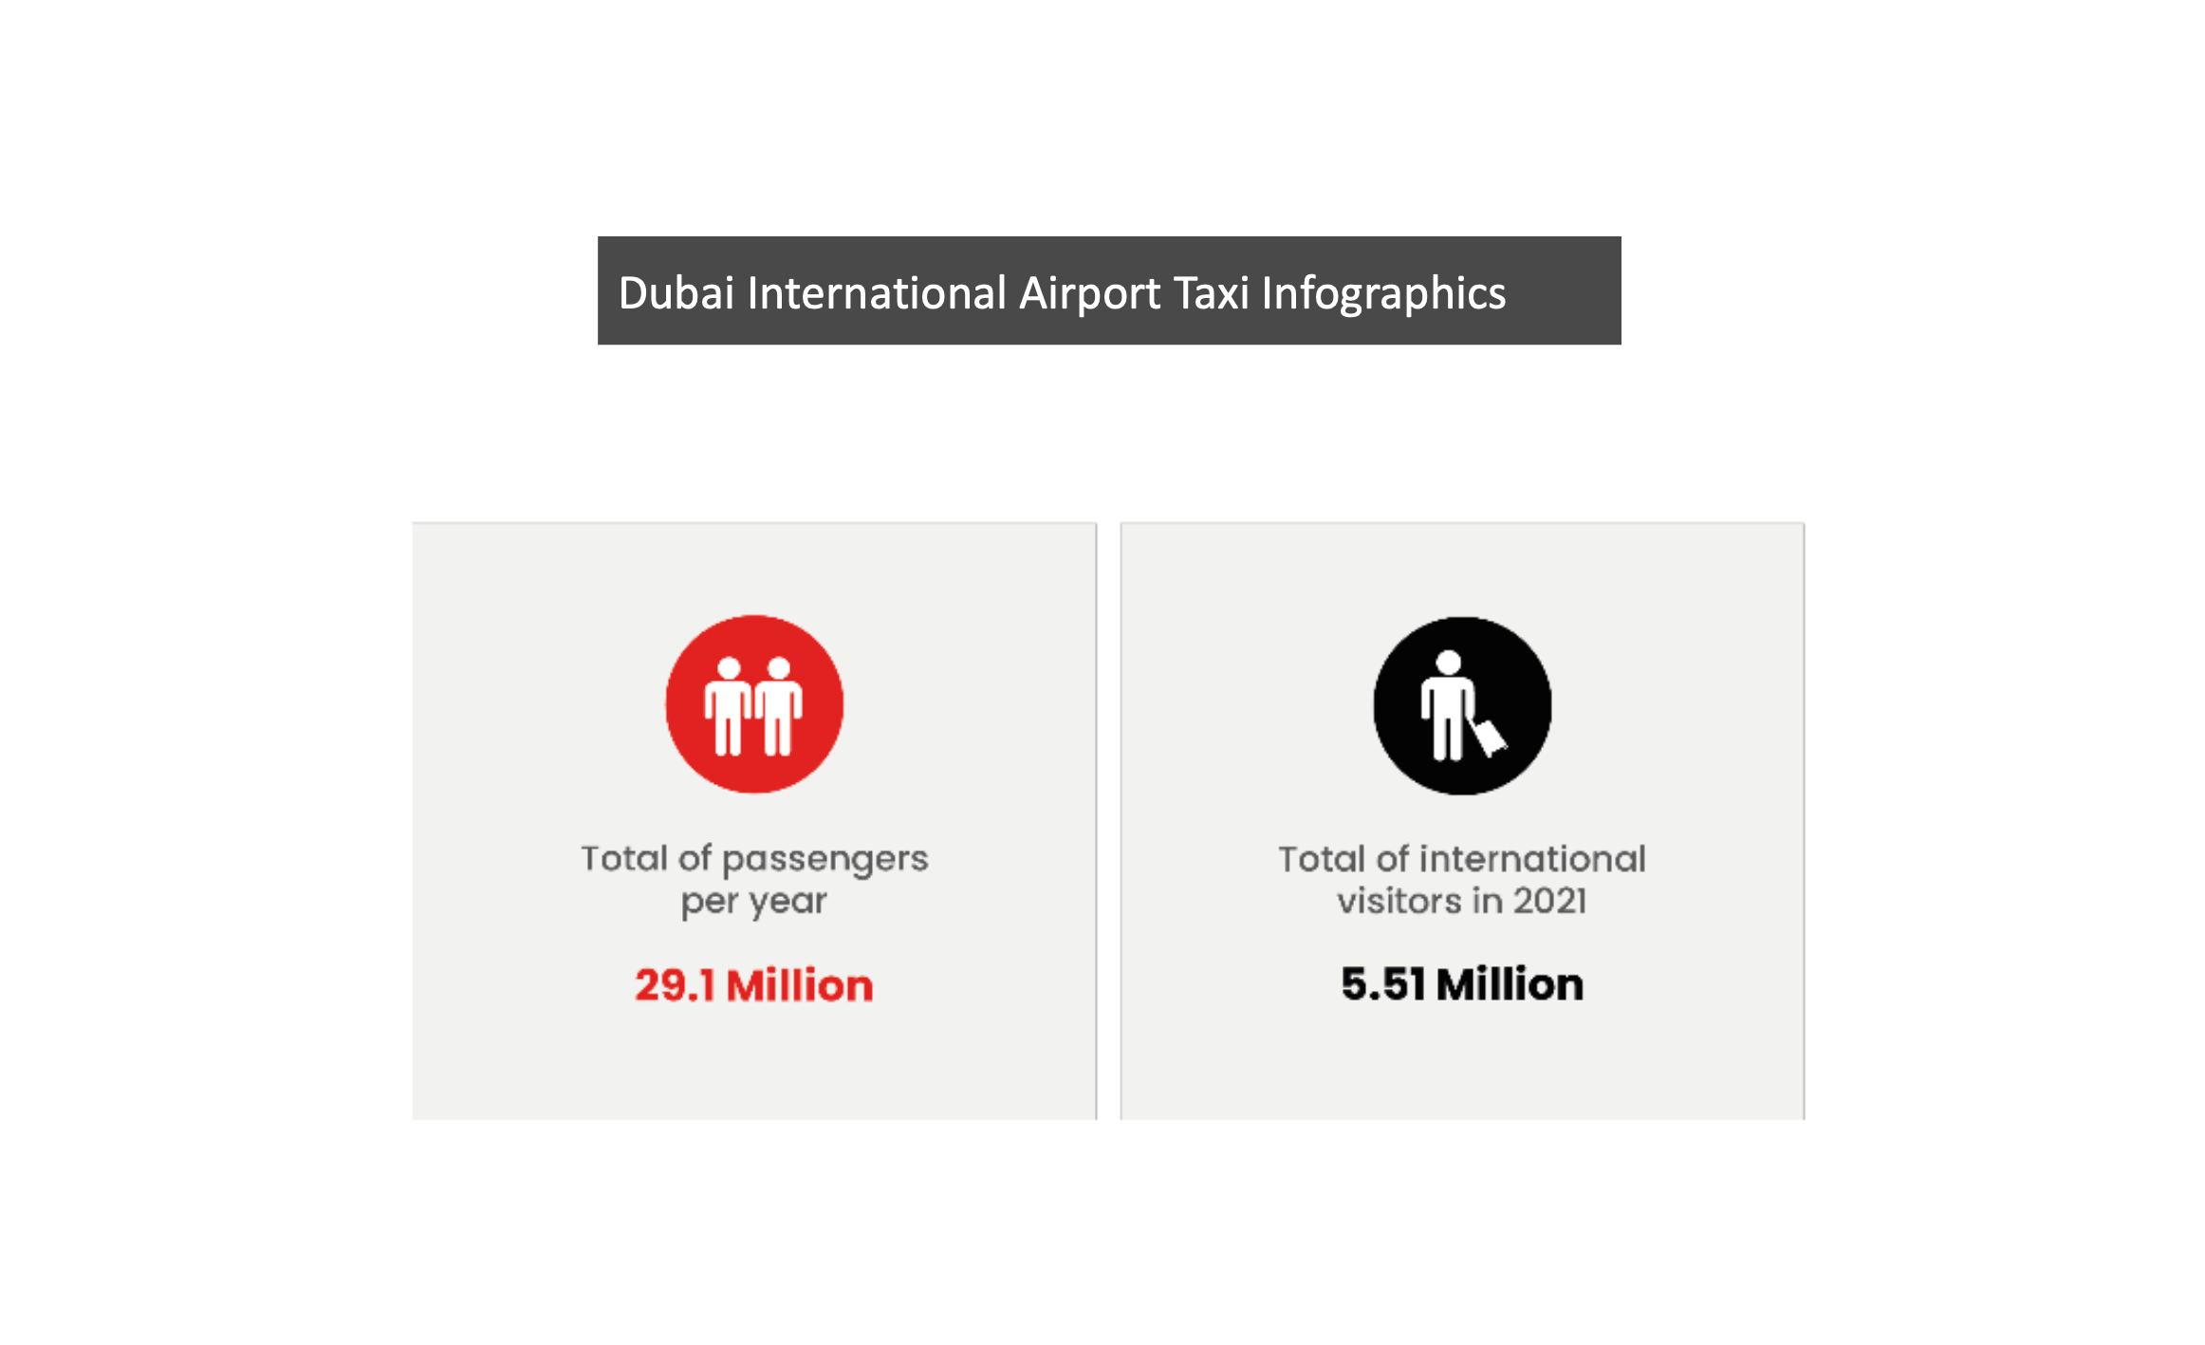
Dubai International Airport Taxis, United Arab Emirates - Dubai - Advertising on Taxis- Dubai International Airport

Slide 6
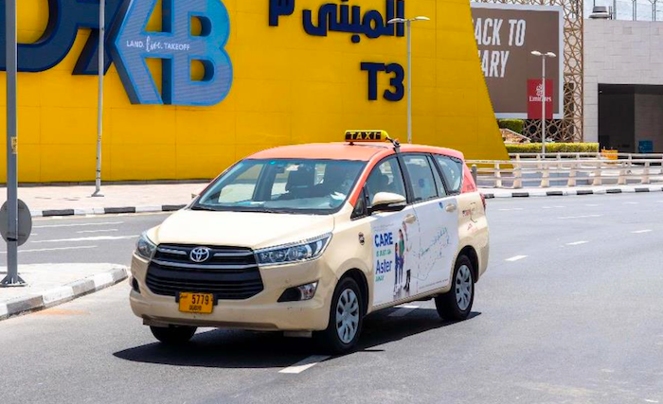

Slide 7
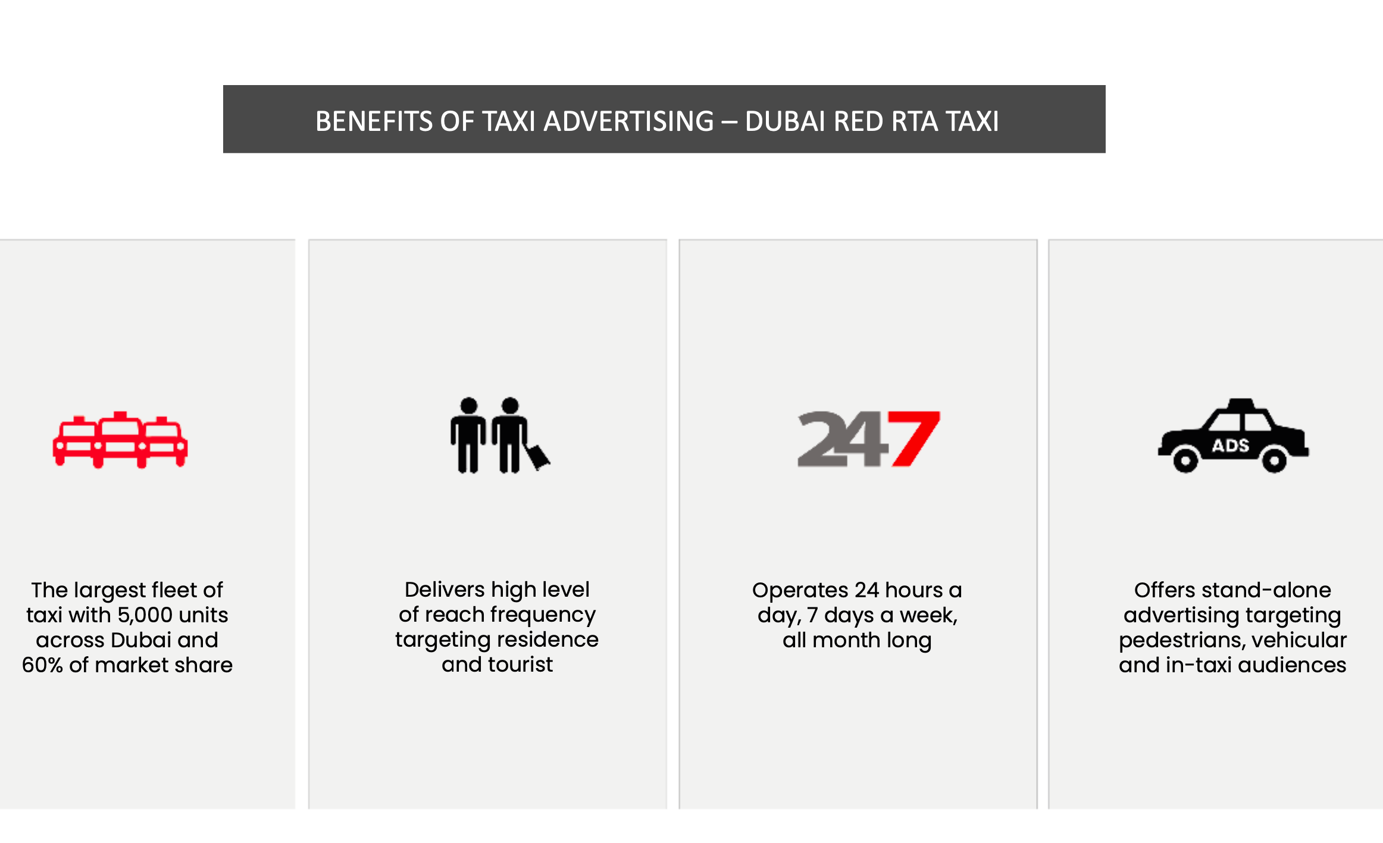

Slide 8
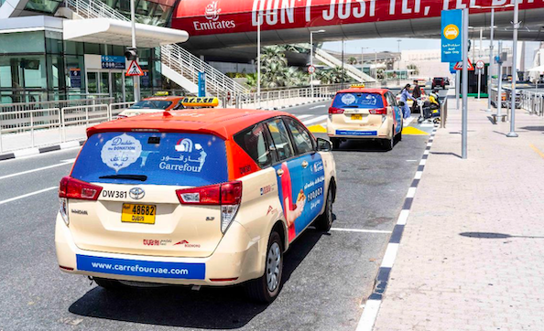

Slide 9
Dubai International Airport Taxis, United Arab Emirates - Dubai - Advertising on Taxis- Dubai International Airport
Rates and details
Number of Screens: 25
Number of production: 1
One time production cost: USD 0.00
Package Rental Rate: USD 13884.95
Discounted rate/Month (Rental): USD 11802.21
Sub Total (Rental+ One Time Production): USD 11802.21

Slide 10
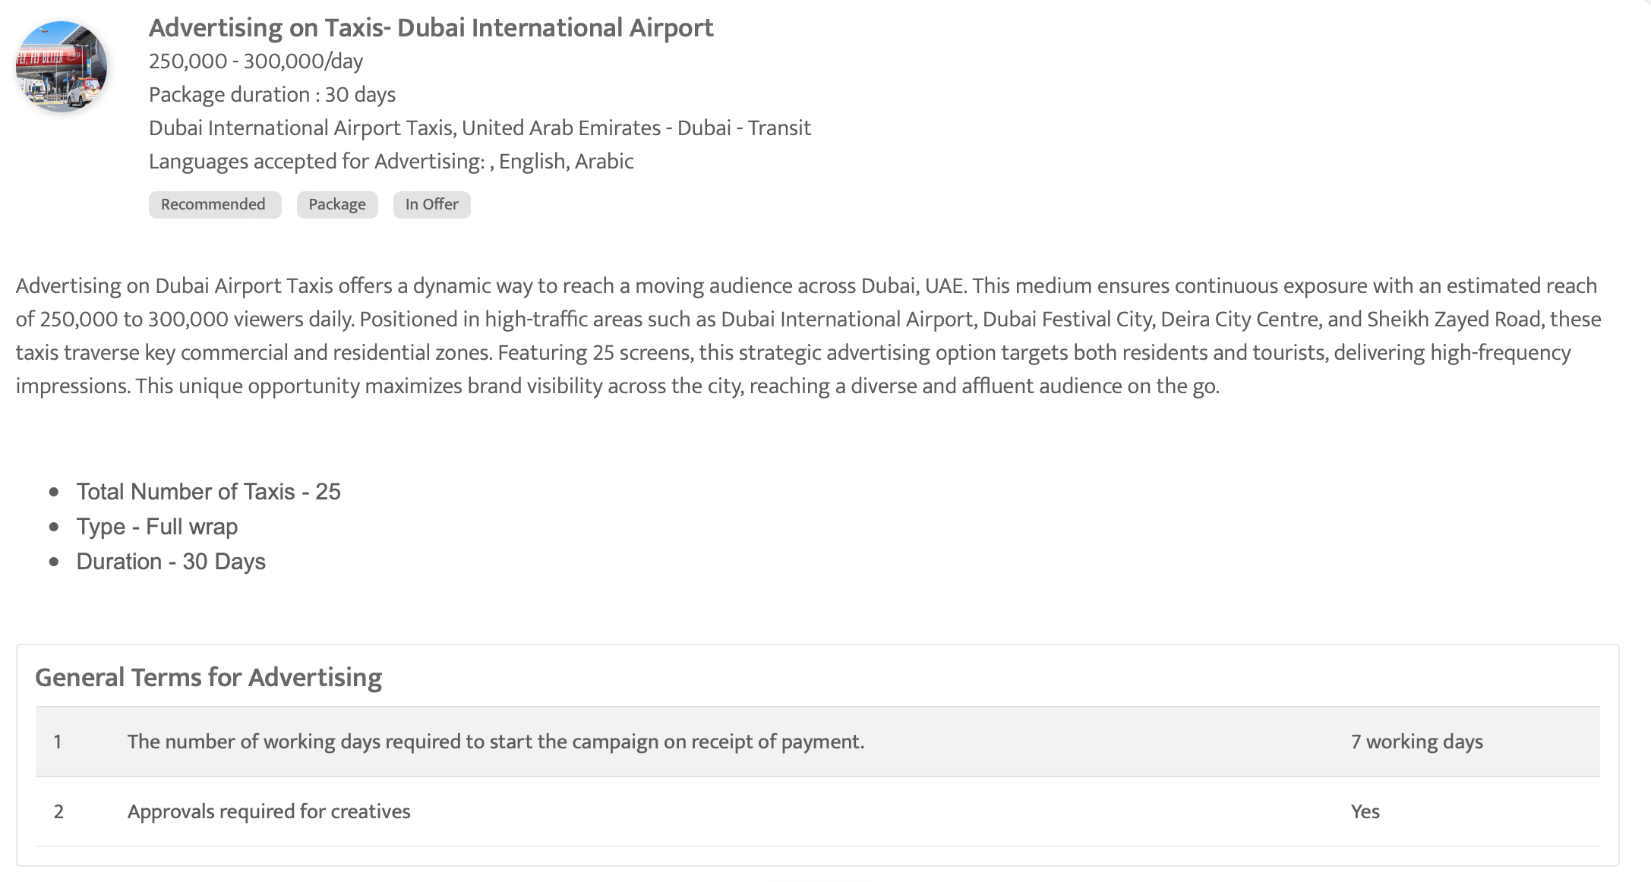

Slide 11
Thank You

