Slide 1
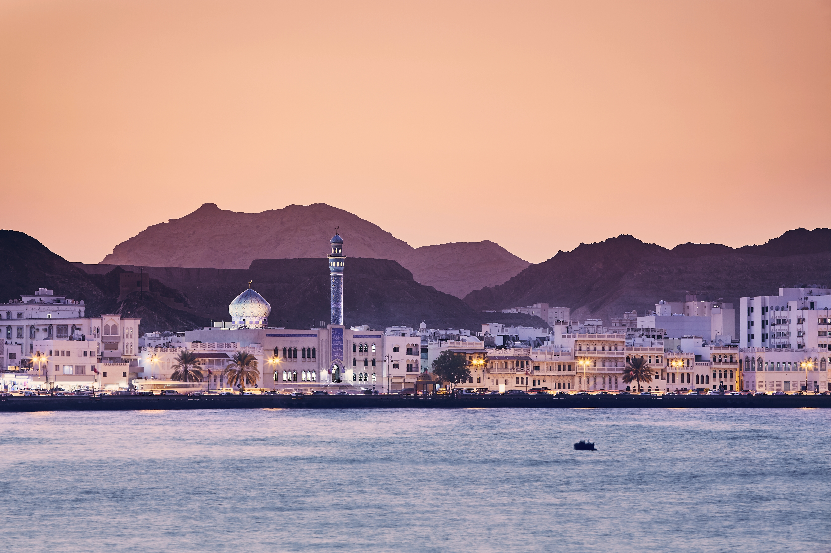
Top Media
Recommendations
In Oman

Slide 2
Airport

Slide 3
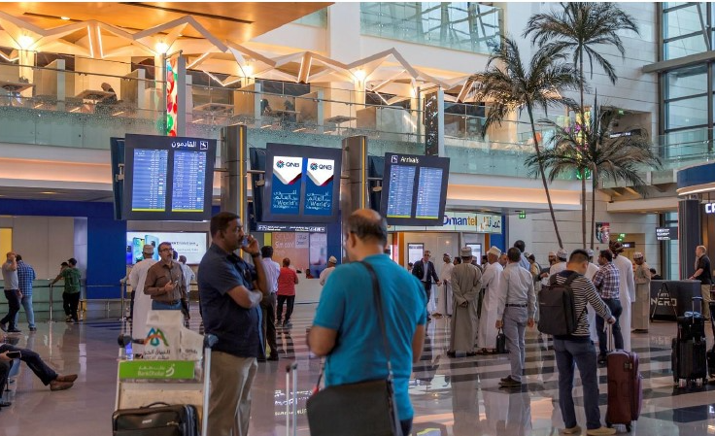
Arrivals Meeters & Greeters, Muscat, Oman
LED Screen at Arrivals Meeters & Greeters, Muscat Airport

Slide 4
Arrivals Meeters & Greeters , Muscat , Oman
LED Screen at Arrivals Meeters & Greeters, Muscat Airport
Details
Number of Screens: 14
Lighting type: Lit
Size: 55 Inch
Single Rotation Time in Seconds: 90
Duration of creative in seconds: 15
Number of production: 1
Total number of months required: 1

Slide 5
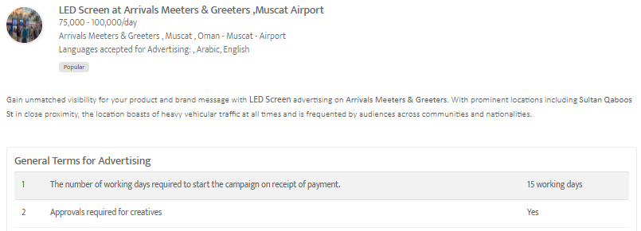

Slide 6
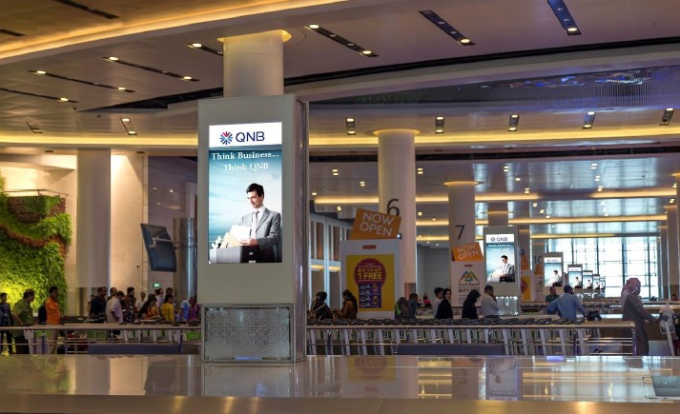
Arrivals Baggage Claim, Muscat, Oman LED Screen at Airport

Slide 7
Arrivals Baggage Claim, Muscat, Oman LED Screen at Airport
Details
Number of Screens: 22
Lighting type: Lit
Size: 55 Inch
Single Rotation Time in Seconds: 90
Duration of creative in seconds: 15
Number of production: 1
Total number of months required: 1

Slide 8
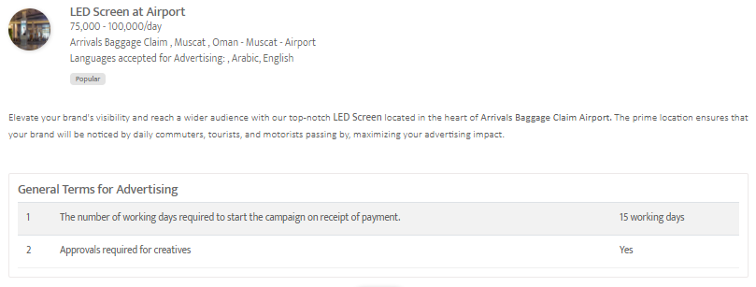

Slide 9
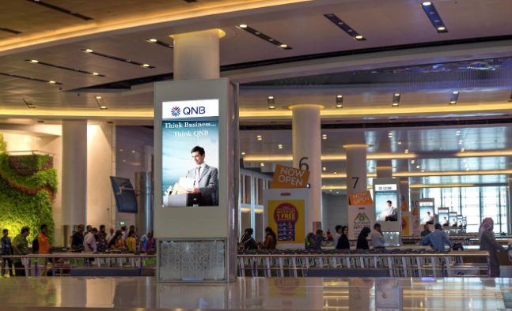
Muscat International Airport, Muscat, Oman
Digital Screens at Arrivals Baggage Claim, Oman

Slide 10
Muscat International Airport, Muscat, Oman
Digital Screens at Arrivals Baggage Claim, Oman
Details
Number of Screens: 22
Number of production: 1

Slide 11
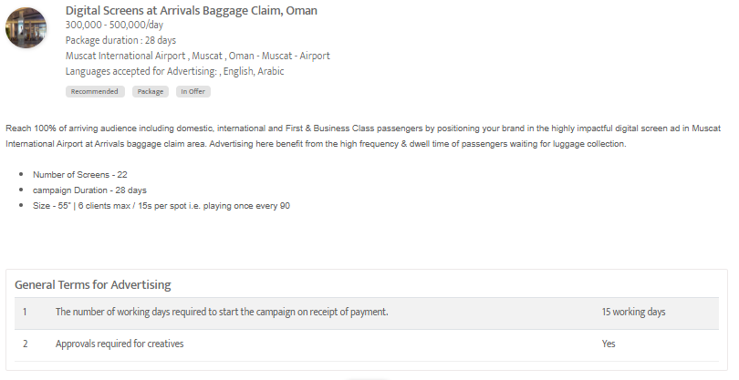

Slide 12
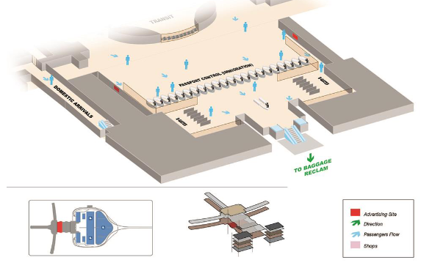
Muscat International Airport, Muscat , Oman
Lightbox at Arrivals Passport Control Area, Oman

Slide 13
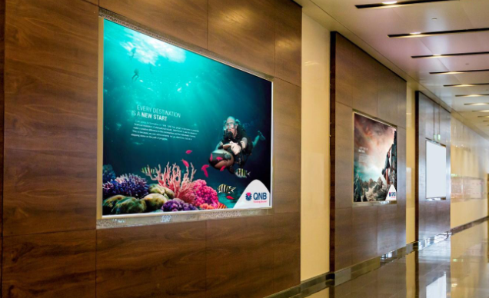

Slide 14
Muscat International Airport, Muscat , Oman
Lightbox at Arrivals Passport Control Area, Oman
Details
Number of Screens: 2
Lighting type: Back-Lit
Size: 4m x 1.7m / Area: 6.7 m²
Number of production: 1
Total number of months required: 1

Slide 15
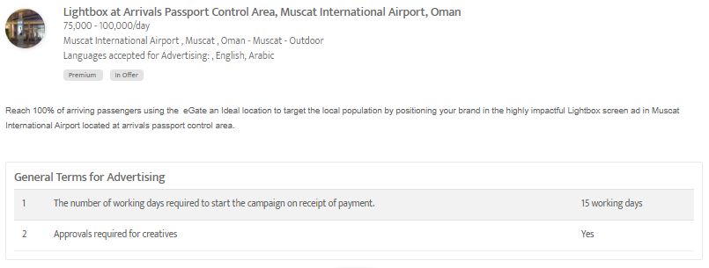

Slide 16
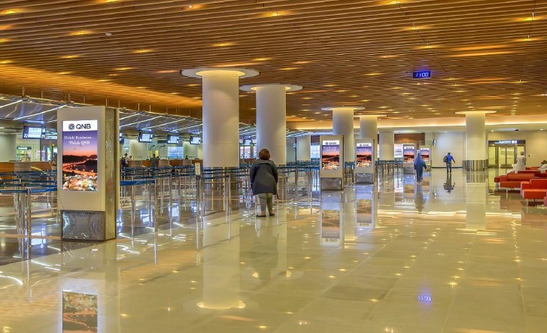
Arrivals Passport Control, Muscat, Oman
LED Screen at Arrivals Passport Control, Muscat Airport

Slide 17
Arrivals Passport Control, Muscat, Oman
LED Screen at Arrivals Passport Control, Muscat Airport
Details
Number of Screens: 12
Lighting type: Lit
Size: 55 Inch
Single Rotation Time in Seconds: 90
Duration of creative in seconds: 15
Number of production: 1
Total number of months required: 1

Slide 18
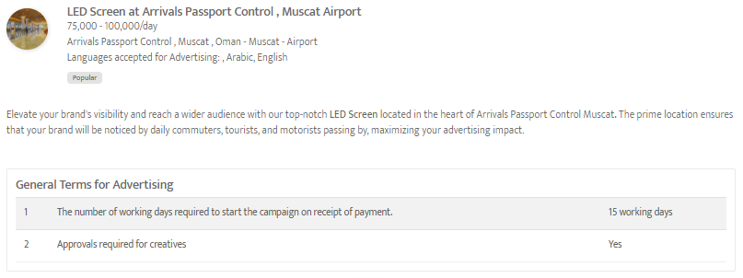

Slide 19
Out Of Home

Slide 20
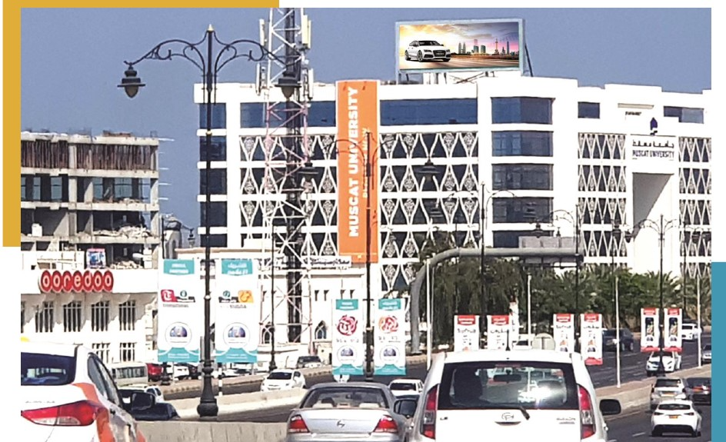
Bowsher, Muscat University, Muscat , Oman
Digital Screen at Bowsher, Muscat University

Slide 21
Bowsher, Muscat University, Muscat , Oman
Digital Screen at Bowsher, Muscat University
Details
Number of Screens: 1
Lighting type: Lit
Size: 14.34m (W) x 5.12m (H)
Single Rotation Time in Seconds: 100
Duration of creative in seconds: 10
Number of production: 1
Total number of months required: 1

Slide 22
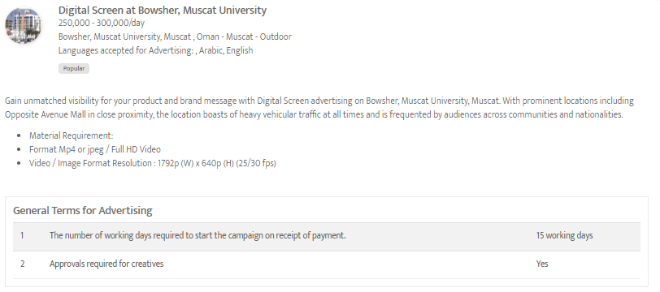

Slide 23
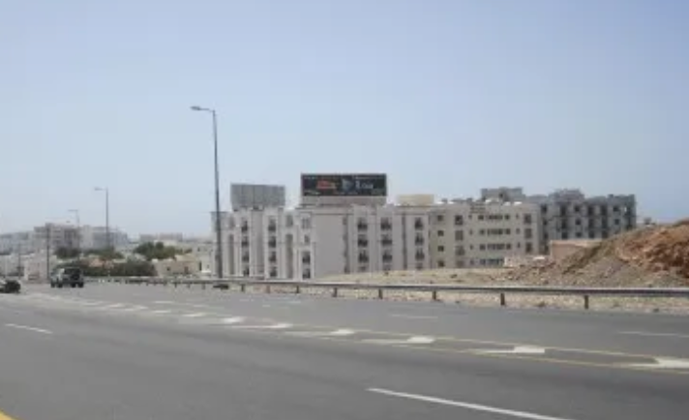
Prime Outdoor Recommendation in Muscat, Oman
OOH Package in Important Highways

Slide 24
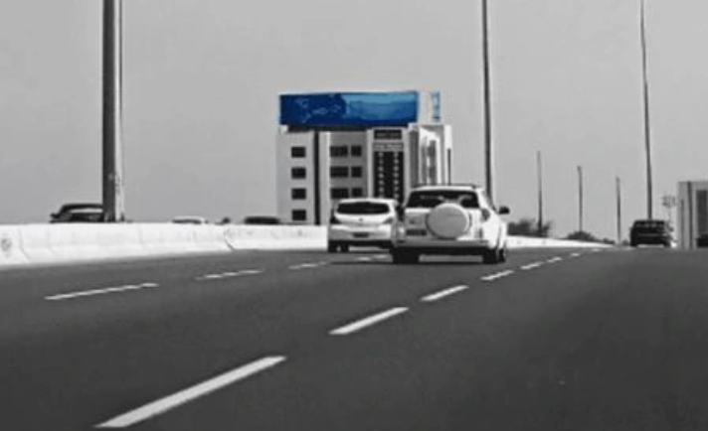

Slide 25
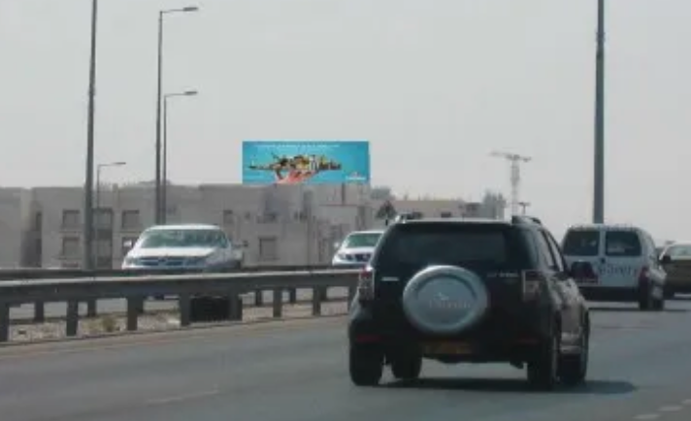

Slide 26
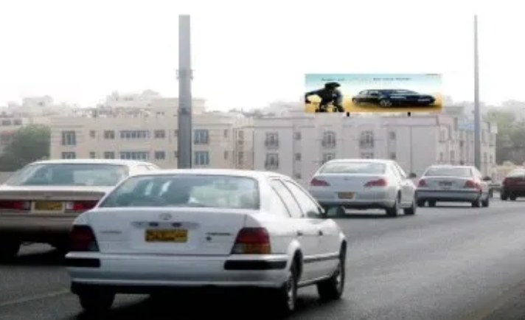

Slide 27
Prime Outdoor Recommendation in Muscat, Oman
OOH Package in Important Highways
Details
Number of Screens: 5
Number of production: 1
One time production cost: USD 0.00
Package Rental Rate: Final Rates To Be Confirmed
Discounted rate: Final Rates To Be Confirmed
Sub Total (Rental+ One Time Production): Final Rates To Be Confirmed

Slide 28
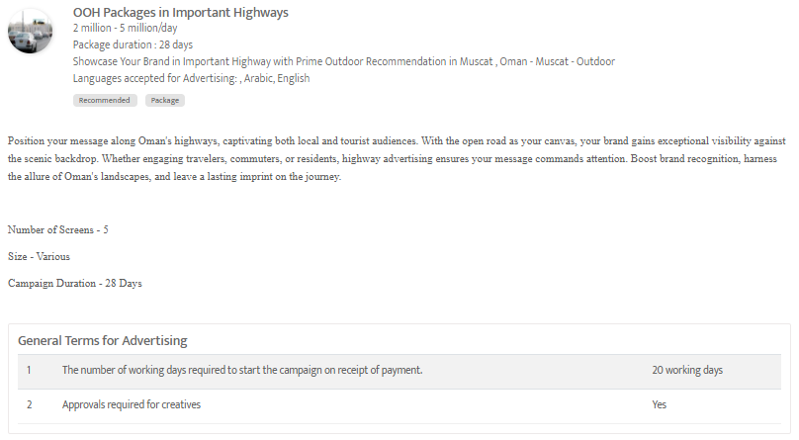

Slide 29
Newspapers

Slide 30
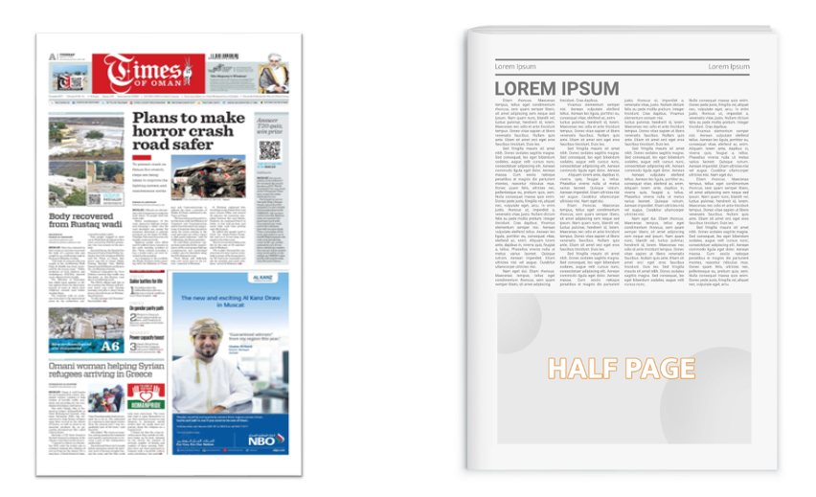
Times Of Oman, Oman
Half page ad on Inside pages

Slide 31
Times Of Oman, Oman
Half page ad on Inside pages
Details
Frequency: Daily
Size: 24.0 cm H x 29 cm W
Standard Positions: Half Page
Number of production: 1
Number of insertions required: 1

Slide 32
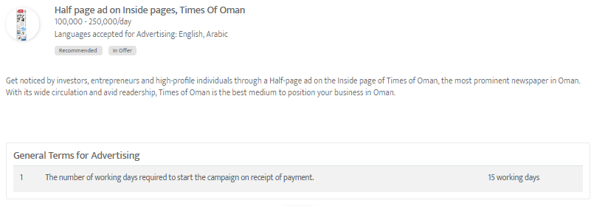

Slide 33
Thank You
media@masscomglobal.com | www.masscomglobal.com
Masscom Global FZE, Office No: 220, One UAQ Building, UAQ Free Trade Zone, Umm Al Quwain, United Arab Emirates.

