Slide 1
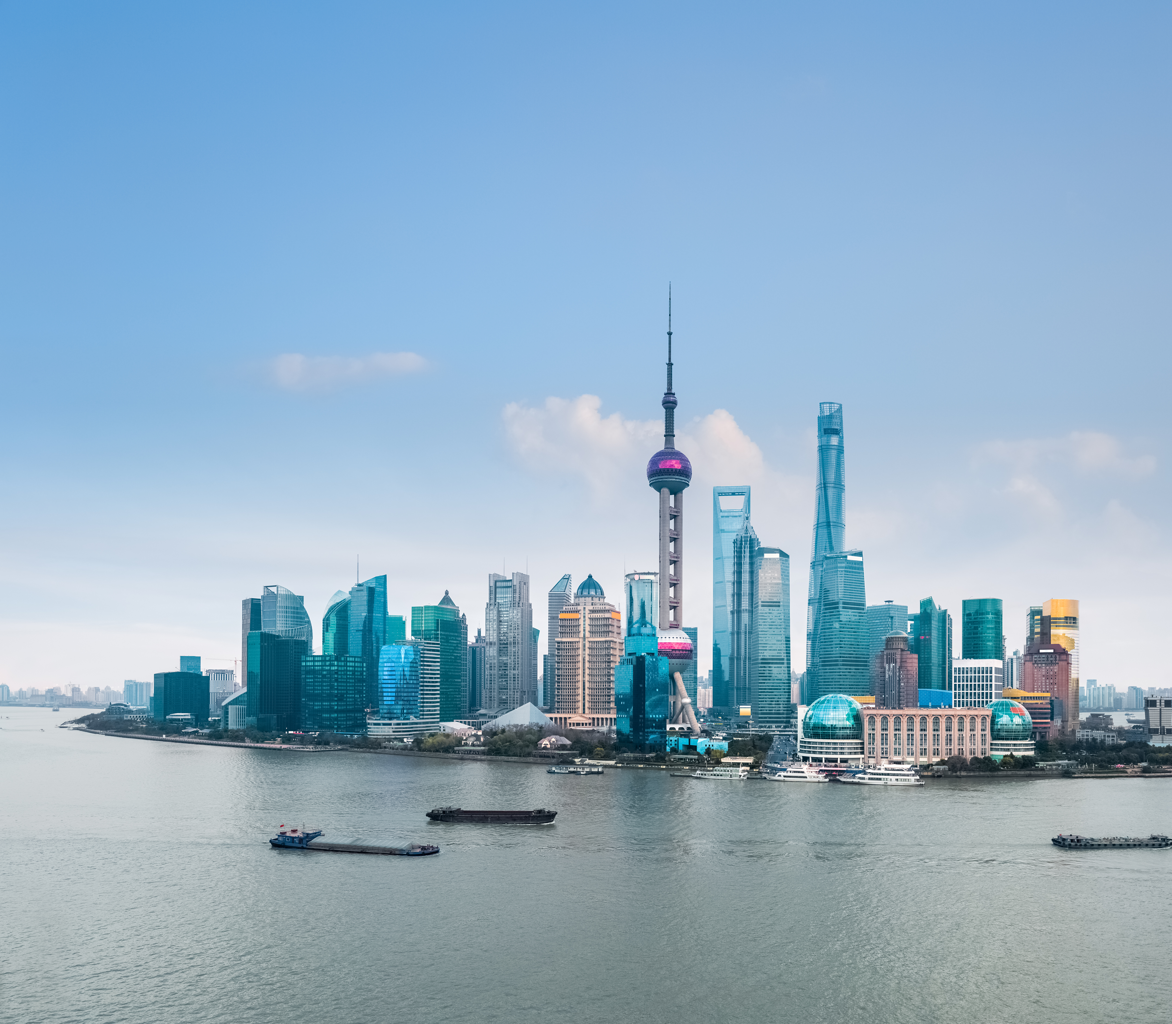
Top Media
Recommendations
in China

Slide 2
Out of Home

Slide 3
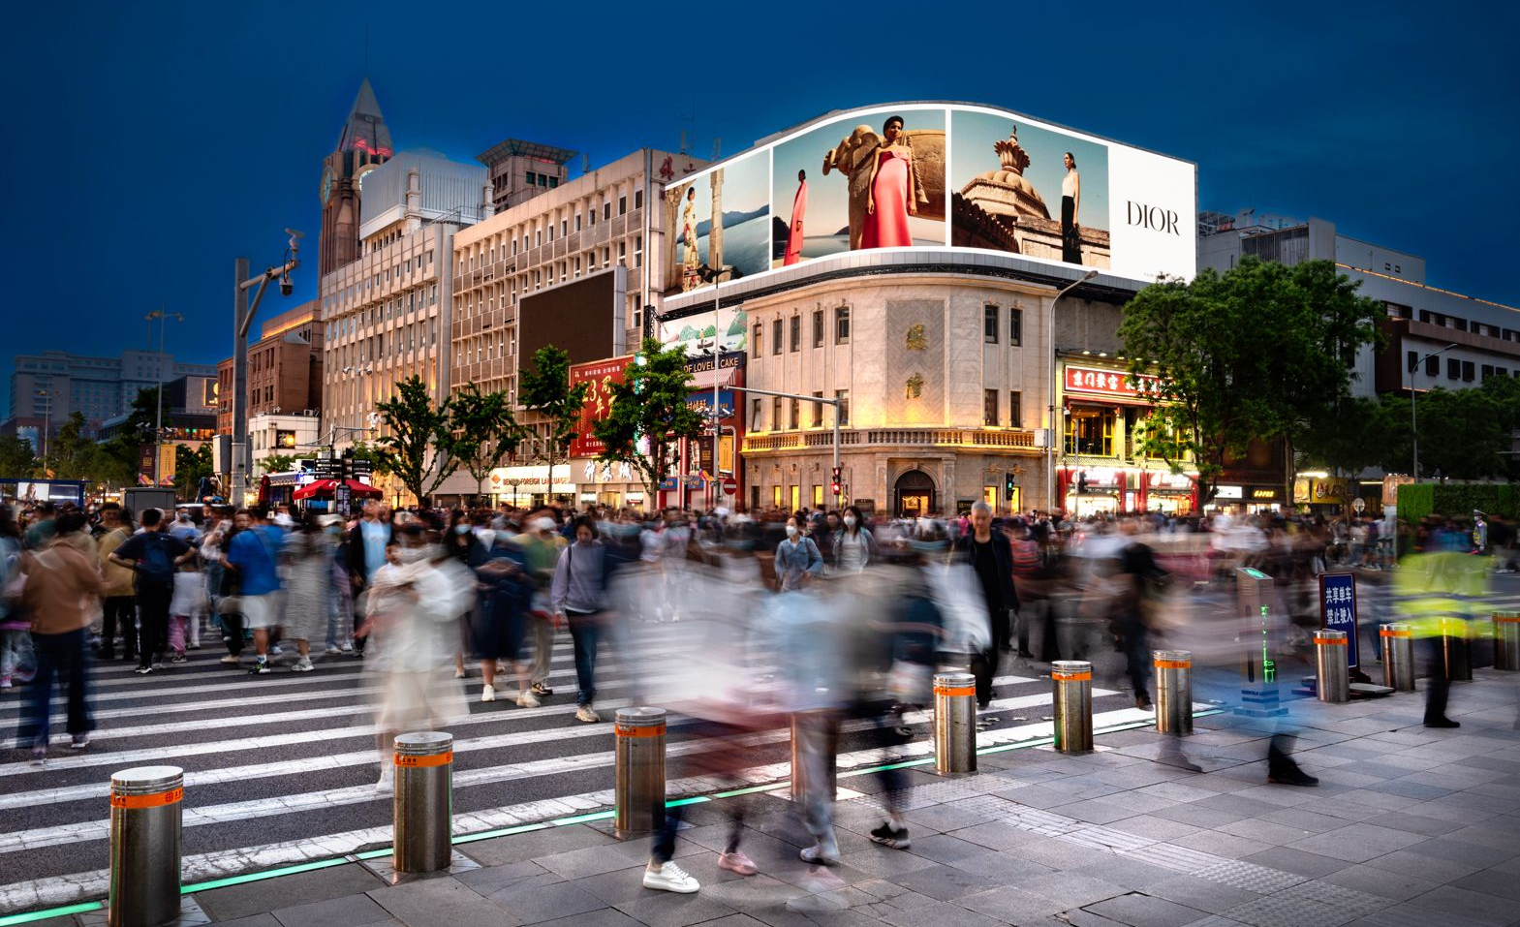
Wangfujing Street, opposite to LotteYintai Mall, Beijing, China
Mega 3D LED screen at WFJ Pedestrian Street
Out of Home

Slide 4
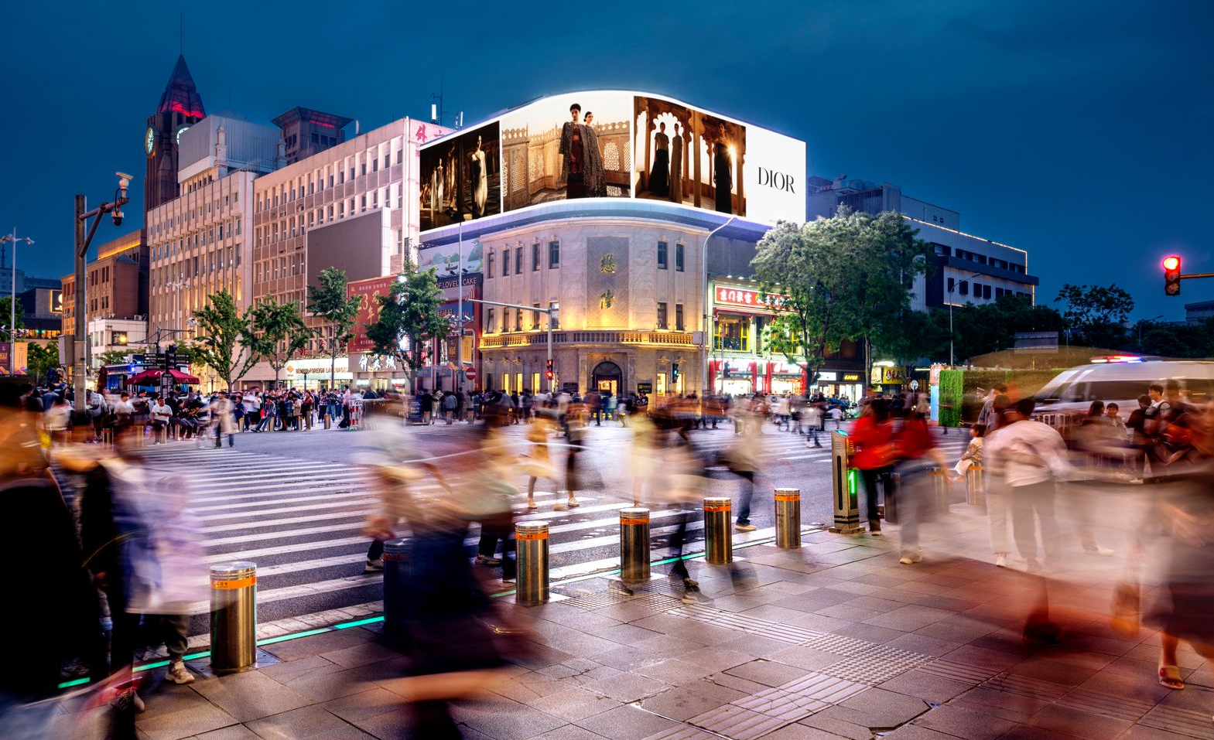

Slide 5
Wangfujing Street, opposite to LotteYintai Mall, Beijing, China
Mega 3D LED screen at WFJ Pedestrian Street
Out of Home
Details
Number of Screens: 1
Number of production: 1

Slide 6
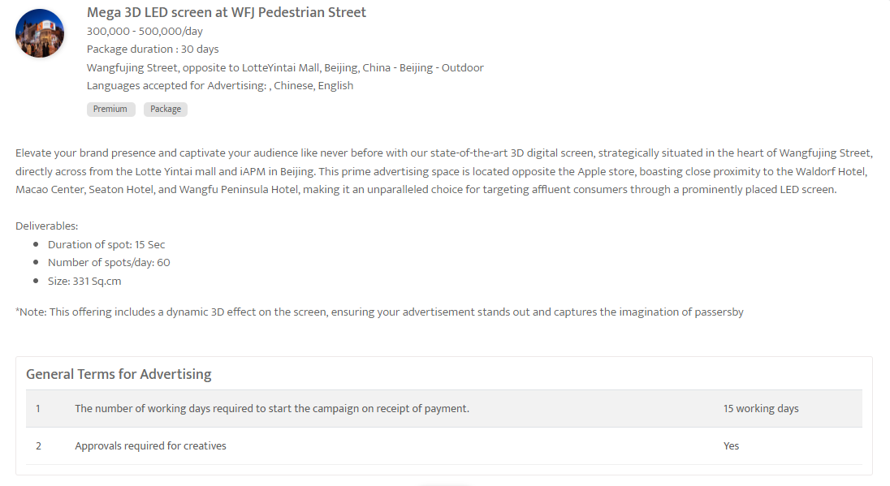

Slide 7
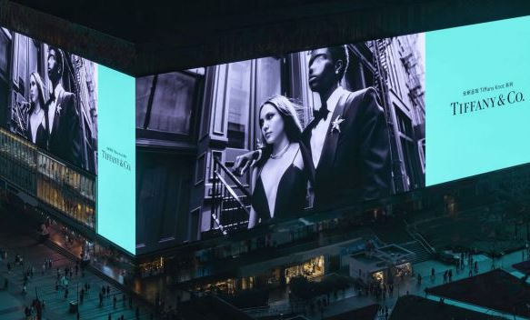
Be the Light of Asia: Premium Exposure on Chongqing's Mega Screen
LED Screen at Guanyinqiao Business Circle in Chongqing, China
Out of Home

Slide 8
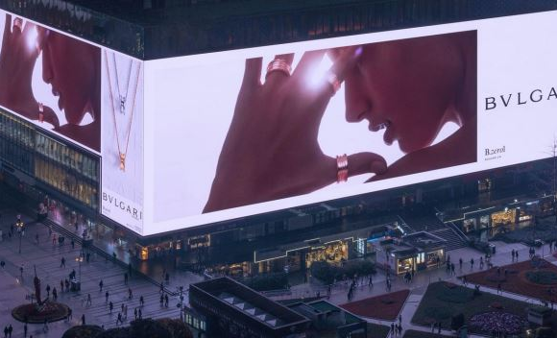

Slide 9
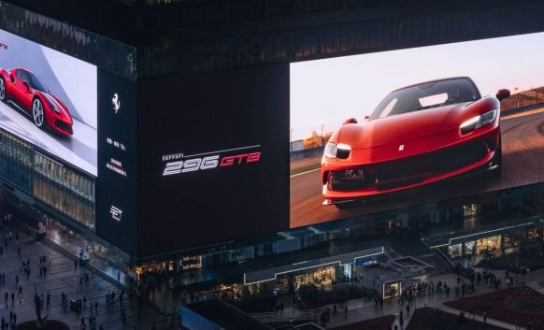

Slide 10
Be the Light of Asia: Premium Exposure on Chongqing's Mega Screen
LED Screen at Guanyinqiao Business Circle in Chongqing, China
Out of Home
Details
Number of Screens: TBC
Number of production: 1

Slide 11
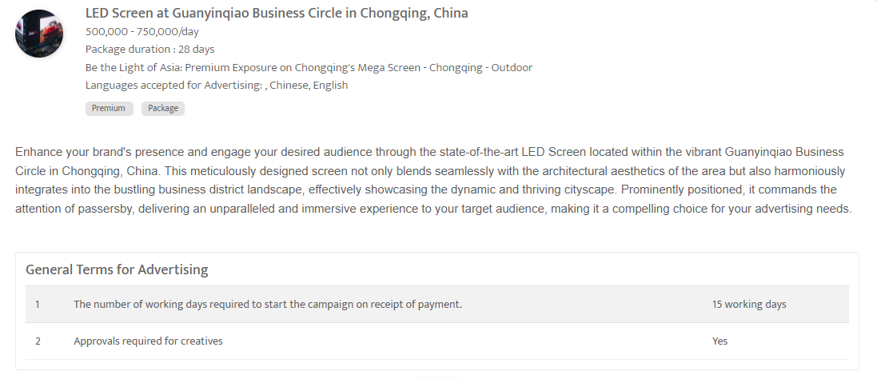

Slide 12
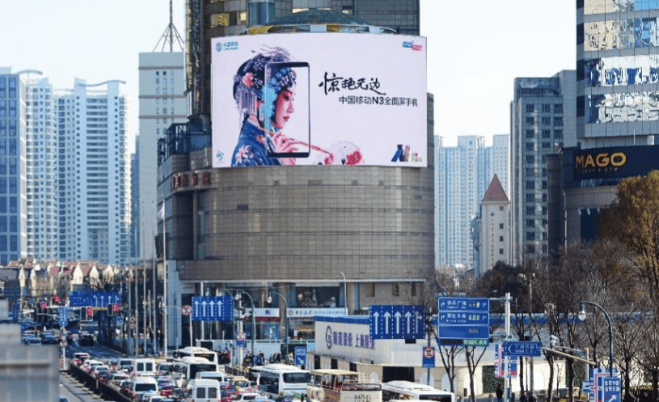
Lansheng Building, Huaihai Road, Shanghai, China
LED screen at Lansheng Building, Huaihai Road
Out of Home

Slide 13
Lansheng Building, Huaihai Road, Shanghai, China
LED screen at Lansheng Building, Huaihai Road
Out of Home
Details
Number of Screens: 1
Number of production: 1

Slide 14
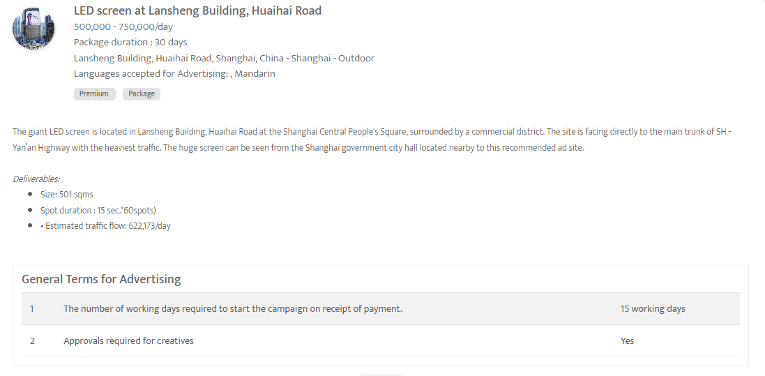

Slide 15
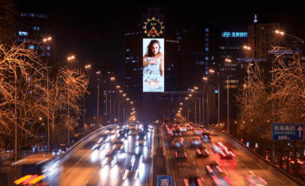
East 3rd Ring Road CBD Area, Beijing, China
Iconic LED screen at East 3rd Ring Road CBD area, Beijing
Out of Home

Slide 16
East 3rd Ring Road CBD Area, Beijing, China
Iconic LED screen at East 3rd Ring Road CBD area, Beijing
Out of Home
Details
Number of Screens: 1
Lighting type: Lit
Size: 759sqms
Single Rotation Time in Seconds:
Duration of creative in seconds: 15
Number of production: 1
Total number of months required: 1

Slide 17
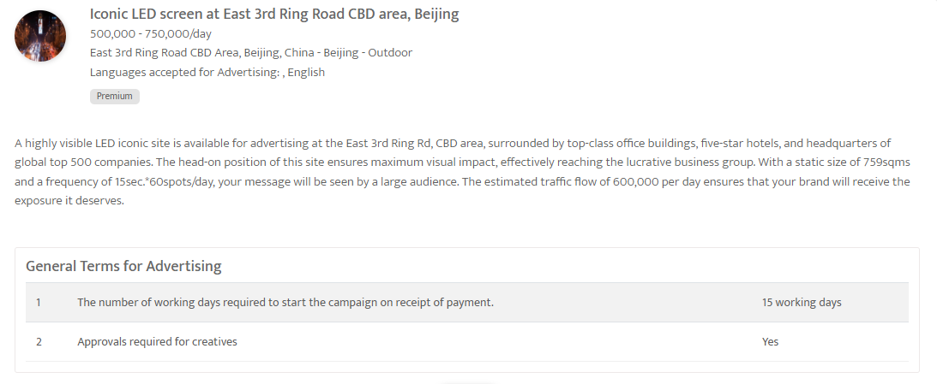

Slide 18
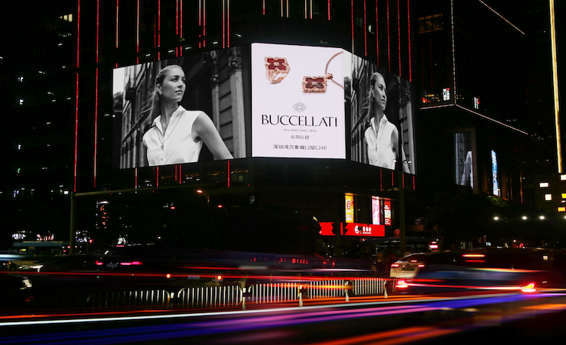
Houhai Super HQ Base LED - Shenzhen - Digital Screen Ad
Out of Home

Slide 19
Houhai Super HQ Base LED - Shenzhen - Digital Screen Ad
Out of Home
Details
Number of Screens: 1
Number of production: 1

Slide 20
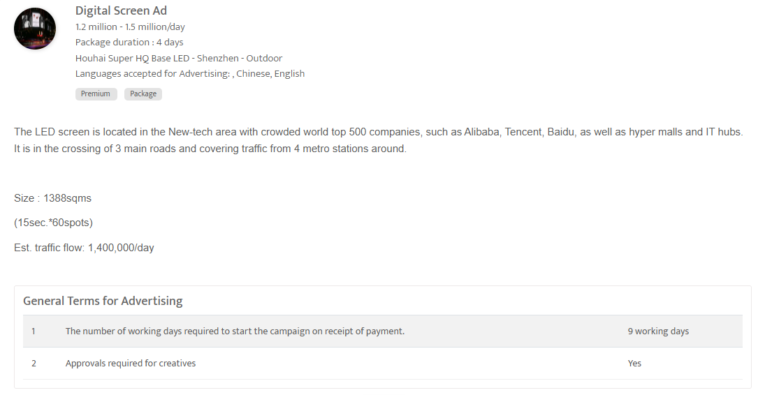

Slide 21
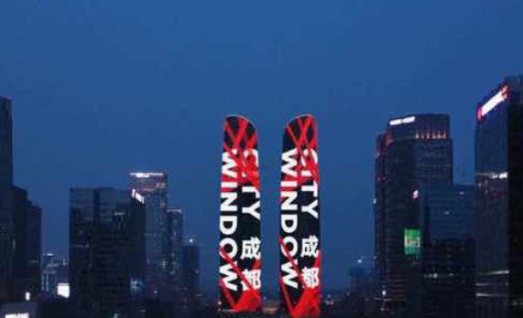
Avenue,Chengdu, China
Digital screen at Chengdu Jiaozi Twin Tower
Out of Home

Slide 22
Avenue, Chengdu, China
Digital screen at Chengdu Jiaozi Twin Tower
Out of Home
Details
Number of Screens: 1
Number of production: 1

Slide 23
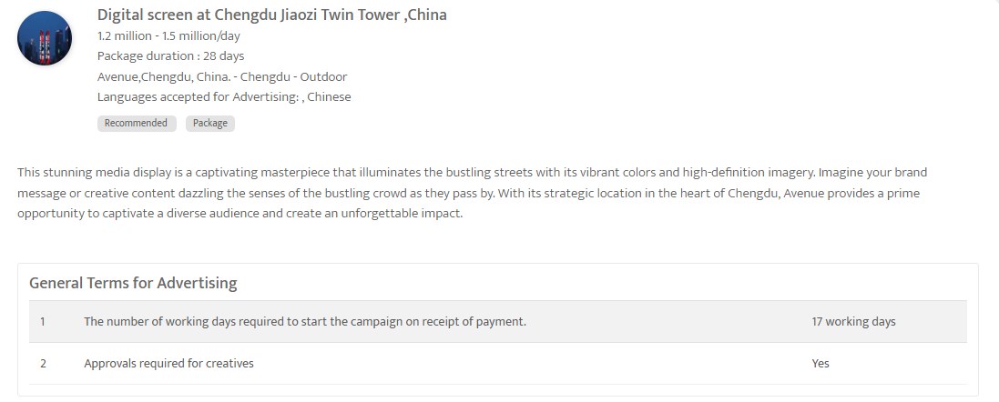

Slide 24
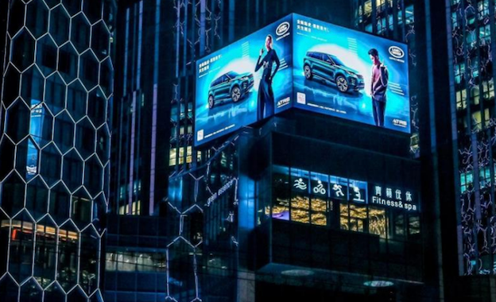
Sanlitun Topwin Center - Fashion centre - Beijing - Digital Screen Ad
Out of Home

Slide 25
Sanlitun Topwin Center - Fashion centre - Beijing - Digital Screen Ad
Out of Home
Details
Number of Screens: 1
Number of production: 1

Slide 26
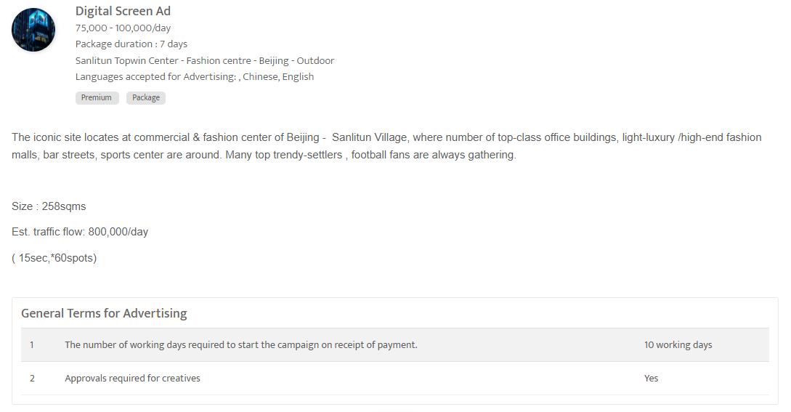

Slide 27
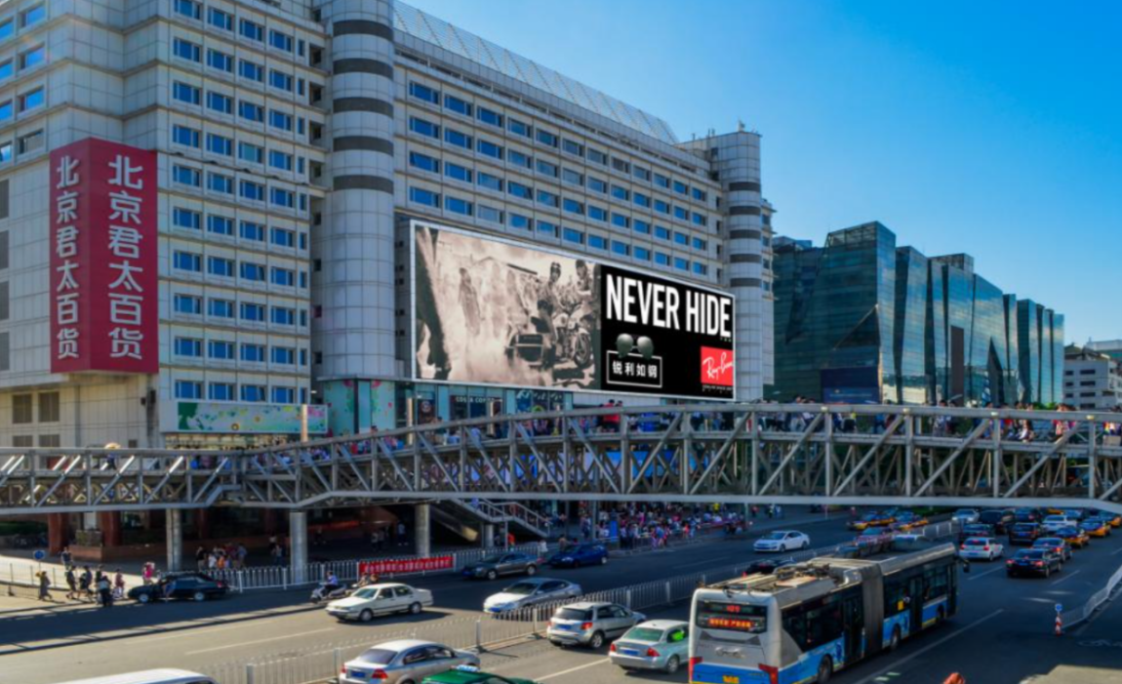
Xidan Grand pacific mall, Beijing, China
Digital Billboard at Xidan Grand Pacific Mall
Out of Home

Slide 28
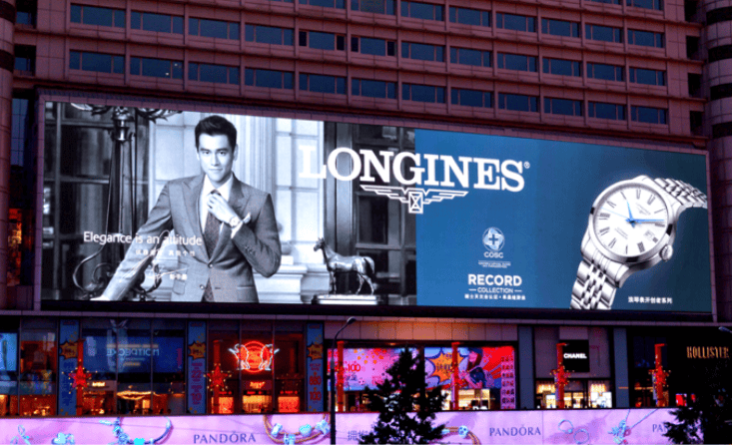

Slide 29
Xidan Grand pacific mall, Beijing, China
Digital Billboard at Xidan Grand Pacific Mall, Beijing
Out of Home
Details
Number of Screens: 1
Lighting type: Lit
Size: 54.4×13.44 m
Single Rotation Time in Seconds:
Duration of creative in seconds: 15
Number of production: 1
Total number of months required: 1

Slide 30
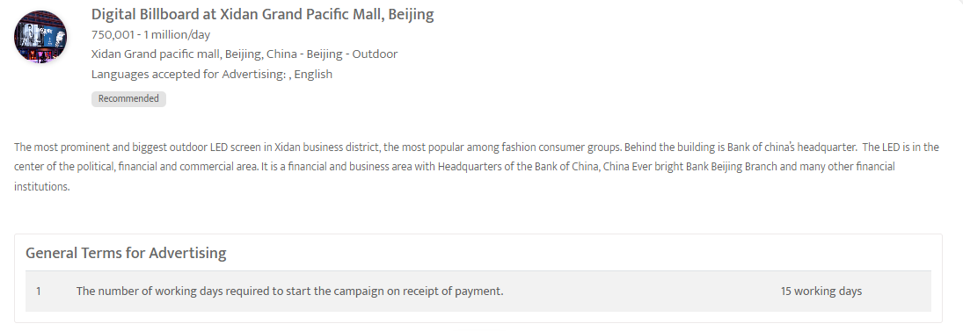

Slide 31
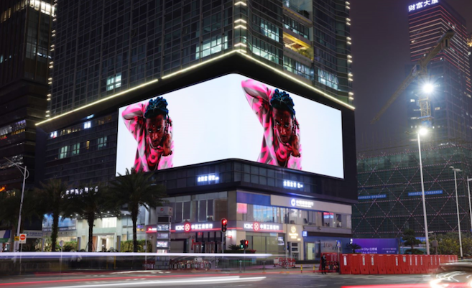
Zhaobangji Building LED - Shenzhen - Digital Screen Ad
Out of Home

Slide 32
Zhaobangji Building LED - Shenzhen - Digital Screen Ad
China
Out of Home
Details
Number of Screens: 1
Number of production: 1

Slide 33
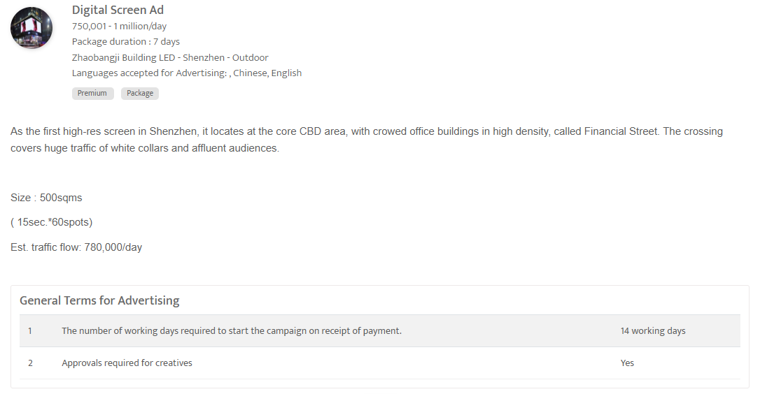

Slide 34
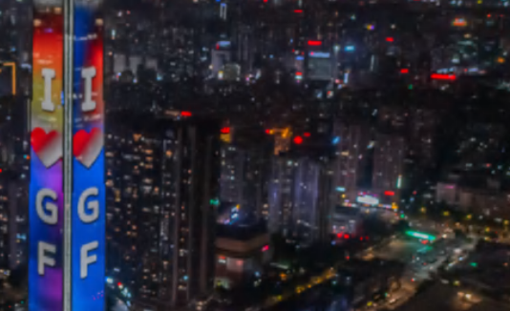
Guangzhou Guangfa ,China
Digital screen at Guangzhou Guangfa Secutiry Tower
Out of Home

Slide 35
Guangzhou Guangfa, China Digital screen at Guangzhou Guangfa Secutiry Tower
Out of Home
Rates and details
Number of Screens: 1
Number of production: 1
One time production cost: USD 0.00
Package Rental Rate: USD 152379.92
Discounted rate/Month (Rental): USD 137141.92
Sub Total (Rental+ One Time Production): USD 137141.92

Slide 36
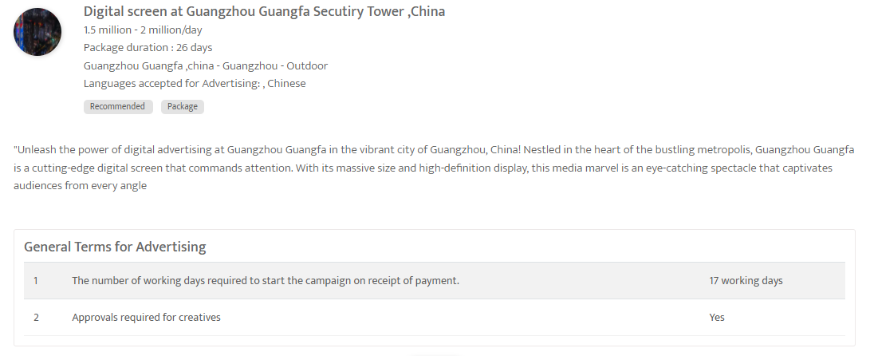

Slide 37
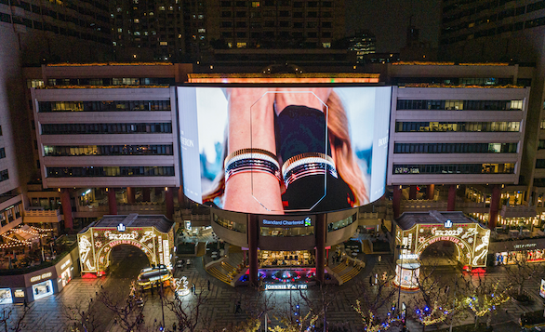
Portman Digital LED Wrap - nearby Plaza 66 - Shanghai - Digital Screen Ad
Out of Home

Slide 38
Portman Digital LED Wrap - nearby Plaza 66 - Shanghai - Digital Screen Ad
Out of Home
Details
Number of Screens: 1
Number of production: 1

Slide 39
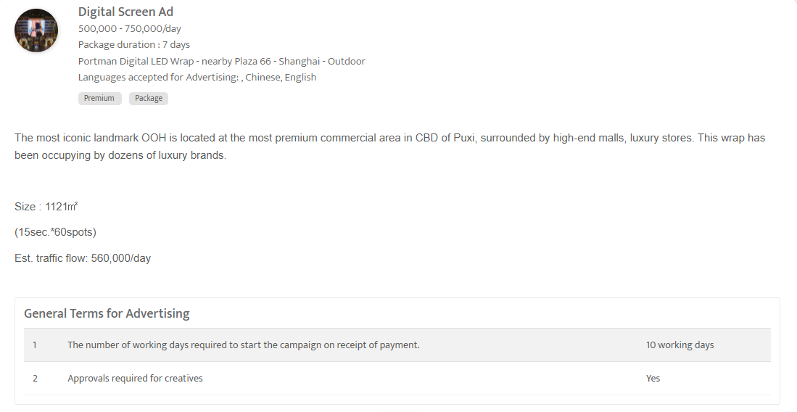

Slide 40
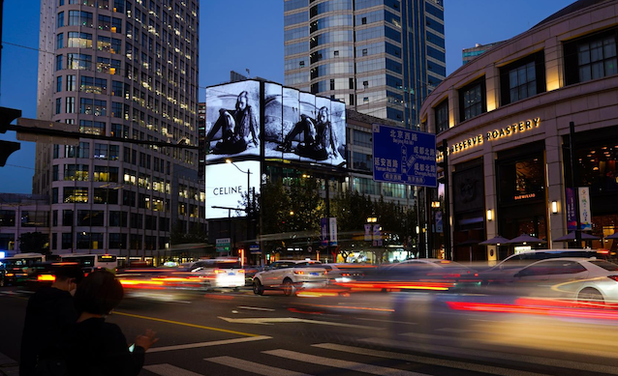
Huiyin Special-built LED - Beijing - Digital Screen Ad
Out of Home

Slide 41
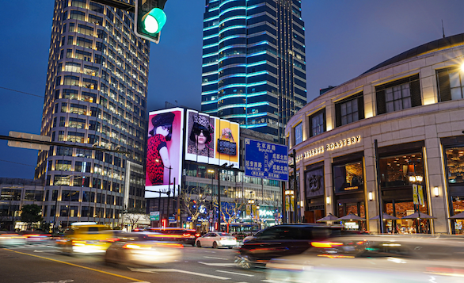

Slide 42
Huiyin Special-built LED - Beijing - Digital Screen Ad
Out of Home
Details
Number of Screens: 1
Number of production: 1

Slide 43
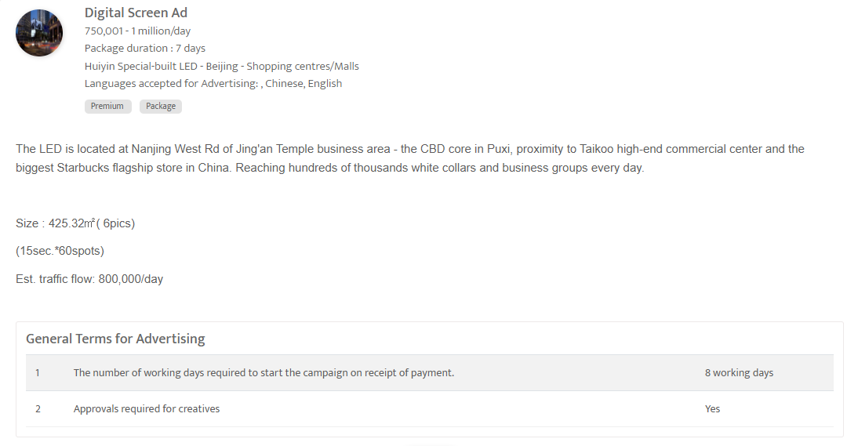

Slide 44
Airports

Slide 45
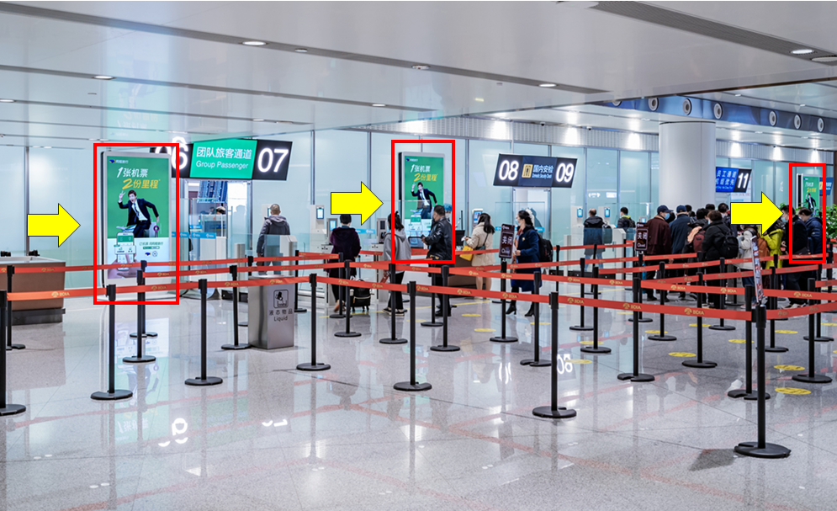
Beijing Daxing International Airport, China
LED screen at Domestic departure security checkpoints
Out of Home

Slide 46
Beijing Daxing International Airport, China
LED screen at Domestic departure security checkpoints
Out of Home
Details
Number of Screens: 20
Lighting type: Lit
Size: 1.2m ×2.194 m (98 inch)
Single Rotation Time in Seconds: 135
Duration of creative in seconds: 10
Number of production: 1
Total number of months required: 1

Slide 47
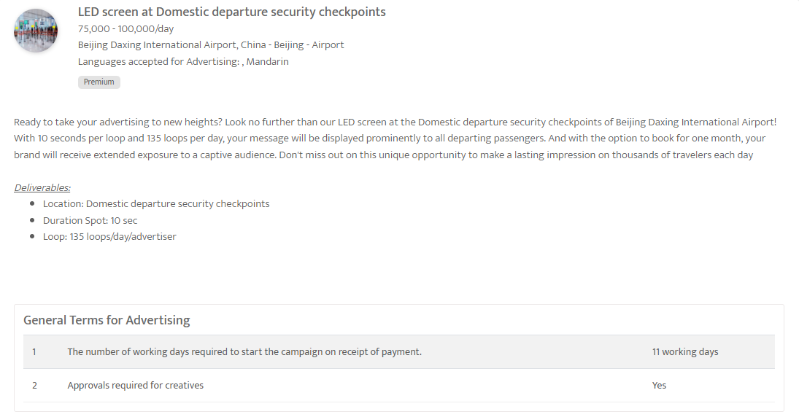

Slide 48
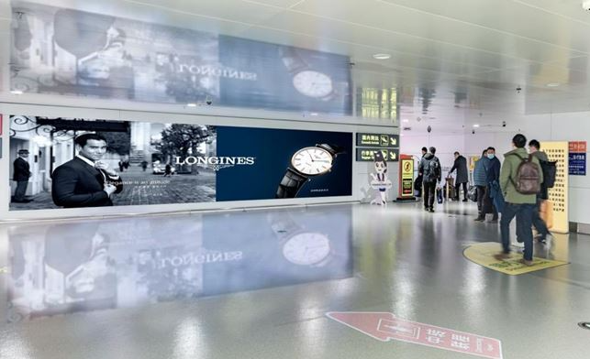
Yinchuan Hedong International Airport, Yinchuan
LED screens at T3 Domestic Arrivals Mezzanine Head on, Yinchuan Hedong International Airport
Out of Home

Slide 49
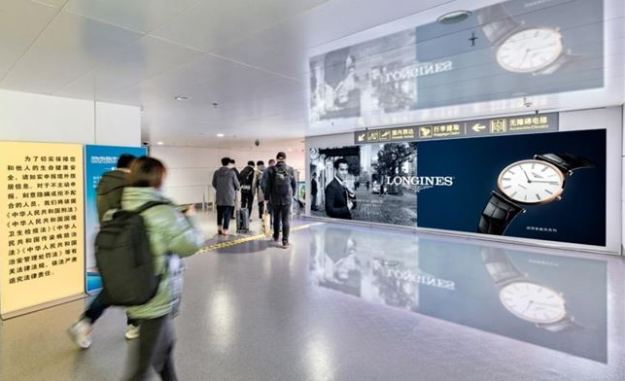

Slide 50
Yinchuan Hedong International Airport, Yinchuan
LED screens at T3 Domestic Arrivals Mezzanine Head on, Yinchuan Hedong International Airport
Out of Home
Details
Number of Screens: 2
Lighting type: Lit
Size: 1.92m×5.76m | 1.92m×9.12m
Single Rotation Time in Seconds:
Duration of creative in seconds: 5
Number of production: 1
Total number of months required: 1

Slide 51
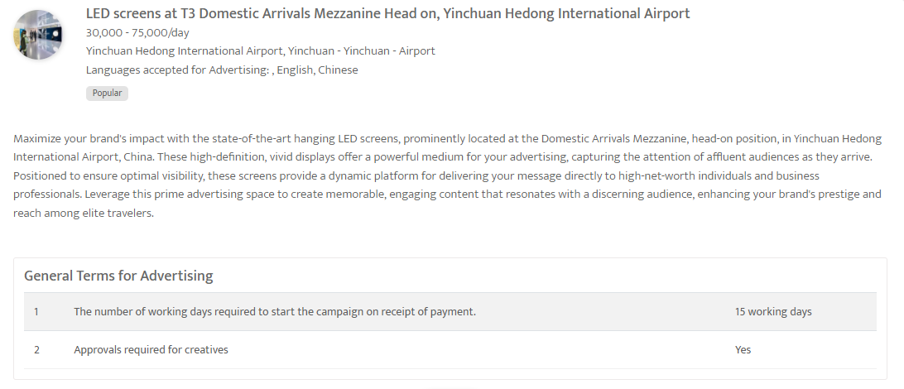

Slide 52
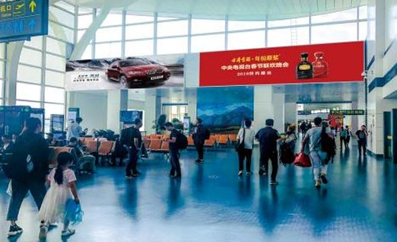
Yinchuan Hedong International Airport, Yinchuan
Light box at T3 Terminal Departure Hall, Yinchuan Hedong International Airport
Out of Home

Slide 53
Yinchuan Hedong International Airport, Yinchuan
Light box at T3 Terminal Departure Hall, Yinchuan Hedong International Airport
Out of Home
Details
Number of Screens: 2
Lighting type: Lit
Size: H 300cm × W 1100cm
Number of production: 1
Total number of months required: 1

Slide 54
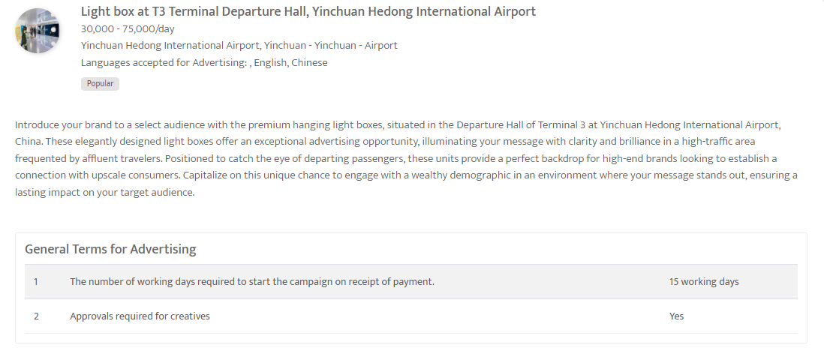

Slide 55
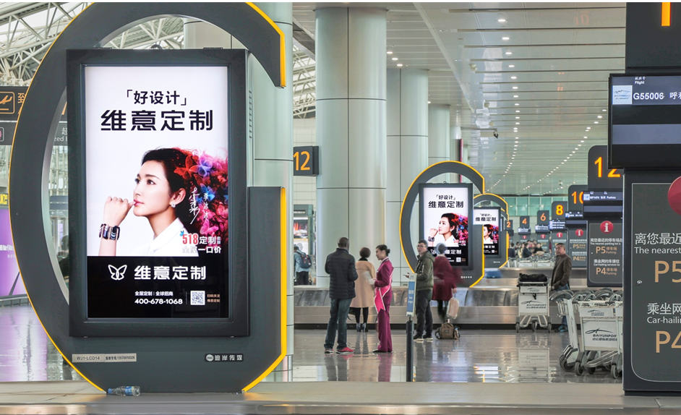
Guangzhou Baiyun International Airport, China
Digital screen package at T1 Arrival Baggage Carousel
Out of Home

Slide 56
Guangzhou Baiyun International Airport, China
Digital screen package at T1 Arrival Baggage Carousel
Out of Home
Details
Number of Screens: 16
Lighting type: Lit
Size: 0.9195 w x 1.5807 H
Single Rotation Time in Seconds: 270
Duration of creative in seconds: 5
Number of production: 1
Total number of months required: 1

Slide 57
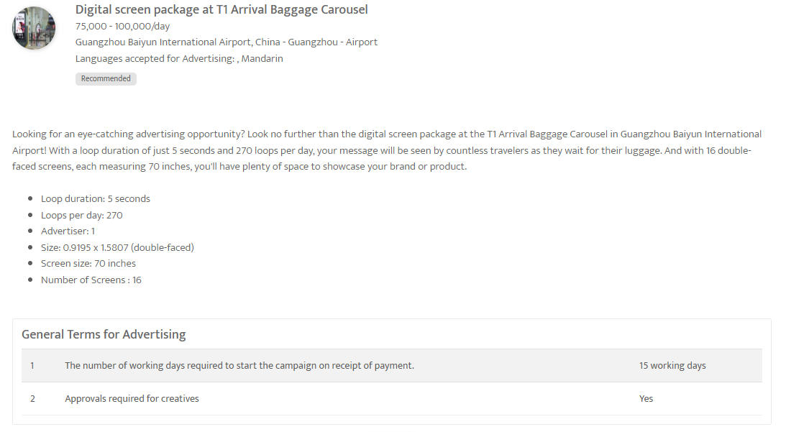

Slide 58
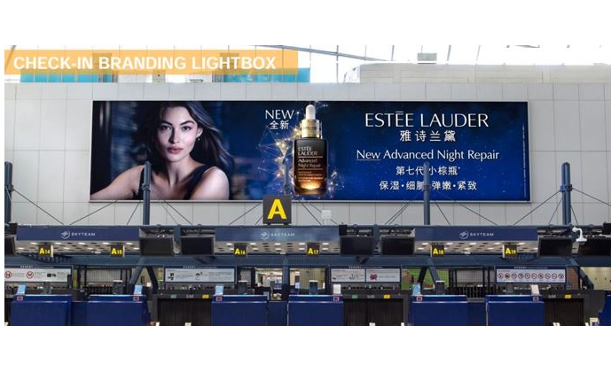
Beijing Capital Airport T2 Premium Check-in & Duty-Free Package
Lightboxes at T2, International Departures, Check-in hall & Duty-free area- Beijing Capital Airport
Out of Home

Slide 61
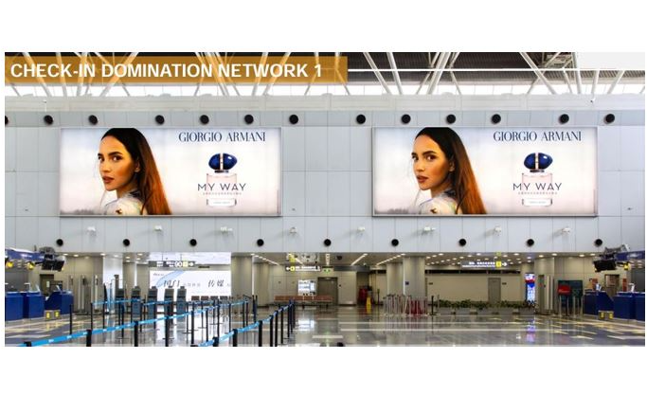

Slide 63
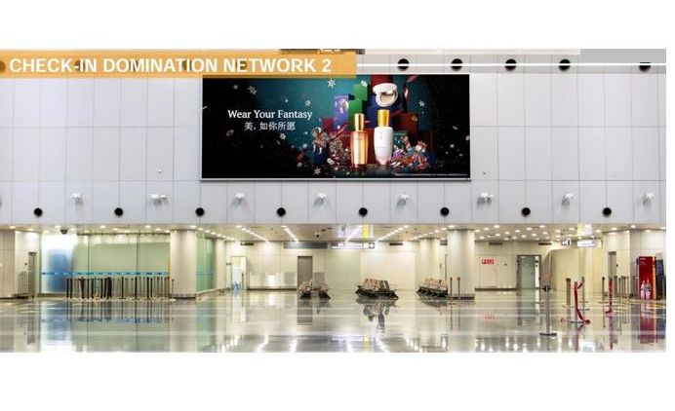

Slide 64
Beijing Capital Airport T2 Premium Check-in & Duty-Free Package
Lightboxes at T2, International Departures, Check-in hall & Duty-free area- Beijing Capital Airport
Out of Home
Details
Number of Screens: 8
Number of production: 1

Slide 65
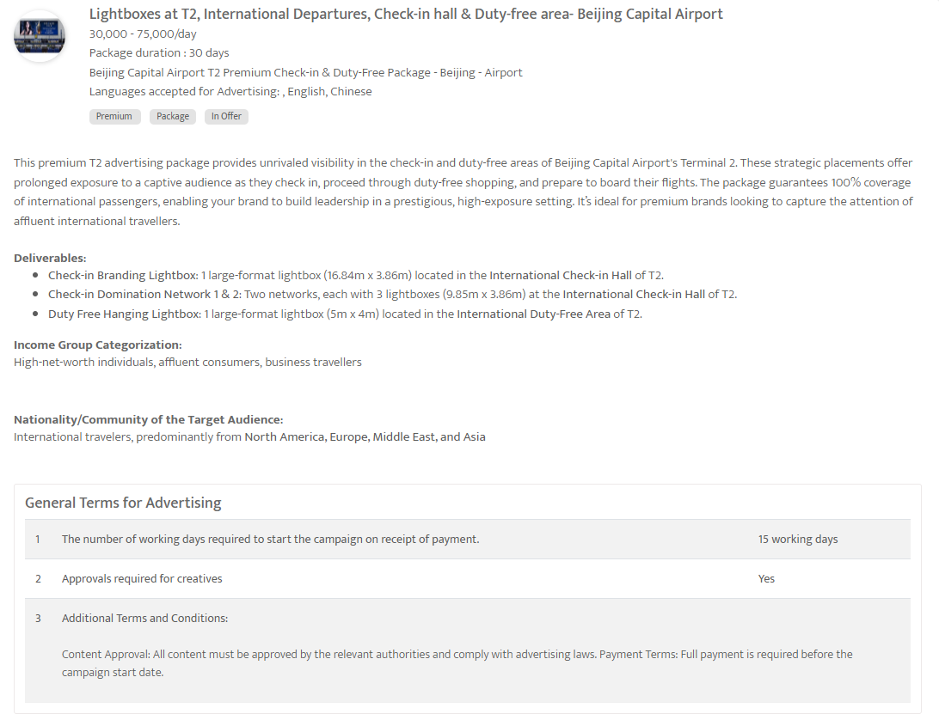

Slide 66
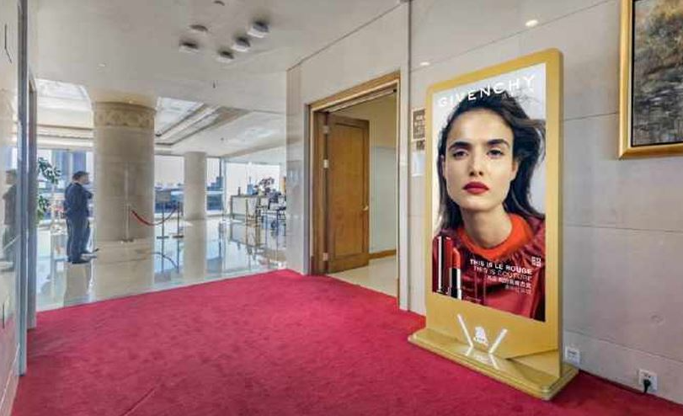
Beijing Capital International Airport, Beijing
Digital Screens at T3 VIP Lounge, Beijing Capital International Airport
Out of Home

Slide 67
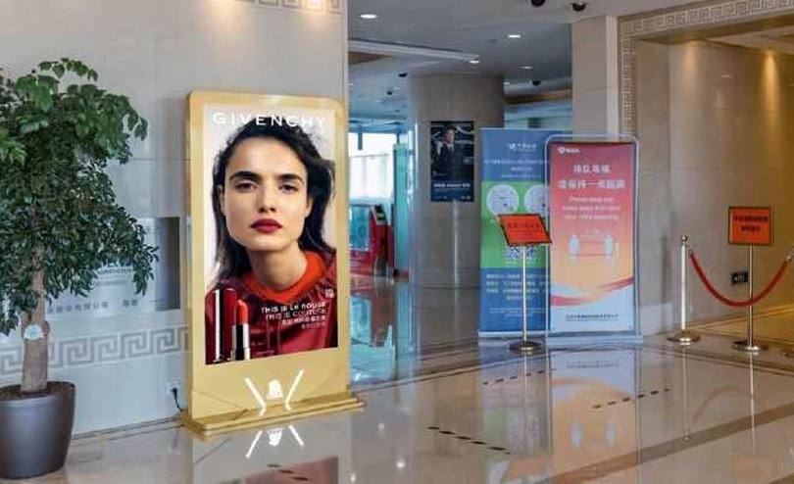

Slide 68
Beijing Capital International Airport, Beijing
Digital Screens at T3 VIP Lounge, Beijing Capital International Airport
Out of Home
Details
Number of Screens: 8
Lighting type: Lit
Size: 75 inches
Single Rotation Time in Seconds: None
Duration of creative in seconds: 10
Number of production: 1
Total number of months required: 1

Slide 69
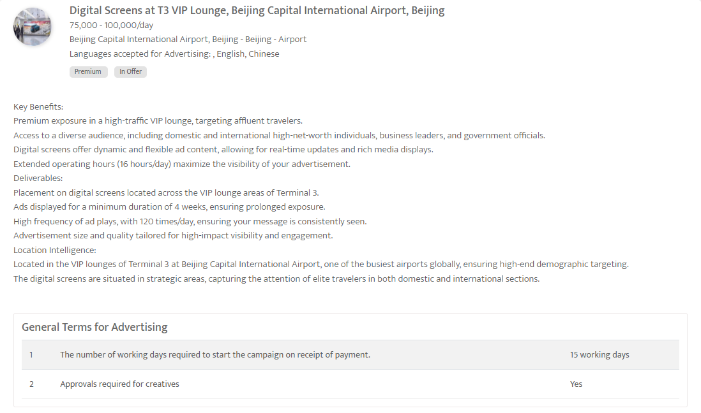

Slide 70
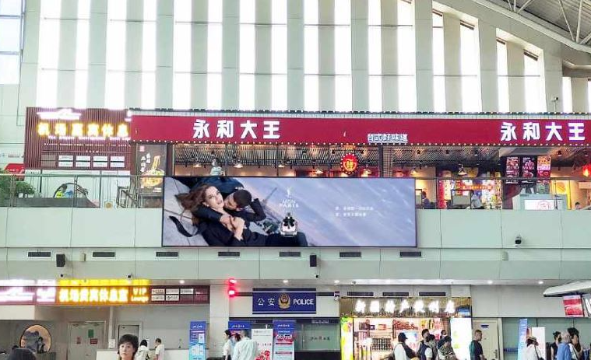
Ürümqi Diwopu International Airport, Ürümqi, China
LED Screen at Check-in Hall, Ürümqi Diwopu International Airport
Out of Home

Slide 71
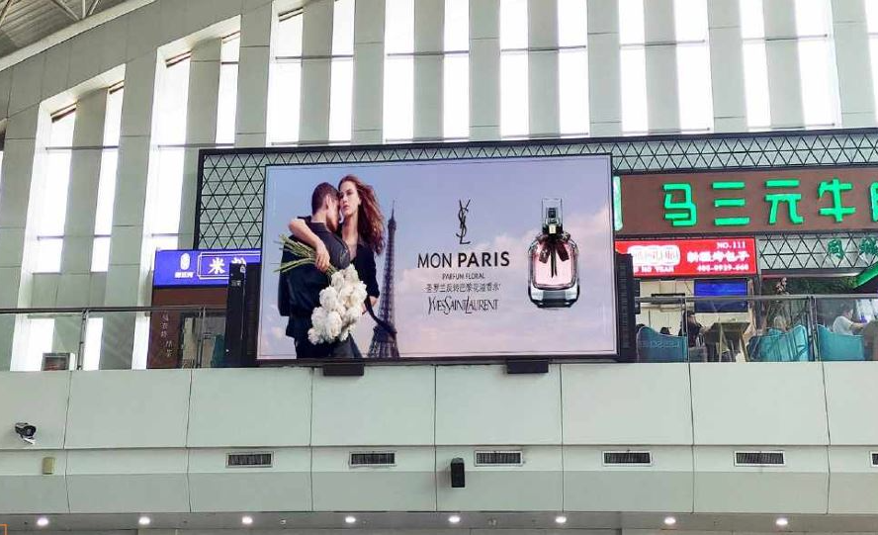

Slide 72
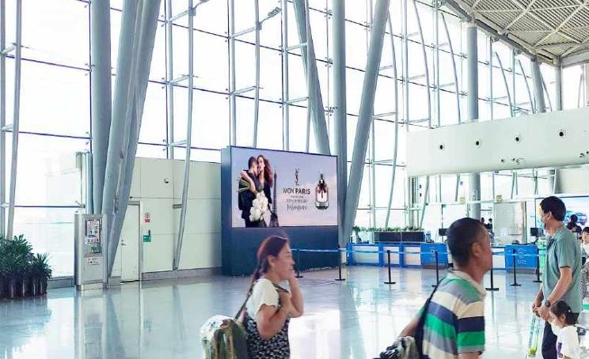

Slide 73
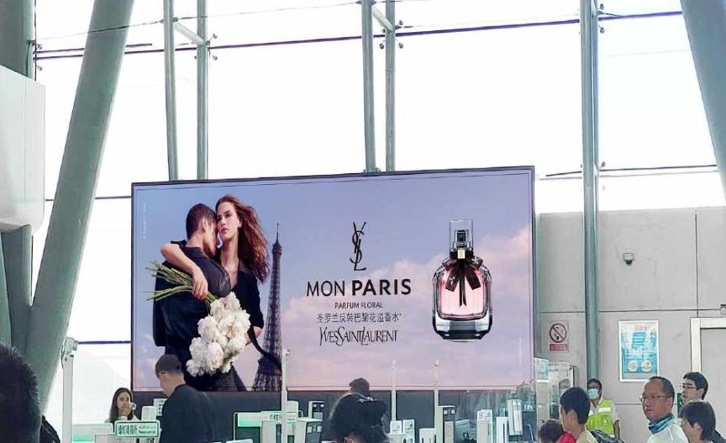

Slide 74
Ürümqi Diwopu International Airport, Ürümqi, China
LED Screen at Check-in Hall, Ürümqi Diwopu International Airport, China
Out of Home
Details
Number of Screens: 4
Lighting type: Lit
Size: 1.8m×8m=14.4m2/piece | 3m×6m=18m2/piece | 2.5m×5.5m=13.75m2/piece | 2.5m×5.6m=14m2/piece
Single Rotation Time in Seconds:
Duration of creative in seconds: 10
Number of production: 1
Total number of months required: 1

Slide 76
Boost Visibility: China's Prime Airport Ad Package Beijing
Triple Airport Advertising Reach-China
Out of Home

Slide 79
Boost Visibility: China's Prime Airport Ad Package Beijing
Triple Airport Advertising Reach
Out of Home
Details
Number of Screens: TBC
Number of production: 1

Slide 81
Xi'an Xianyang International Airport
LED large screen-above the security check, domestic departure check-in hall of Terminal 2
Out of Home

Slide 82
Xi'an Xianyang International Airport
LED large screen-above the security check, domestic departure check-in hall of Terminal 2
Out of Home
Details
Number of Screens: 1
Lighting type: Lit
Size: 2.88m×16.32m
Number of production: 1
Total number of months required: 1

Slide 84
Signature Global Reach Package – Beijing Capital Airport T3
LED screen network at T3E International Departure Corridors, Beijing Capital Airport
Out of Home

Slide 87
Signature Global Reach Package – Beijing Capital Airport T3
LED screen network at T3E International Departure Corridors, Beijing Capital Airport
Out of Home
Details
Number of Screens: 38 ad faces
Number of production: 1

Slide 89
Newspaper

Slide 90
21st Century Business Herald, Newspaper, China
Prime Ad Placements in 21st Century Business Herald, Newspaper
Newspaper

Slide 91
21st Century Business Herald, Newspaper, China
Prime Ad Placements in 21st Century Business Herald, Newspaper
Newspaper
Details
Frequency: Daily
Size: TBC
Standard Positions: Full page
Number of production: 1
Number of insertions required: 1

Slide 93
China Daily - Full page ad on Inside pages
Newspaper

Slide 94
China Daily - Full page ad on Inside pages
Newspaper
Details
Frequency: Daily
Size: 50cm H x 30.8cm W
Premium Positions: Full page
Number of production: 1
Number of insertions required: 1

Slide 96
Economic Daily - Full page ad on inside pages
Newspaper

Slide 97
Economic Daily - Full page ad on inside pages
Newspaper
Details
Frequency: Daily
Size: TBC
Standard Positions: Full page
Number of production: 1
Number of insertions required: 1

Slide 99
Thank You
media@masscomglobal.com | www.masscomglobal.com
Masscom Global FZE, Office No: 220, One UAQ Building, UAQ Free Trade Zone, Umm Al Quwain, United Arab Emirates.

