Slide 1
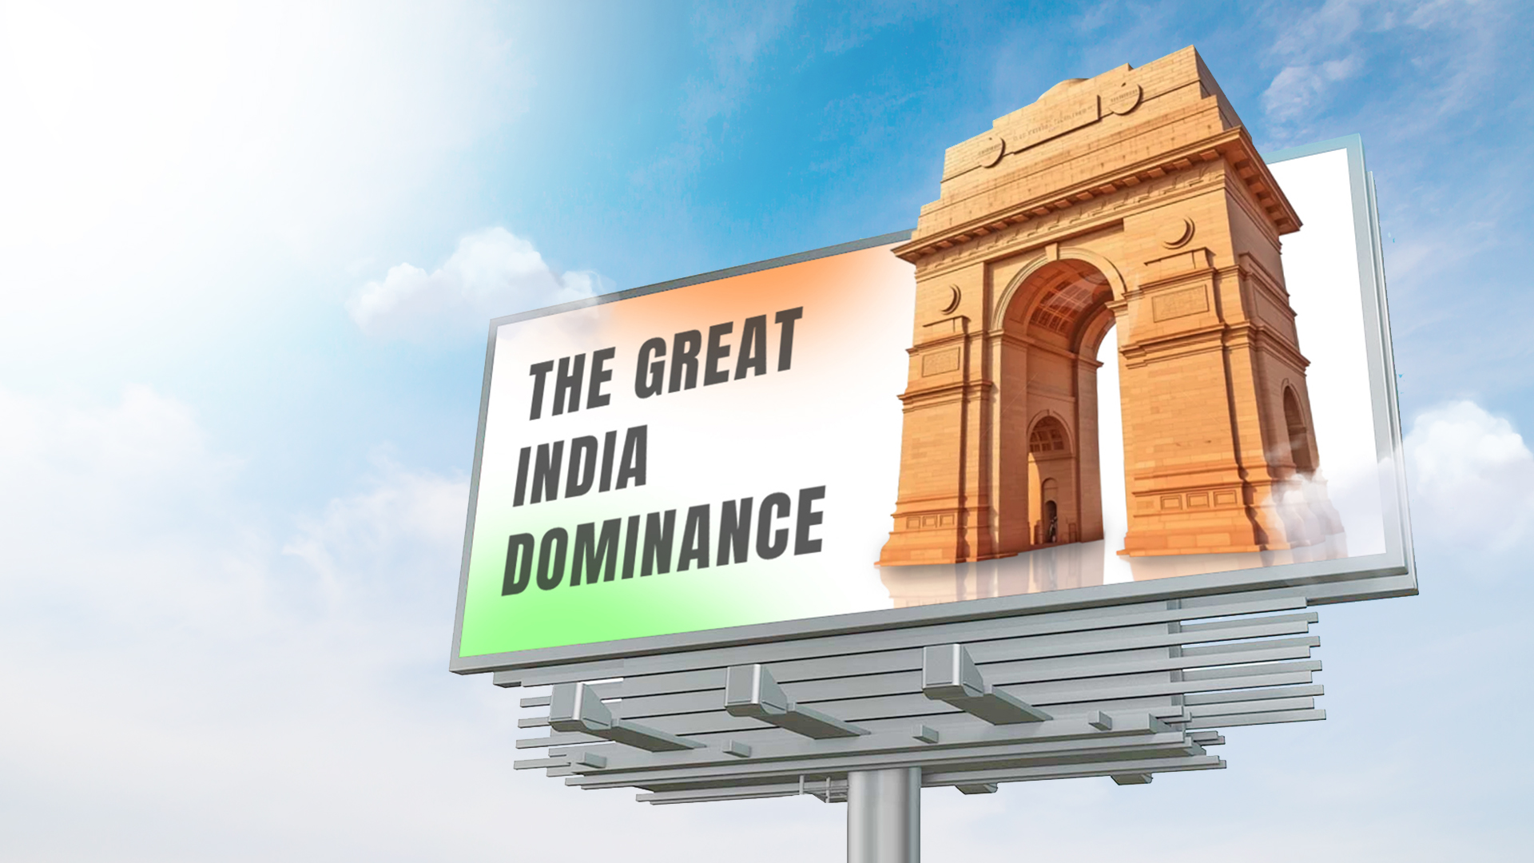
www.masscomglobal.com

Slide 2
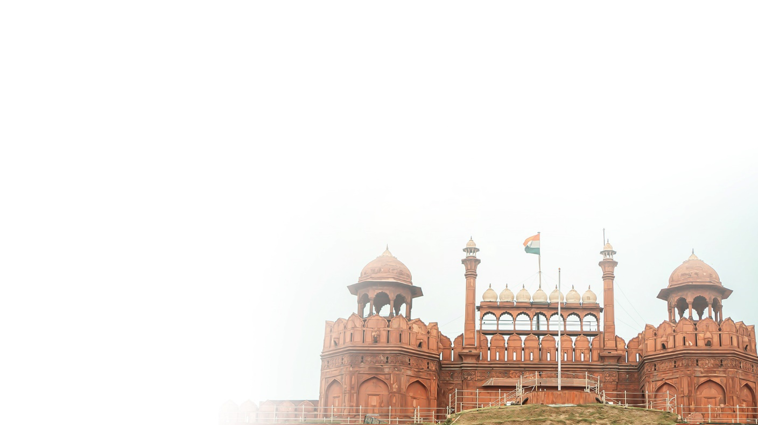
The Great India Dominance
Gain unparalleled access to 13 of India's top tier airports, securing prime visibility in high-impact zones. Seamlessly integrate your brand into the journeys of high-net-worth individuals, business leaders, and luxury consumers at India’s most exclusive airports. A nationwide execution delivering unmatched exposure in premium environments. Position your brand at the heart of influence, ensuring top-of-mind recall where it matters most. From March to May 2025, India’s dynamic event calendar is set to create an unprecedented surge in consumer engagement, travel, and luxury spending. This period is packed with high-energy sports action, vibrant cultural festivities, and summits.
www.masscomglobal.com

Slide 3
Prime Airports Recommendations

Slide 4
Delhi
International Airport
The airport handled over 73.6 million passengers, including 19 million international passengers and t is expected to handle 82.7 million passengers by 2026.

Slide 5
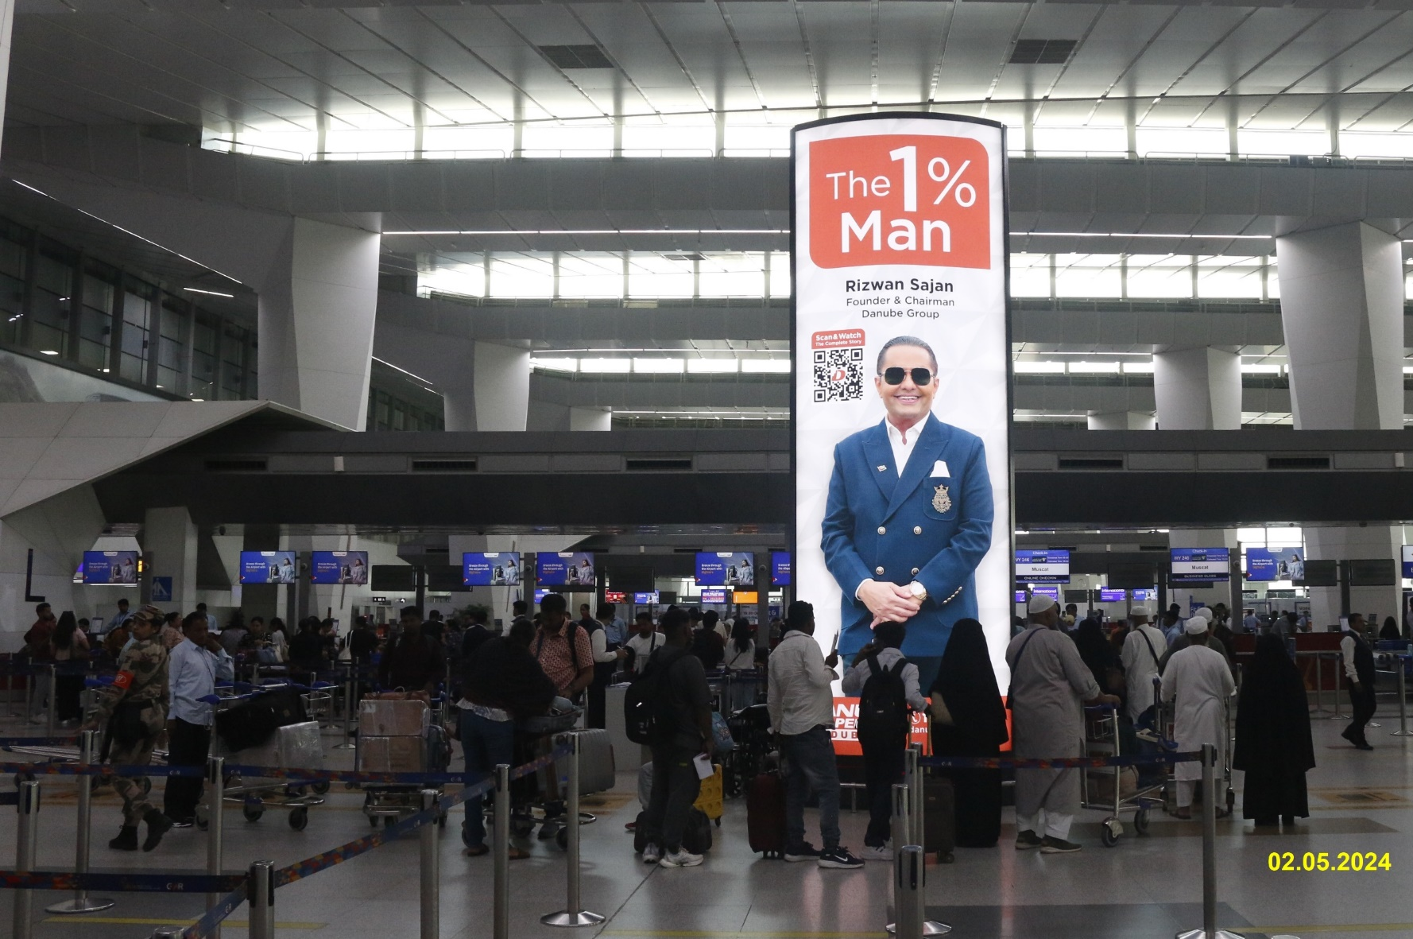
T3 International Departures
3 Totems- Check in Hall
Location
T3 Departures (Check-in Area)
Size of Media
15’2” x 3’8” each unit
Media Units
3 Faces in each package
Format
Backlit Static Media (Totems)

Slide 6
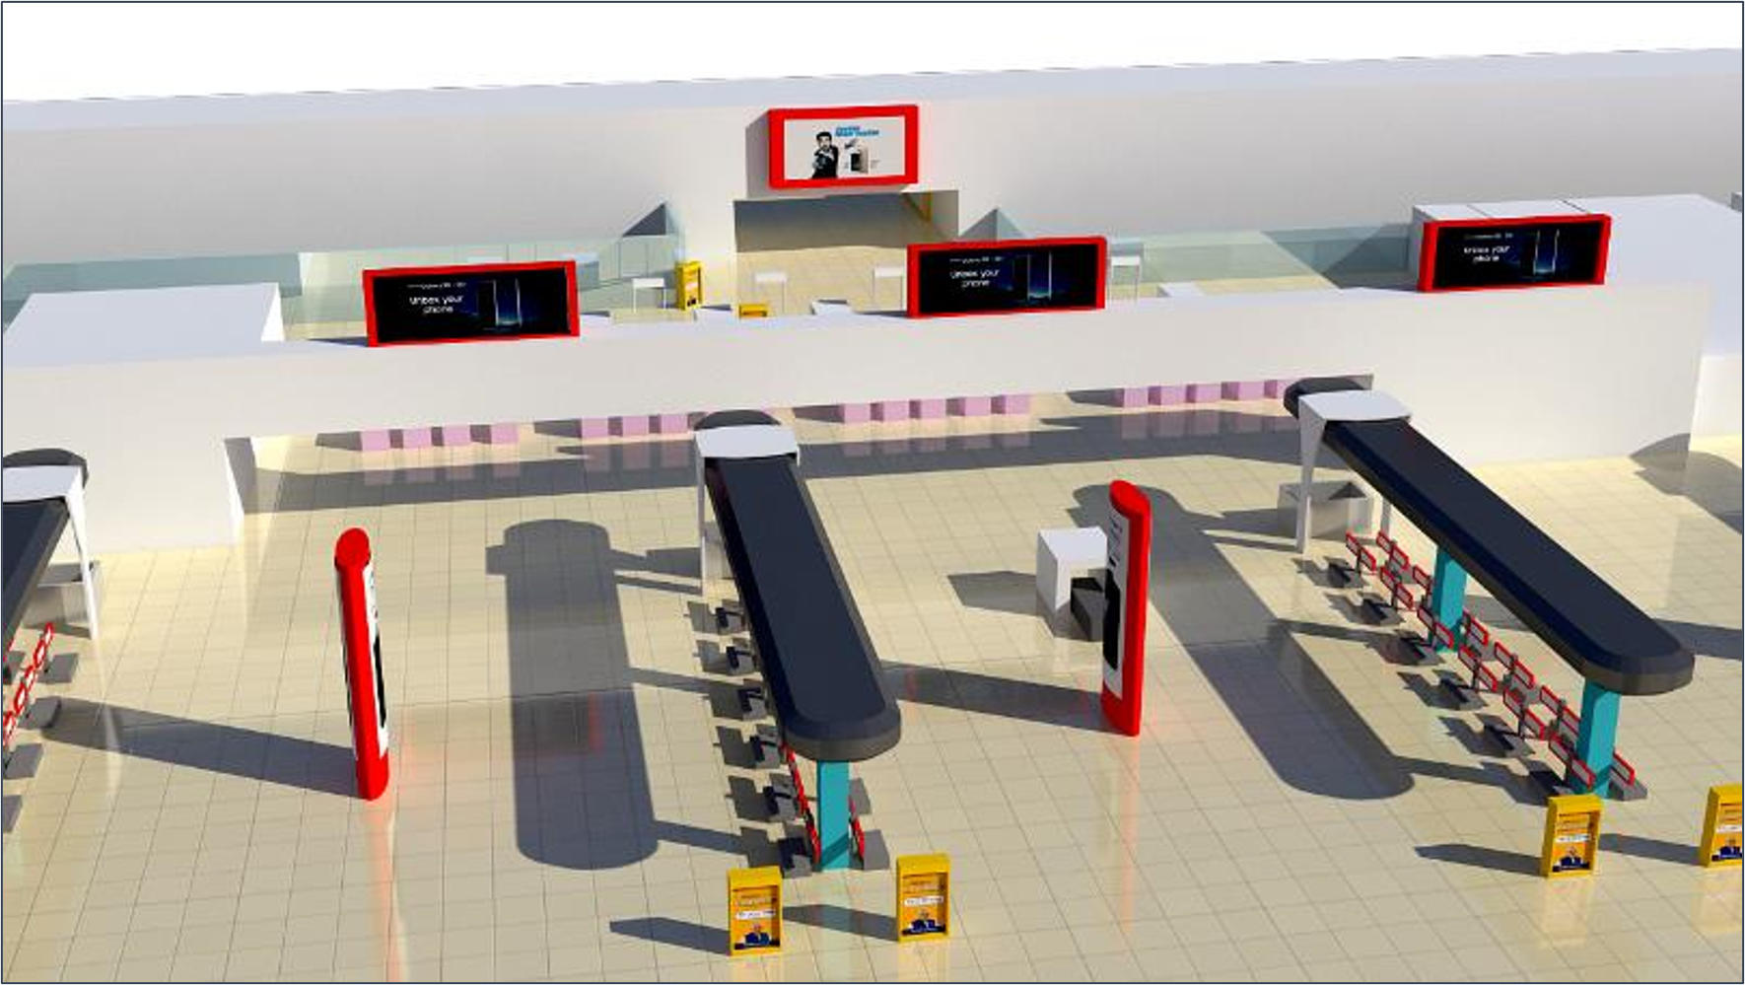
3 Totems Check in Hall (Map View)

Slide 7
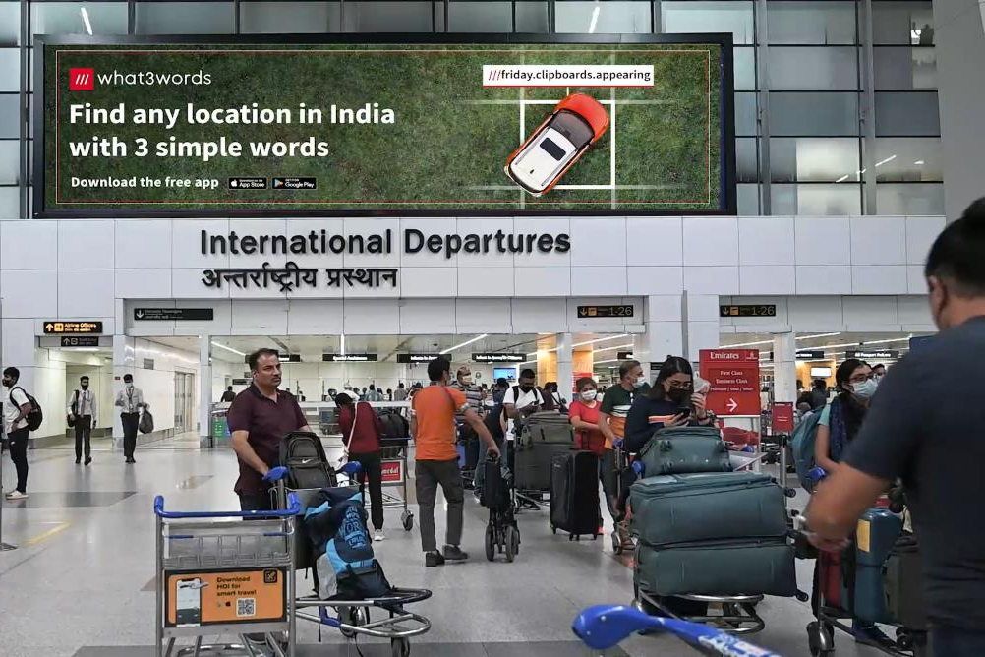
T3 International Departures
Site no. 12
Location
T3 Departures (Check-in Area)
Size of Media
60’ X 15’
Media Units
1
Format
Ambient lit Static Media

Slide 8
Site No 12 (Map View)
12

Slide 9
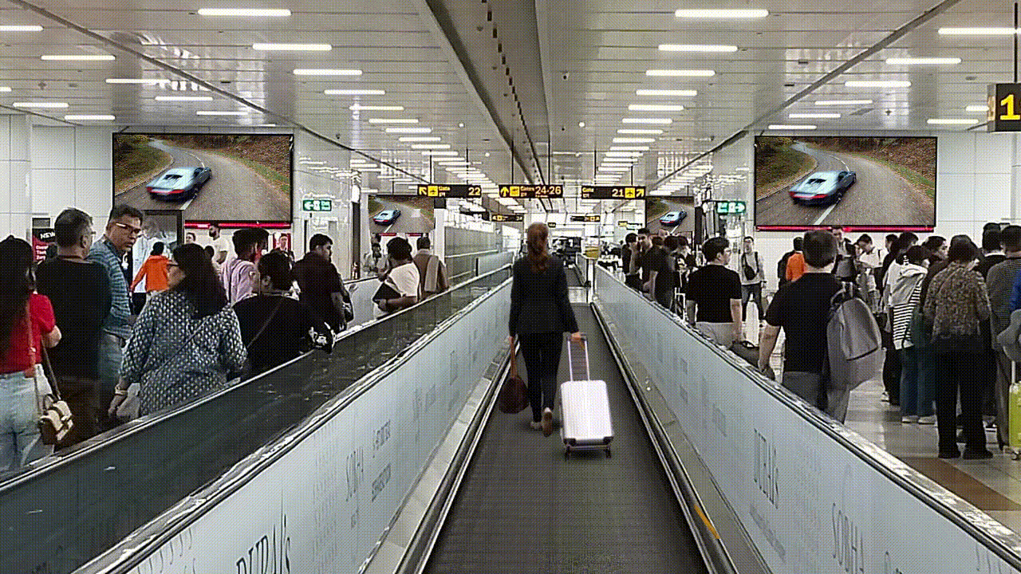
T3 International Departures
International Digital Arcade
High-Impact Large Format
11-Videowalls Int’ll Digital Arcade Network
At Highest Dwell-time Location of Boarding Gates

Slide 10
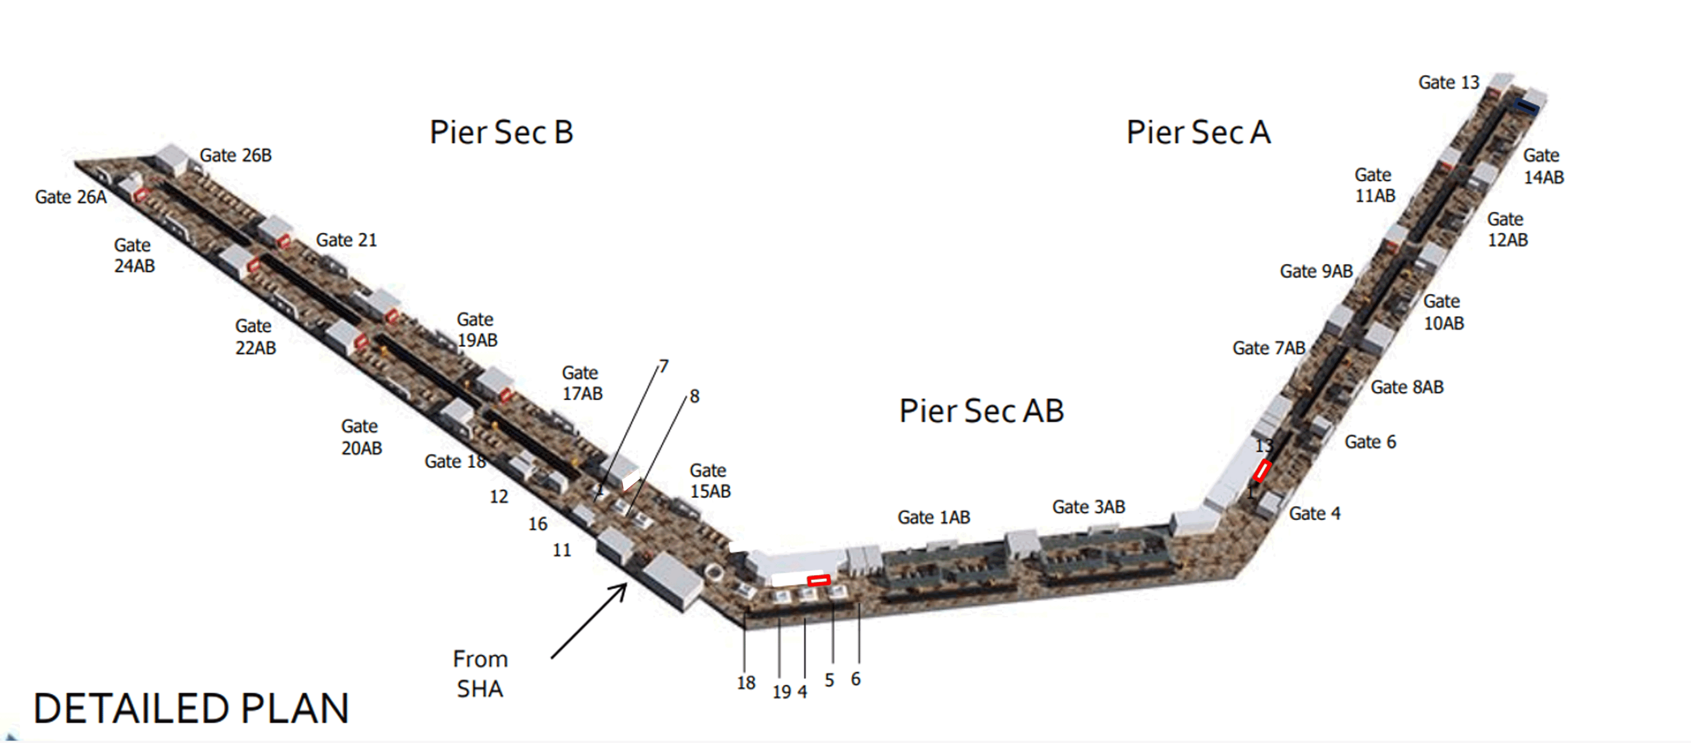
International
Digital Arcade (Map View)

Slide 11
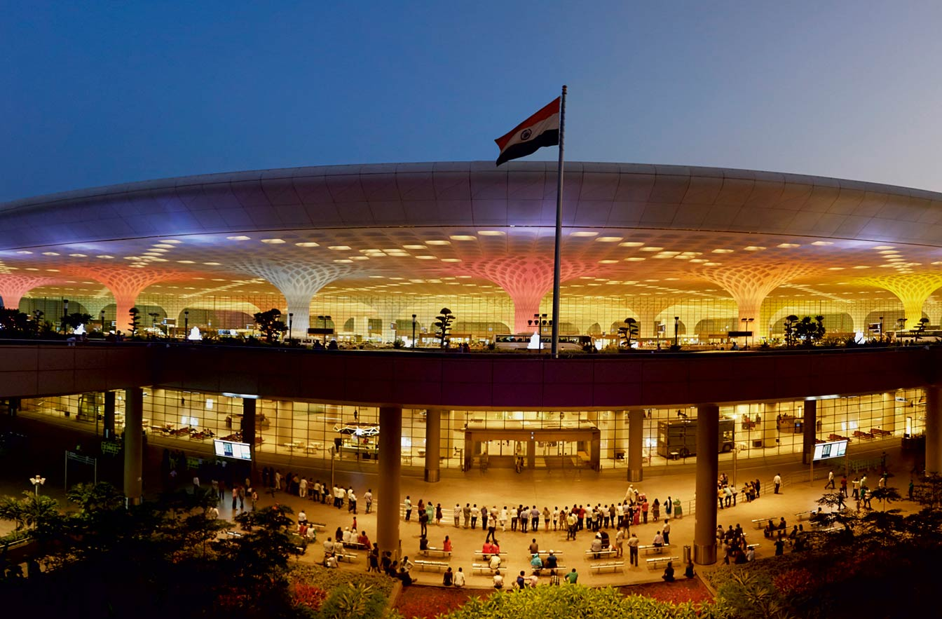
Mumbai
International Airport
Mumbai International Airport handles approximately 52.8 million passengers, with over 14 million being international travelers, with a significant amount of them being HNWI and business focused audience.

Slide 12
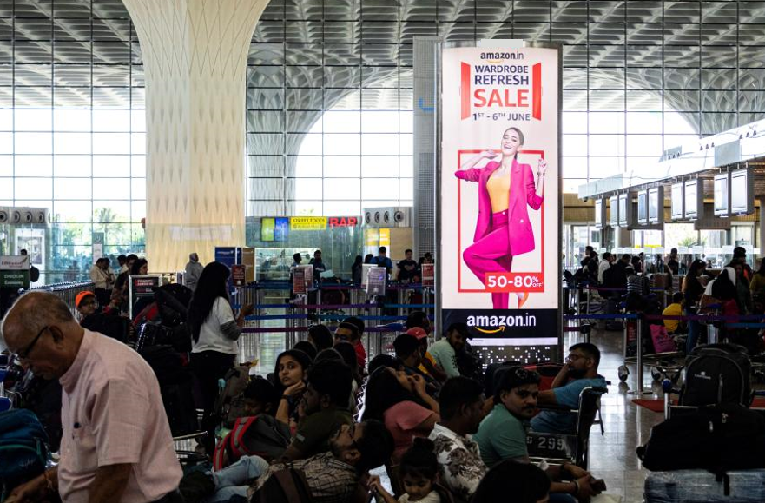
First impression
Totems-
Double sided,
Light box
Site USP 100% visibility to all international and domestic departing passengers Location : L4 Entry

Slide 13
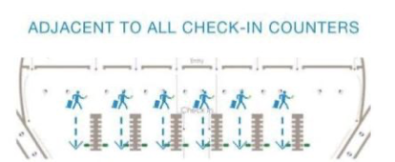
First impression​
​Totems (Map View)

Slide 14
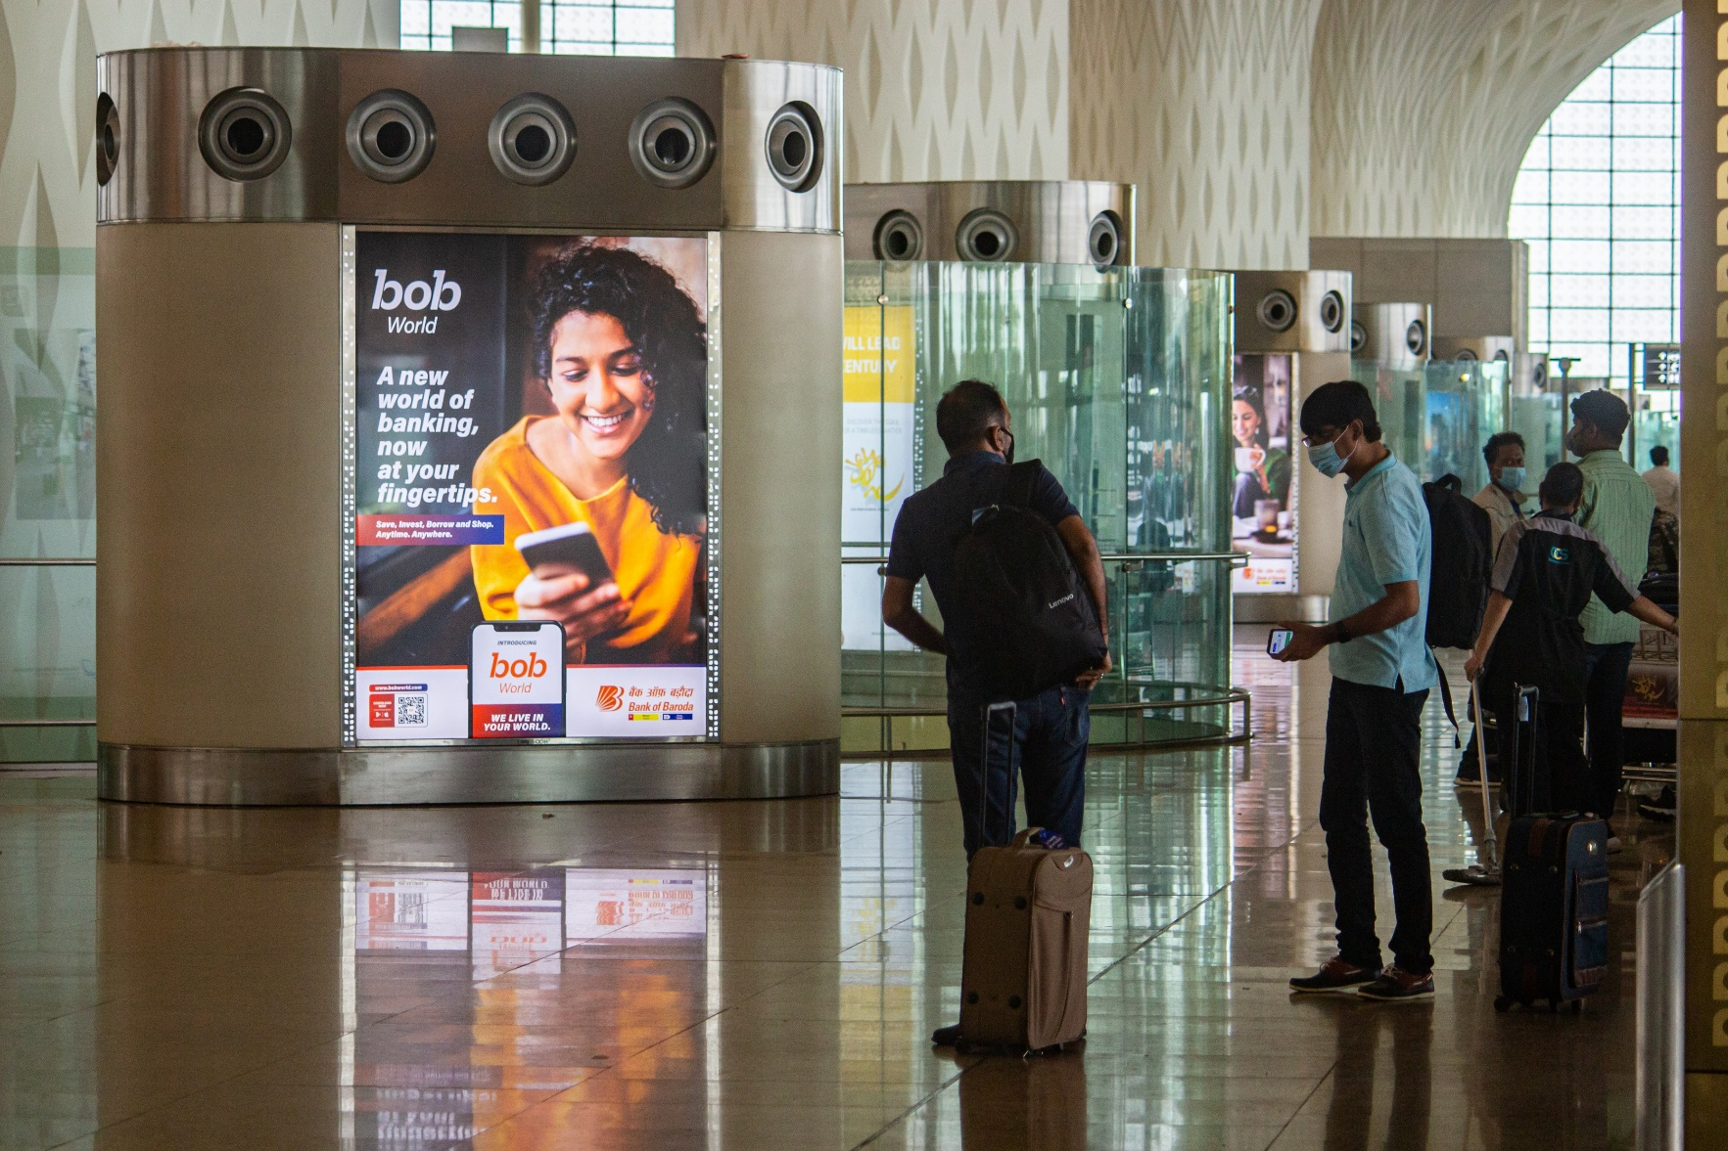
Welcome Package
Quad tower,
Light box
Site USP 100% departure audience targeted
Location : L4 Entry

Slide 15
Welcome
Package
(Map View)

Slide 16
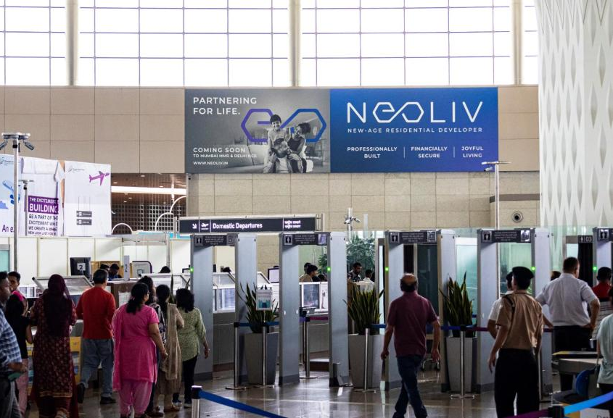
Arch SAV (pack of 2)
2 Packaged
static sites LHS
and RHS at security
check terminal 2
Site Dimensions : 40”3’X10”10’ft for 2 units

Slide 17
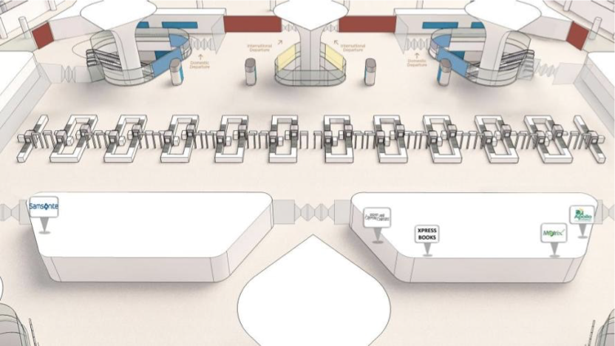
Arch SAV
(pack of 2)
(Map View)

Slide 18
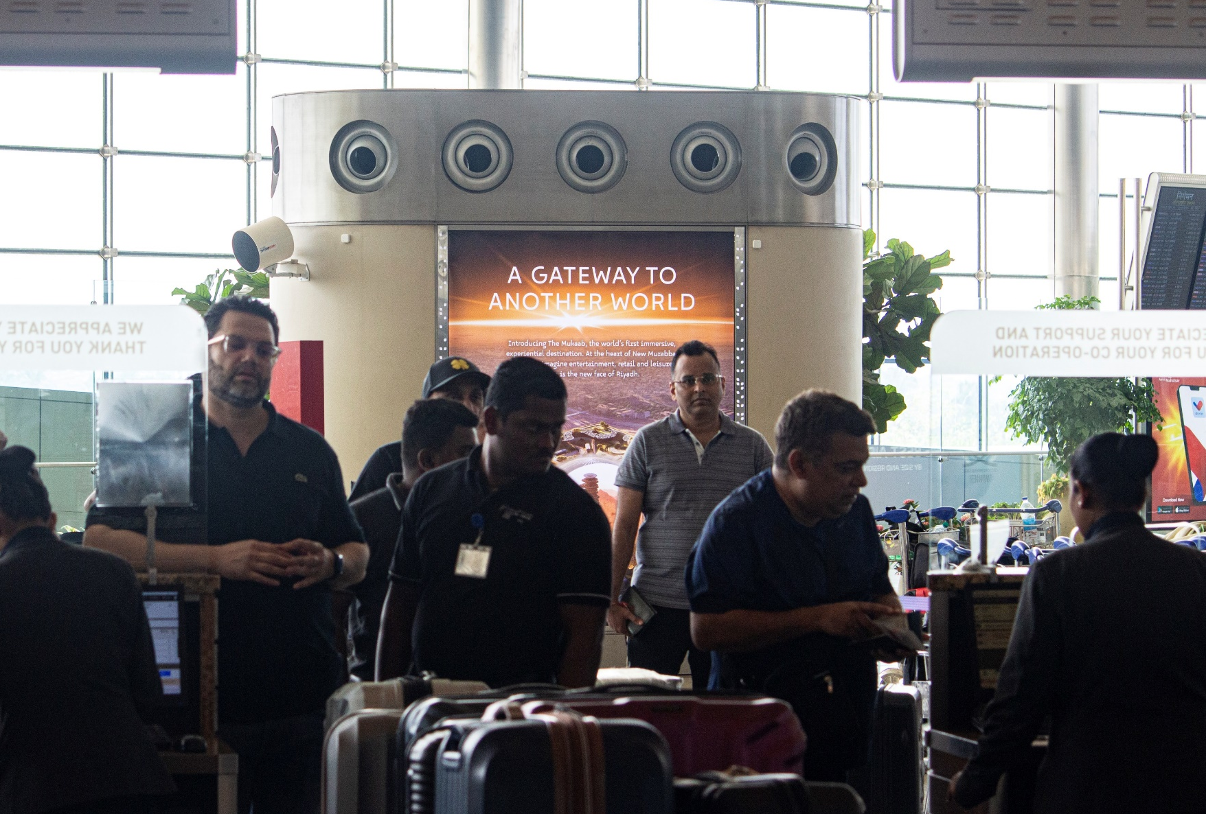
Red carpet Package
International
Departures –
Quad Towers (4)

Slide 19
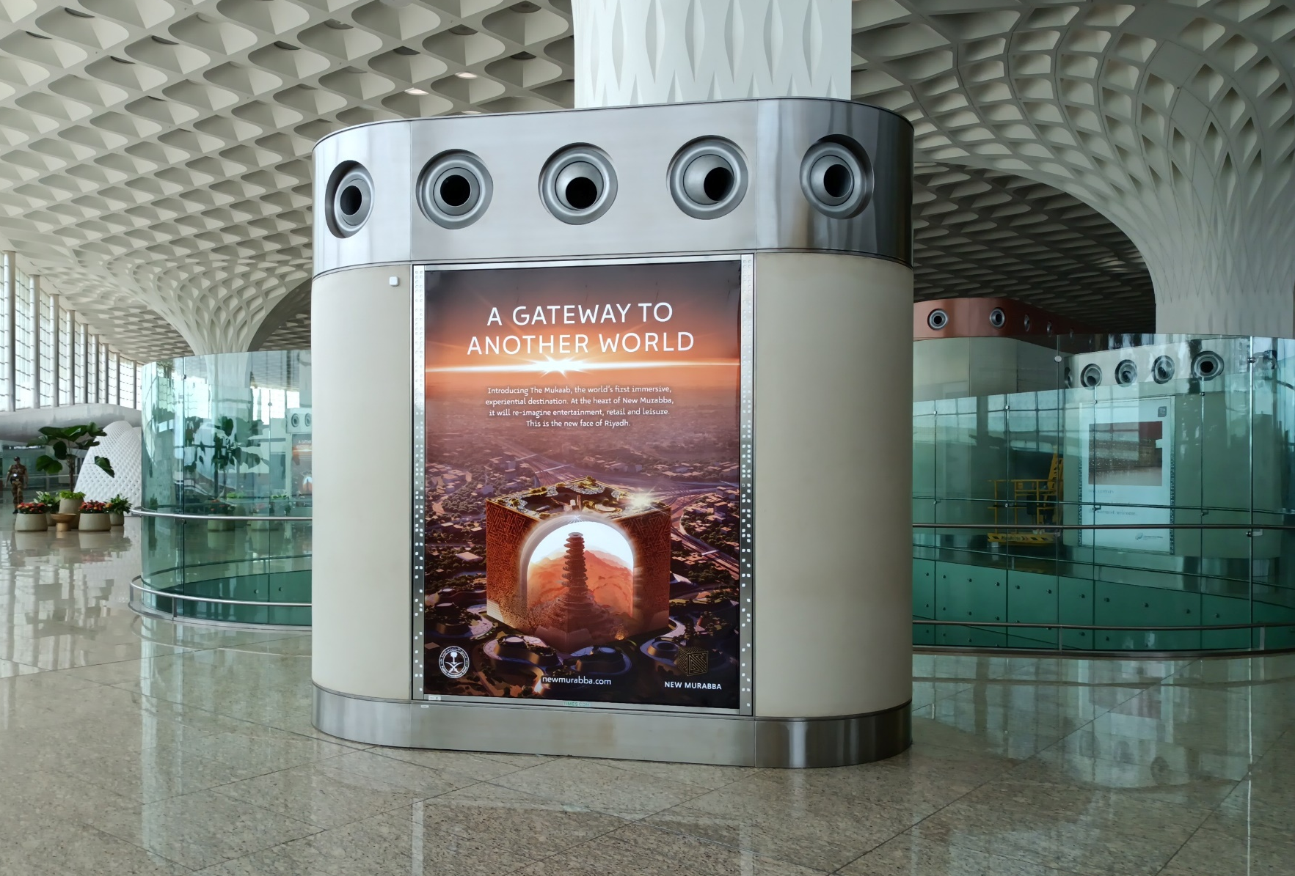
Red carpet Package
International
Departures –
Quad Towers

Slide 20
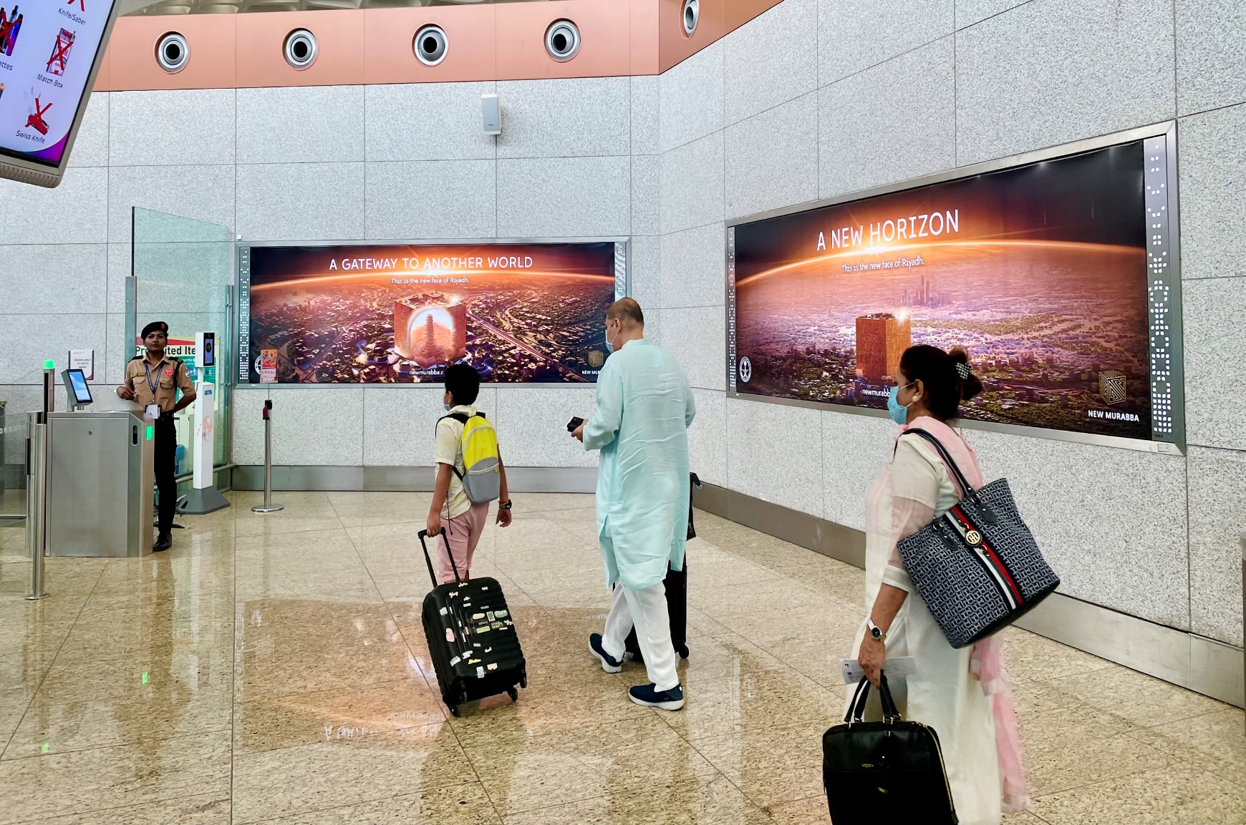
Red carpet Package
International
Departures –
Light Boxes (8)
Location Dedicated corridor from Entry to Security Check

Slide 21
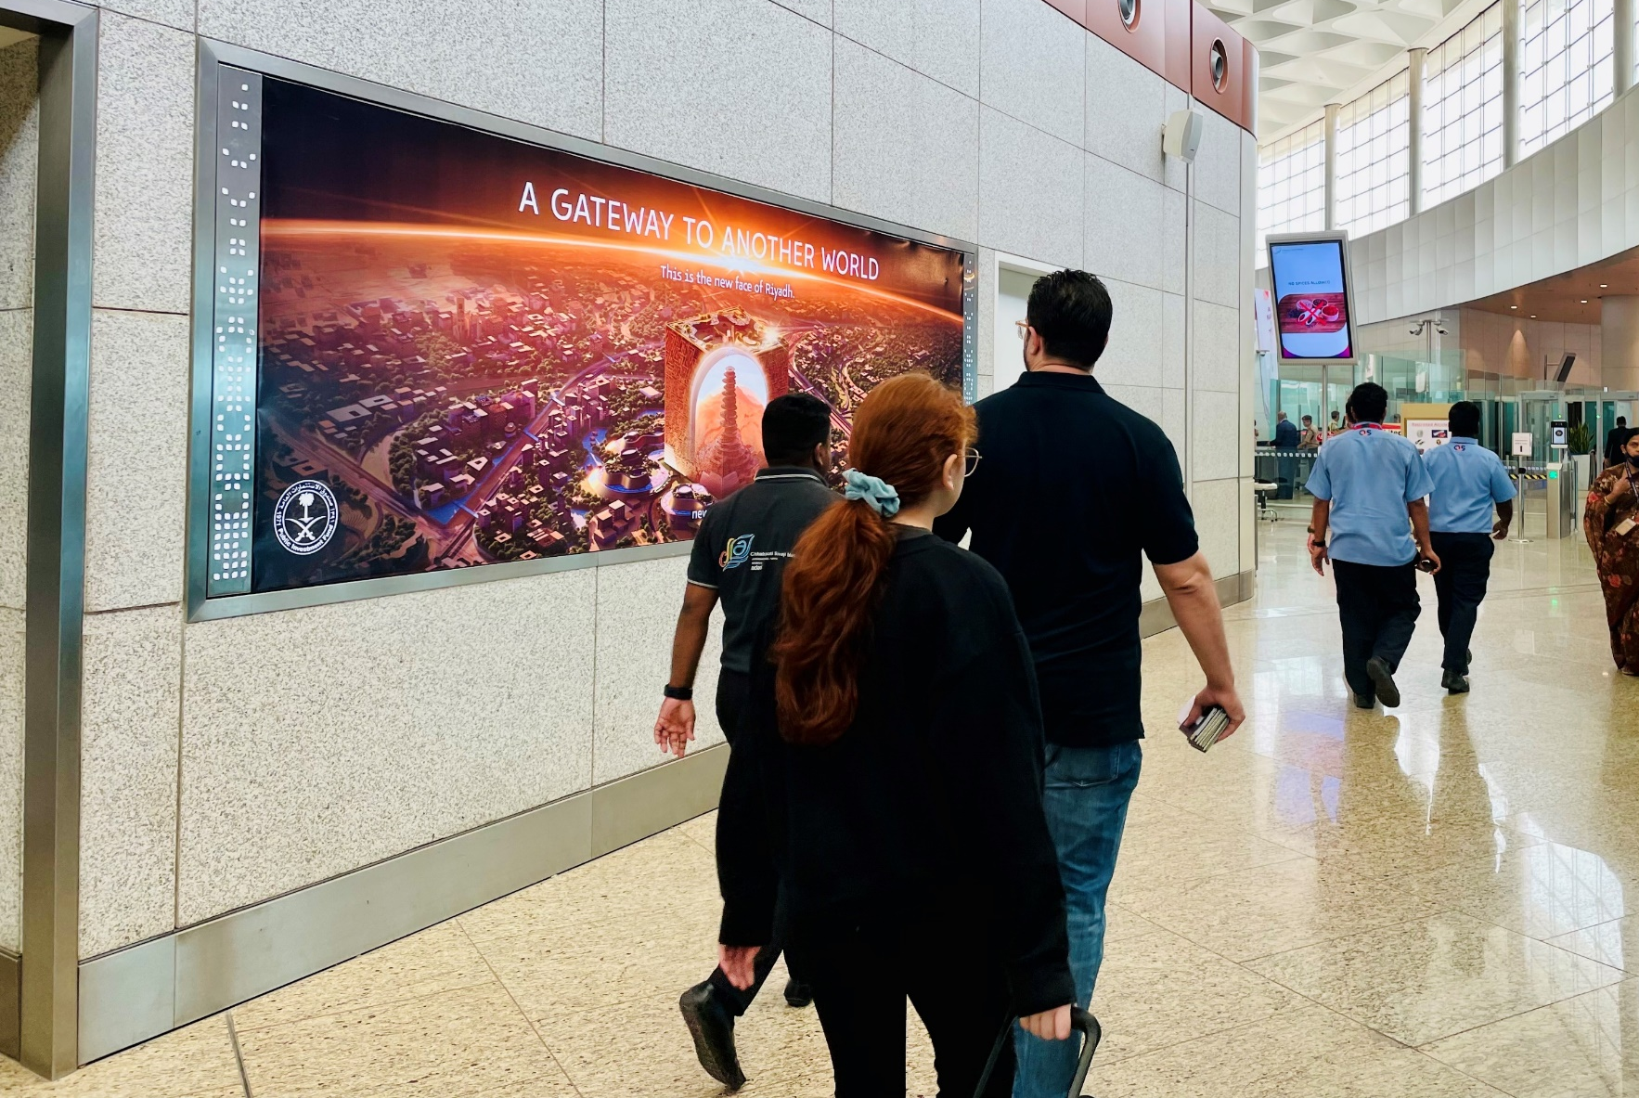
Red carpet Package
International
Departures
Targets crème de la crème of Mumbai Airport, who are among India’s most affluent celebrities/politicians/industrialists etc.

Slide 22
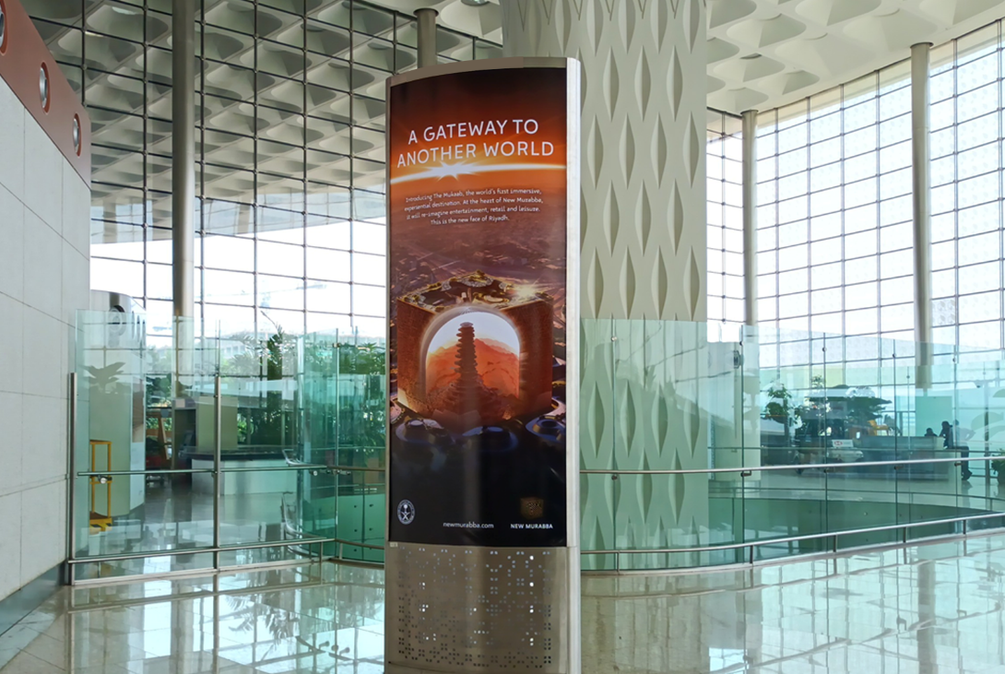
Red carpet Package
International
Departures –
Totems (2)

Slide 23
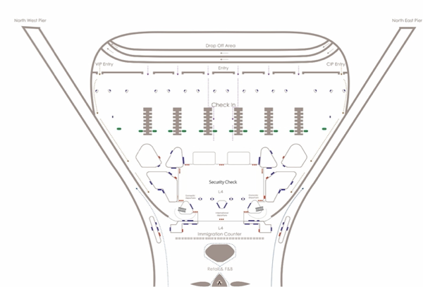
Red Carpet
Package
(Map View)

Slide 24
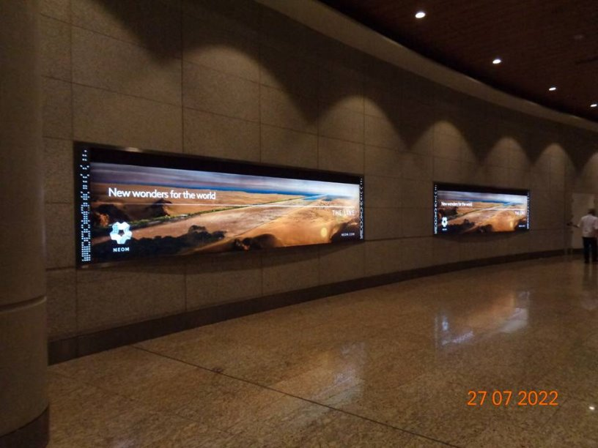
TICKER SITES 1 & 2
Entry of the North-West Pier close Units: 2 Site USP Sites at Pier entrance
Passengers in a receptive frame of mind and high dwell time to focus on brand advertising

Slide 25
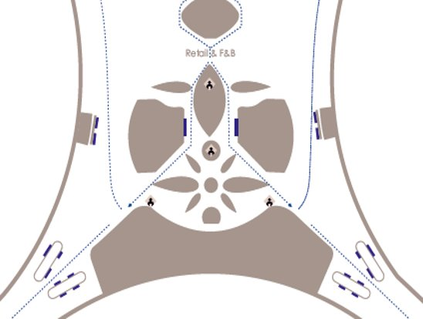
Map View
09
08
Light Box

Slide 26
Bangalore International Airport
Bengaluru International Airport hosts record passenger traffic of 40.73 million passengers

Slide 27
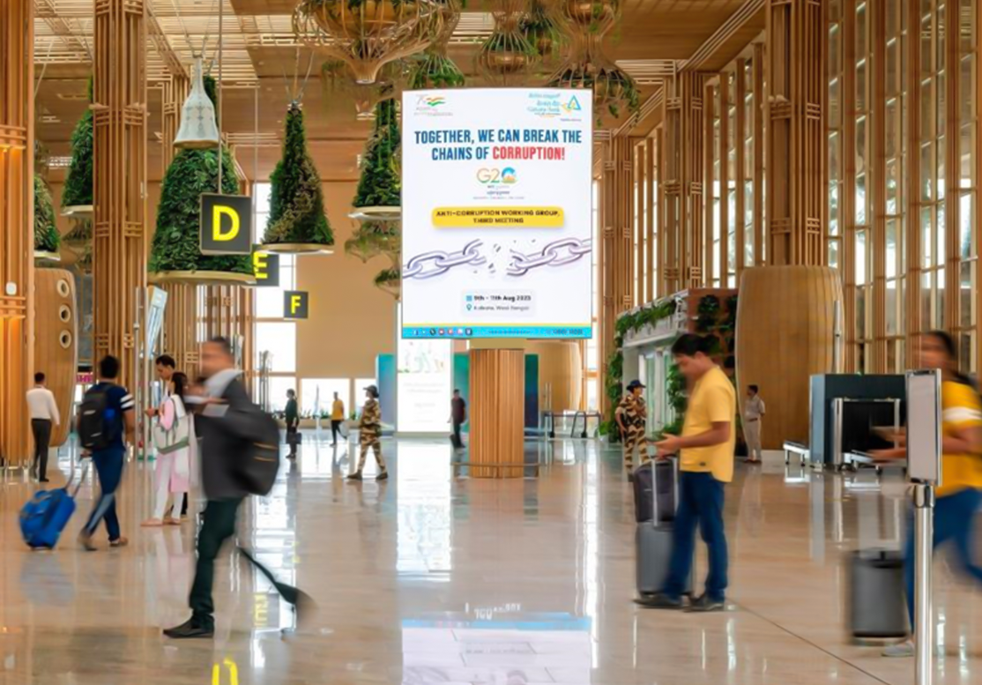
Landmark
Rotating Led
Check In Hall Common
MEDIA BENEFITS
Create a bold first impression with your audience.
360% rotating LED screen, first of its kind in India to effectively broadcast brand message to the passengers
Iconic landmark site strategically located at the check in Hall
Captures attention of 100% departing passenger

Slide 28
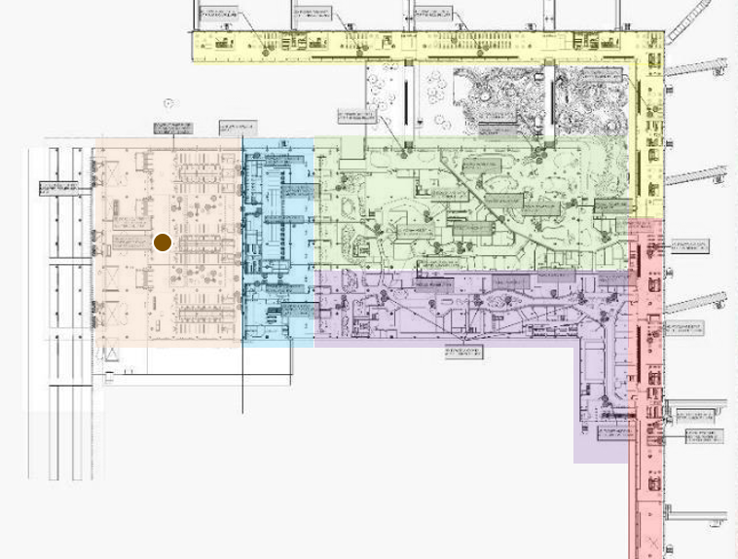
Landmark
Rotating Led
Check In Hall Common
LOCATION
Level: 3
Area: Check In Hall
Audience: Common
Site Code: CH01RD
Quantity: 1 Nos. (Double Sided)
No. of Clients: 06
Format (WxH): 9.8 x14.7 Ft
DYNAMIC CONTENT
Contextually relevant digital ads can be run on digital media targeting Location, Weather, Temperature, Time of Day, Social Feed plugin, Data Feed (Flight updates, Sports updates, Live News), Language and Live Telecast.

Slide 29
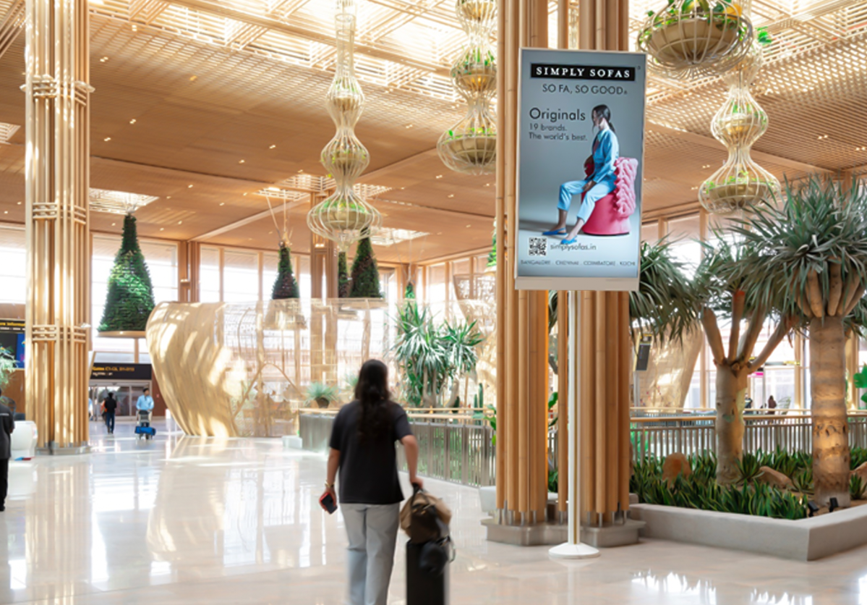
Digital pole Mounted Mupi
International Departure Post Duty Free
MEDIA BENEFITS
Unique, Dominating and Eye-Attracting Digital display located at a key location Capture attention of 100% international departing passengers and communicate to highly receptive audience Display your message by having limitless creativity to broadcast in network format at international duty free

Slide 30
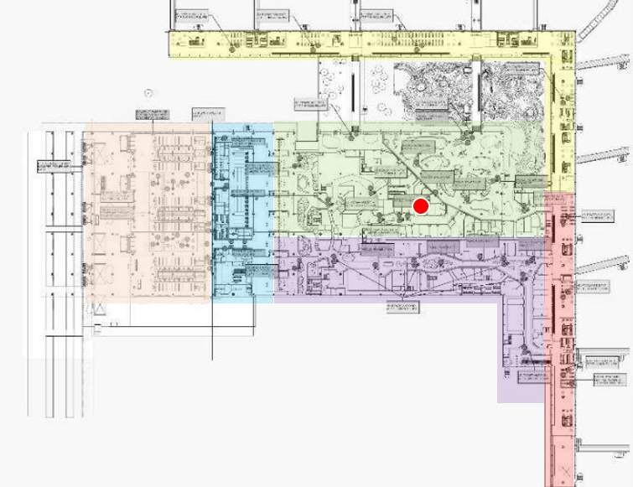
Digital pole Mounted Mupi
International Departure Post Duty Free
LOCATION
Level: 3
Area: International Post Duty Free
Audience: International Departure
Site Code: IR01DM
Quantity: 1 Nos.
No. of Clients: 06
Format (WxH): 85” LCD Screen
Spot Duration: 10 sec
DYNAMIC CONTENT
Contextually relevant digital ads can be run on digital media targeting Location, Weather, Temperature, Time of Day, Social Feed plugin, Data Feed (Flight updates, Sports updates, Live News), Language and Live Telecast.

Slide 31
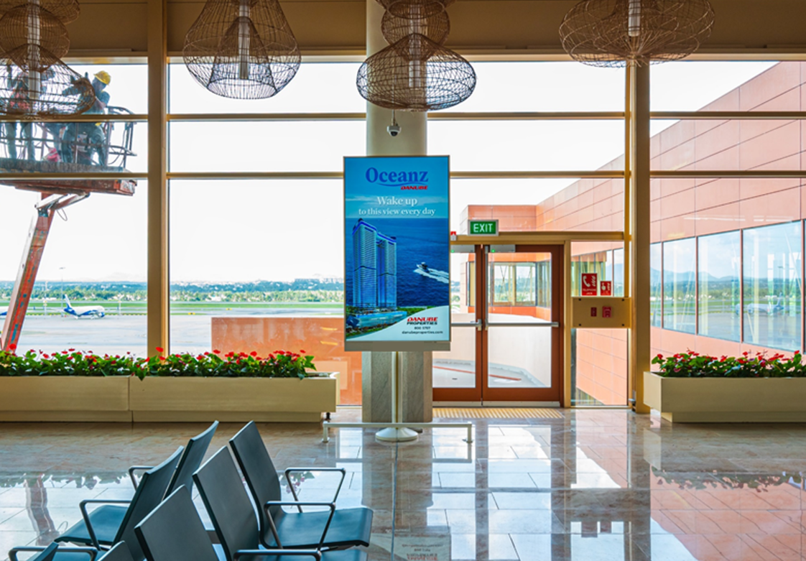
Digital pole Mounted Mupi
Boarding Lounge International Departure
MEDIA BENEFITS
Strategically located at the boarding area, this network optimizes reach with 100% international departure passengers
Communicate to domestic departing passengers in a relaxed frame of mind with high dwell time
Capture the attention of your target audience by associating your brand and enhance brand recall

Slide 32
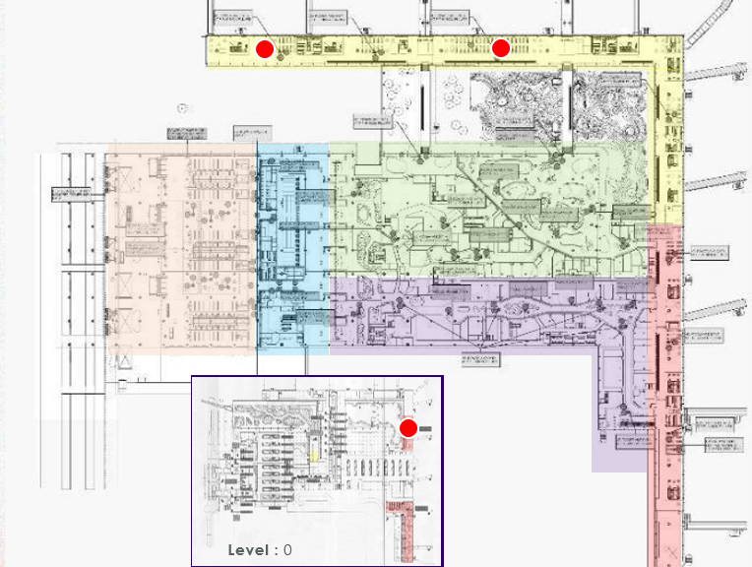
Digital pole Mounted Mupi
Boarding Lounge International Departure​
LOCATION
Level : 3
Area: Boarding Lounge
Audience: International
Site Code: IBL01DM – IBL03DMT2
Quantity: 3 Nos.
No. of Clients: 06
Format (WxH): 85”
DYNAMIC CONTENT
Contextually relevant digital ads can be run on digital media targeting Location, Weather, Temperature, Time of Day, Social Feed plugin, Data Feed (Flight updates, Sports updates, Live News), Language and Live Telecast.

Slide 33
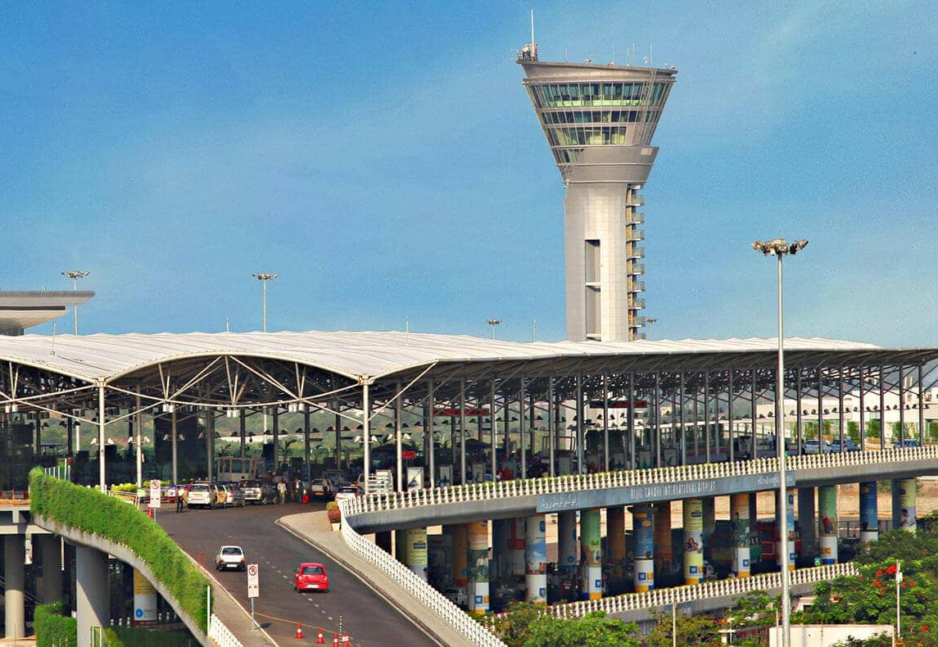
Hyderabad International Airport
Hyderabad International airport handles over 25 million passengers, marking a 19% increase from the previous year. This growth included a 23.2% surge in international travelers.

Slide 34
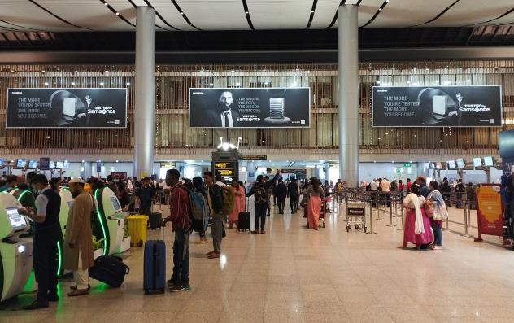
International Check-in-Hall : Wall Mount
The Wall Mount at Check-in-Hall welcomes the passenger audience at the International Airport Terminal Building with it’s grandeur.
The site as one of the premium media options at RGIAH catches them at their movement and encapsulates their attention while they are in a hustle to get along the check-in process.
They cater to 100% domestic departing passengers creating a lingering impact in their minds long after they have traversed the area.

Slide 35
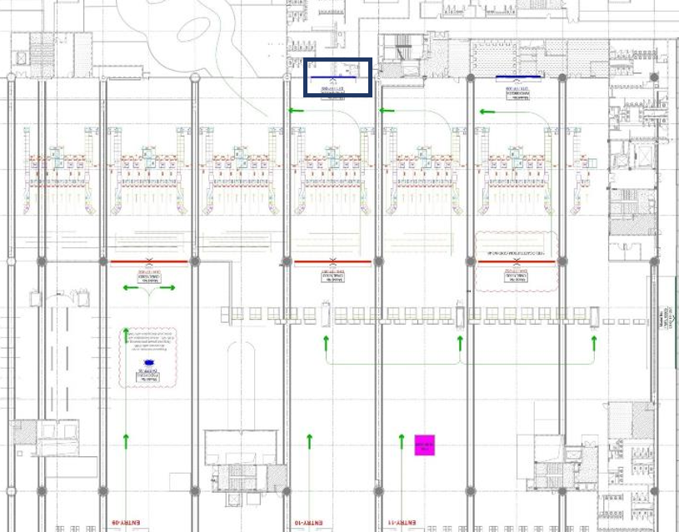
International Check-in-Hall : Wall Mount
SPECIFICATION
Size: 30ft x 7ft
Illumination: Back Lit
Display Faces: 1
Location: International Check In Hall

Slide 36
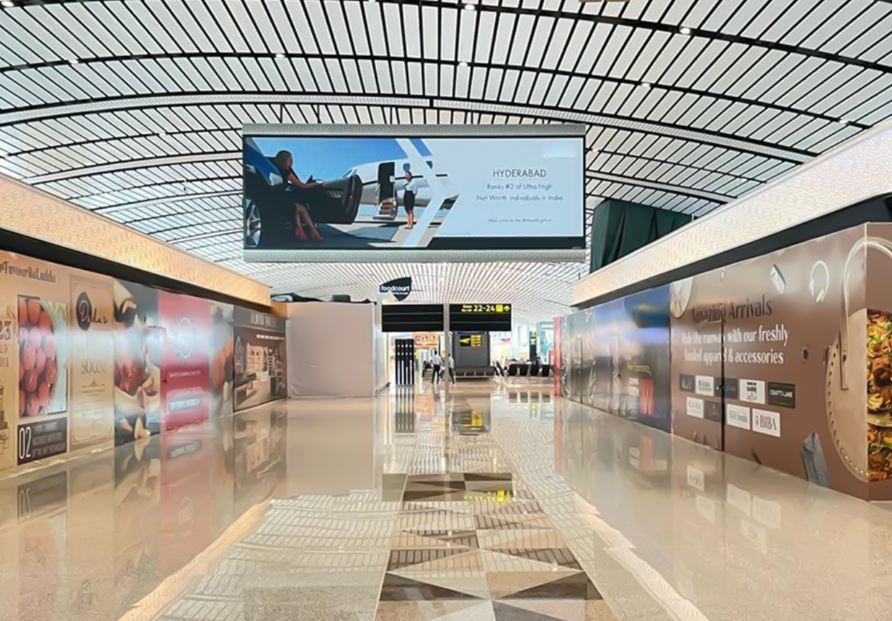
Binnacle @ International SHA Level F (Faces 2)
MEDIA DESCRIPTION
This media unit is located at the heart of the international security hold area. This head on media Chandelier. The unit caters to international departing passengers and grabs their attention as they are moving towards the Boarding Gates.

Slide 37
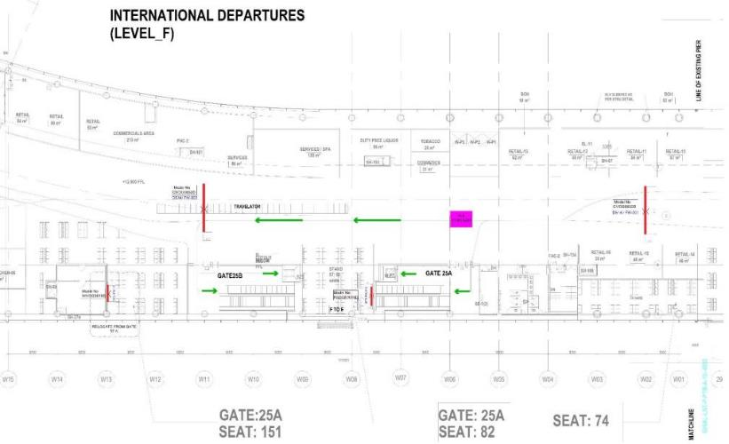
Binnacle @ International SHA Level F (Faces 2)
SPECIFICATION
Size: 30 ft x 10 ft
Illumination: Back Lit
Display Faces: 2
Location: International Security Hold Area

Slide 38
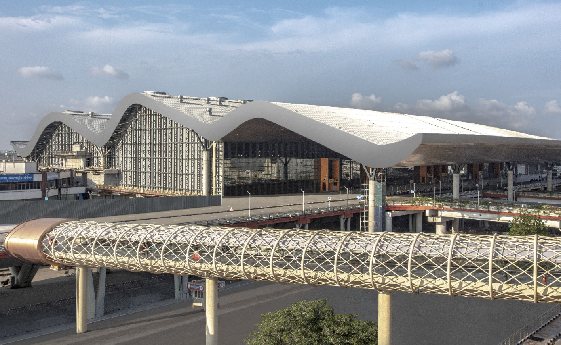
Chennai
International Airport
Chennai International Airport (MAA) handled approximately 21.2 million passengers, reflecting a 14.2% increase from the previous year. This total included more than 5 million international passengers

Slide 39
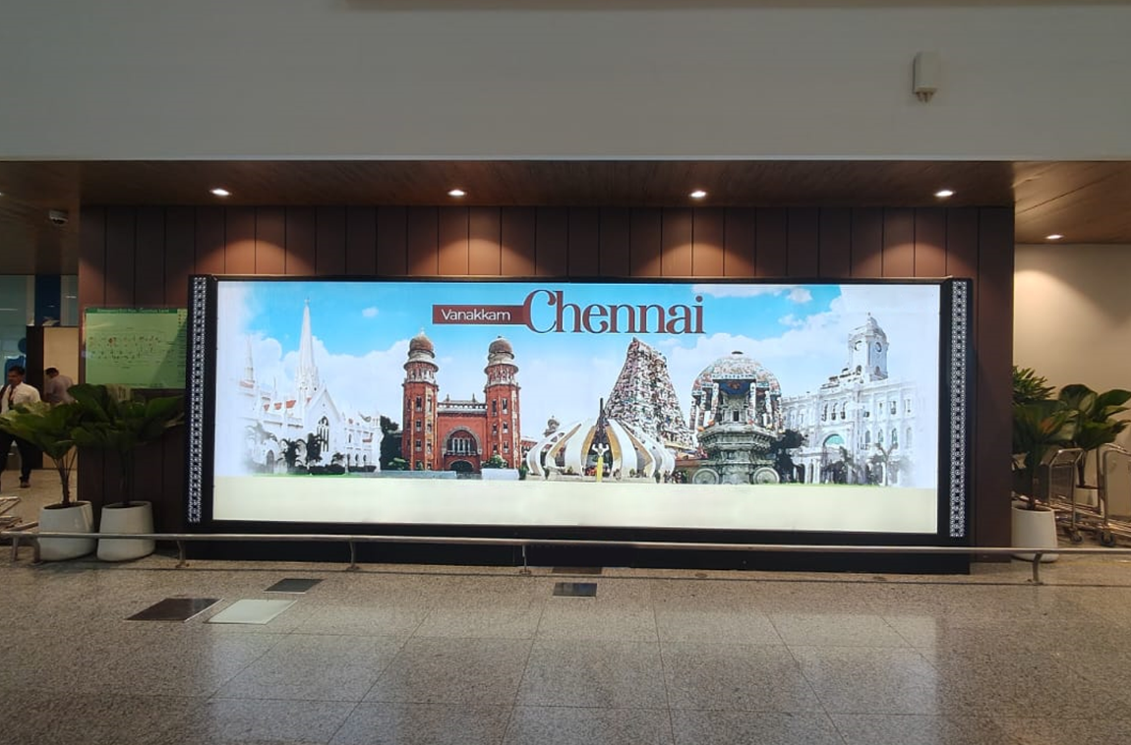
T2 International
Departures
Int Welcome
Static screen at check-in area

Slide 40
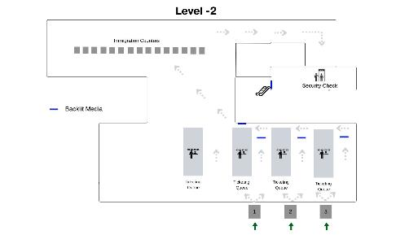
Int Welcome
(Map View)

Slide 41
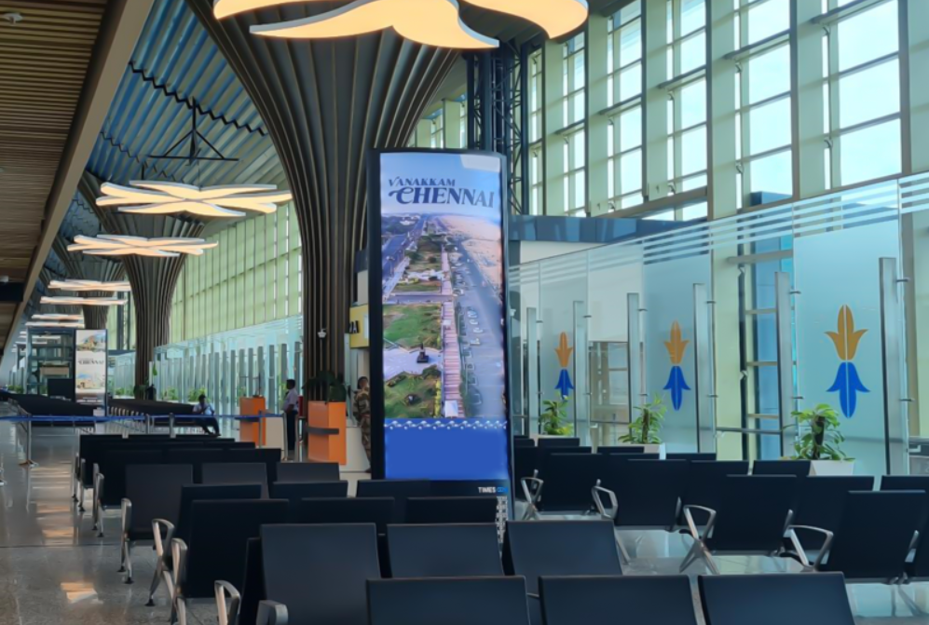
T2 International
Departures
International Bon Voyage
Static screen at boarding gate

Slide 42
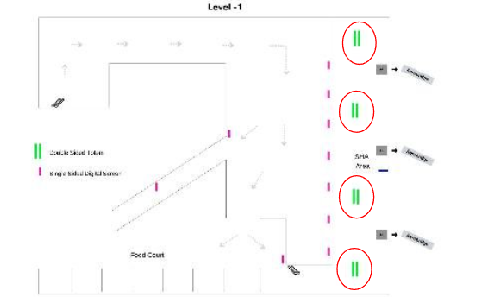
International Bon Voyage
(Map View)

Slide 43
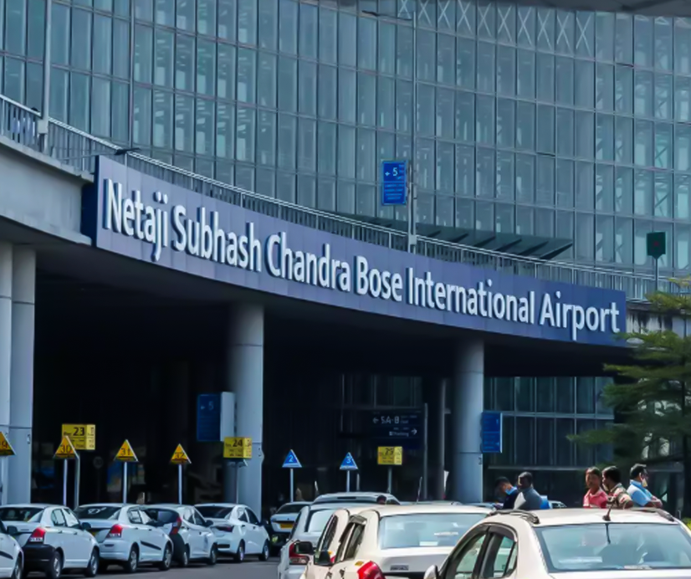
Kolkata
International Airport
Kolkata International airport hosted approximately 19.78 million passengers, with over 2 million being international travelers.

Slide 44
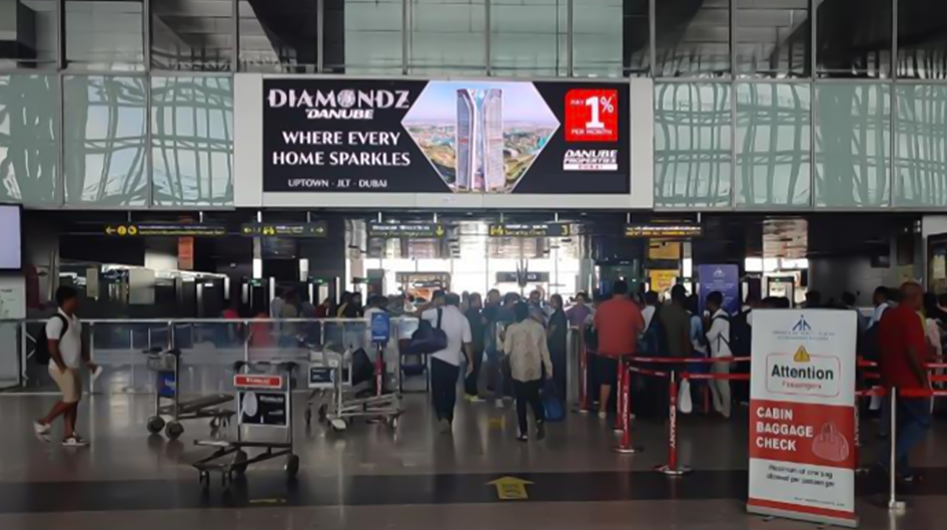
Digital video walls at common check in area
Prime Spot (Departures)
Large format media, high dwell time
Create impact for brand communications

Slide 45
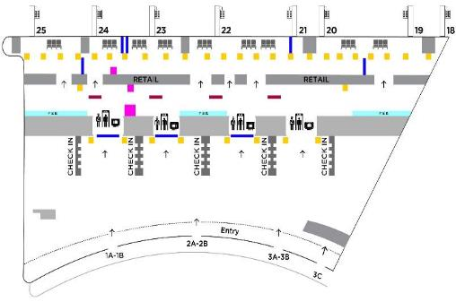
Prime Spot (Departures)
(Map View)

Slide 46
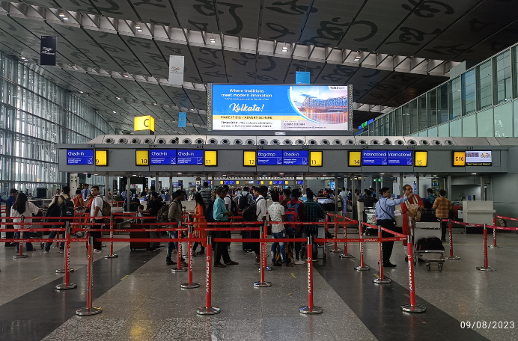
Welcome Package
Static screens on top of check in counter ‘C’
before frisking area

Slide 47
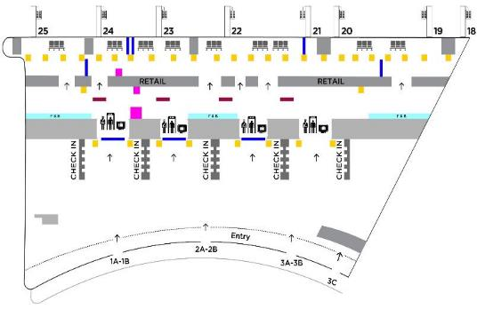
Welcome Package
(Map view)

Slide 48
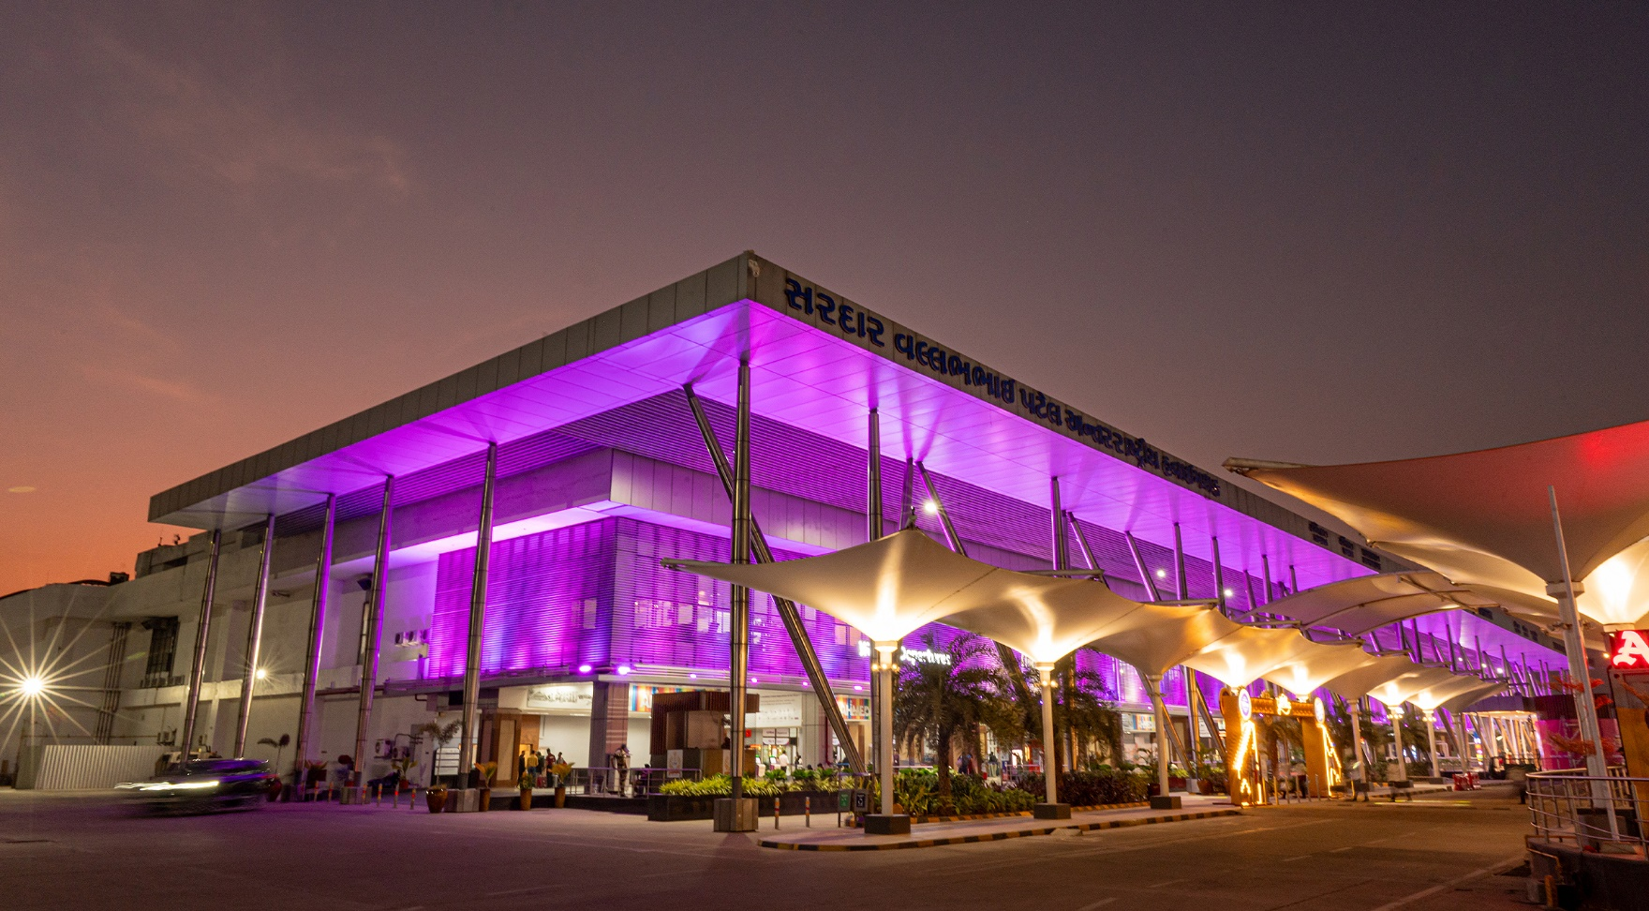
Ahmedabad
International Airport
Ahmedabad handled approximately 11.7 million passengers, with
215,000 international travelers.

Slide 49
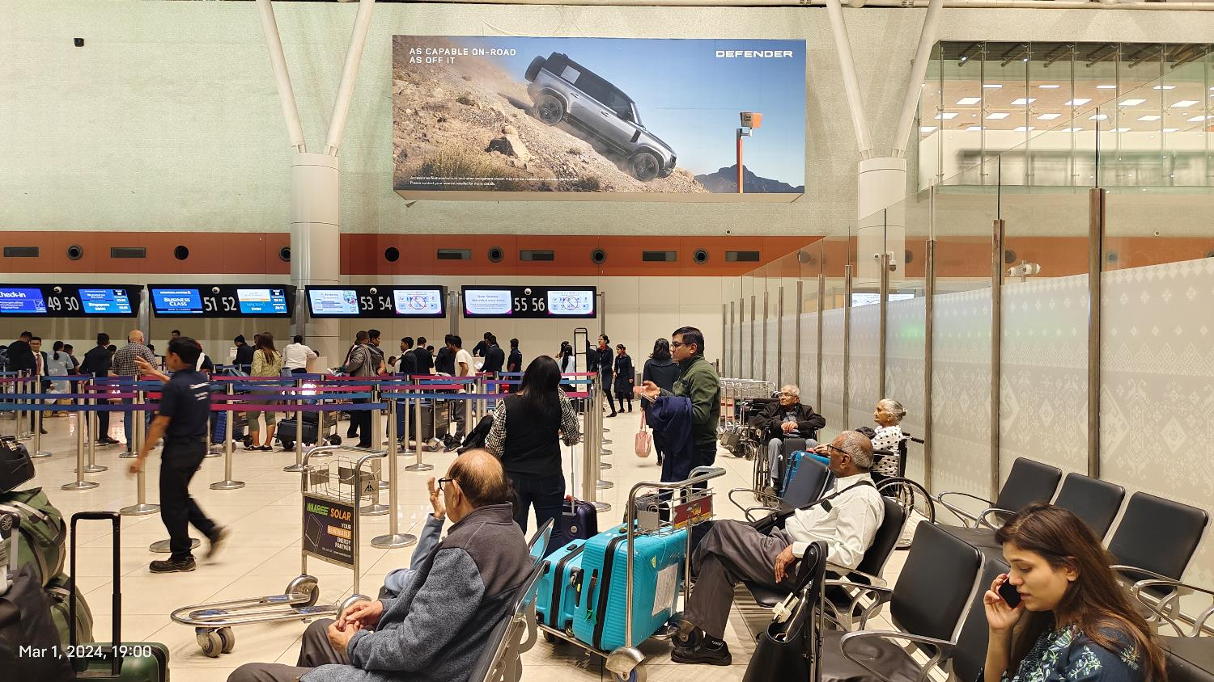
Check-in Hall Spectacular (CHS)
at International Departure
International Departure ( T2)
Head on placement of the media to capture the attention of Departing passengers.

Slide 50
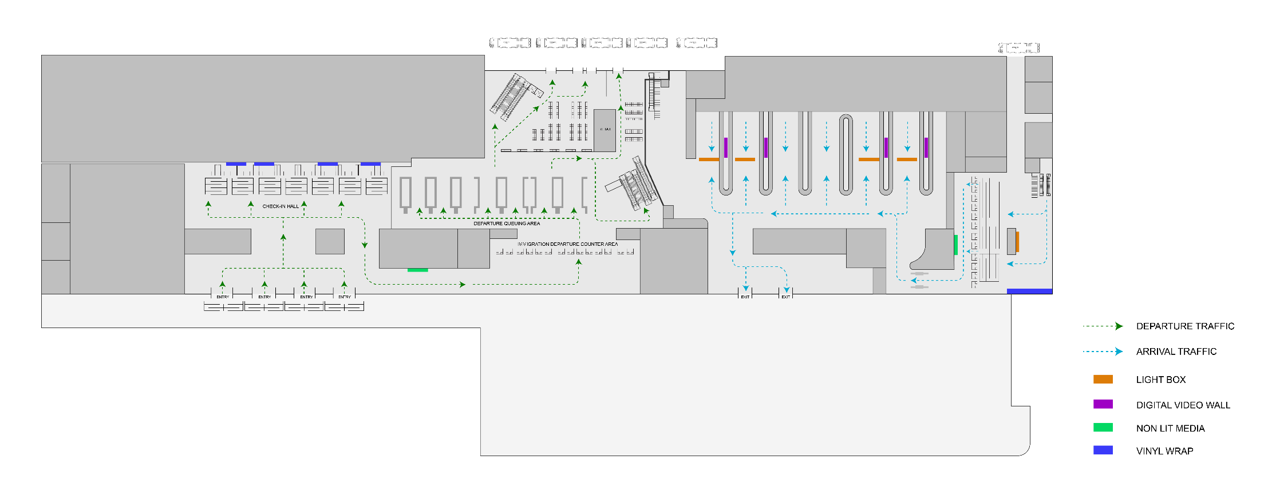
Proposed
Media Unit
Check-in Hall Spectacular (CHS)
at International Departure (Map View)

Slide 51
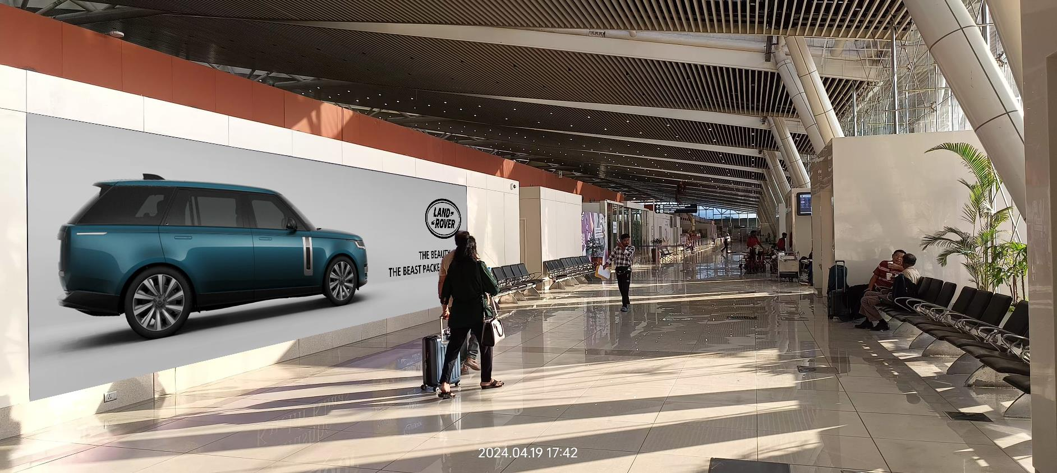
Departure corridor spectacular
at International Departure
International Departure ( T2 )
Placed strategically to Capture all the internationally departing passenger attention

Slide 52
Proposed
Media Unit
Check-in Hall Spectacular (CHS)
at International Departure

Slide 53
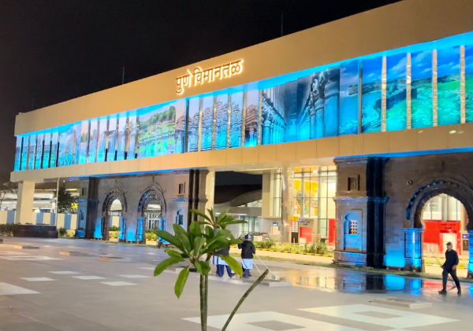
Pune
International Airport
Pune International airport handled a total of 10 million passengers, reflecting an 8.8% increase.

Slide 54
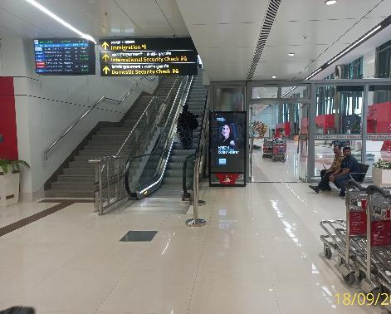
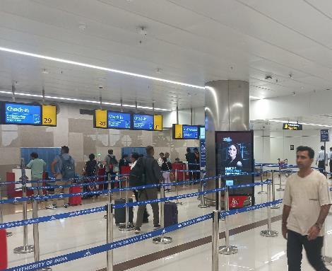
Domestic Departure - Across the Terminal Building
Check in Area - 2 Unit

Slide 55
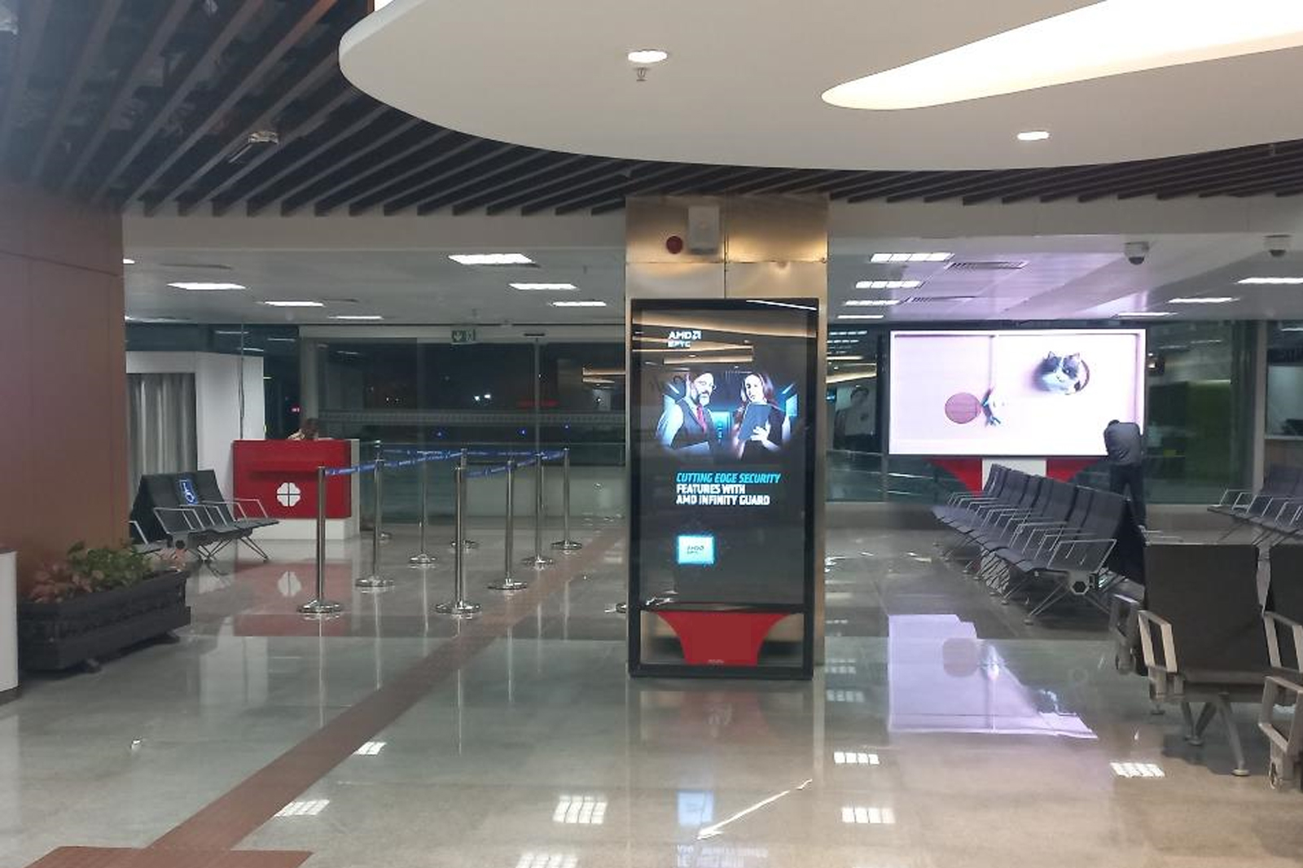
SHA – GF - 1 Unit

Slide 56
Security Hold, First Floor, LHS Hall– 4 Unit

Slide 57
International SHA– 2 Unit

Slide 58
Cochin
International Airport
Cochin International airport handles over 10 million passengers, marking an 18% increase. This growth included 5.22 million international passengers

Slide 59
International Departure
Cochin Airport Traffic facing from City Side to International Departure
Location – Right above the immigration & security Check, visible to all passengers moving toward SHA, an impactful site with 100% visibility

Slide 60
International Departure
International Departure
Site No. – CIDIM-01
Size – 35’ x 7’ – 245 sq.ft – 1 nos.
Media – Non-Lit SAV

Slide 61
Chandigarh
International Airport
Chandigarh handled approximately 3.72 million passengers, reflecting a 1.2% increase

Slide 62
Welcome Package
Backlit drop down in check in area

Slide 63
Welcome Package (Map View)

Slide 64
First Impression
Glass SAV on top of check in counter

Slide 65
First Impression (Map View)

Slide 66
Jaipur
International Airport
Jaipur International airport handled approximately 5.47 million passengers, marking a 14.7% increase from the previous year. This growth is attributed to a significant rise in international travelers.

Slide 67
Wall Wrap – International Departure
Departure – SHA Frisking Zone
Capture 100% Traffic entering International Airport Terminal for Departures
Placed strategically to create a lasting impression to departing passengers

Slide 68
Wall Wrap – International Departure

Slide 69
Wall Wrap – International Departures
Departures – Near Boarding Gate
Capture 100% Traffic entering International Airport Terminal for Departures
Placed strategically to create a lasting impression to departing passengers

Slide 70
Wall Wrap – International Departures

Slide 71
Lucknow
International Airport
Lucknow International airport achieved a record monthly passenger movement of 629,000, comprising over 105,000 international travelers.

Slide 72
Digital Totem
Departure Area
Capture 100% departing passengers' attention
First of its kind dominating digital network placed strategically to cater to the departing passengers before entering the terminal
Screens
3 (Double Sided)
Dimension
6*11 ft (662 x 1117 pixels)
Spot Duration
10 sec
No of Clients
6

Slide 73
Digital Totem (Map View)

Slide 74
Backlit Box
Check-In Area
Capture 100% departing passengers' attention (Dom + Intl) via 2 backlit units
First head-on media to be visible within the airport premise
Strategically placed to cater to dwell time of departing passengers near ticket check-in counters

Slide 75
Backlit Box (Map view)

Slide 76
Indore
International Airport
Indore International airport achieved a record passenger traffic of 3.8 million, reflecting an increase of over 330,000

Slide 77
High Street Domestic, Site : 15
High Street International
Locations:
5 unit in check in, 2 in security check, 5 in boarding gate and retail, 3 in aerobridge corridor, 3 in bus gate

Slide 78
High Street Domestic,
Site : 15
High Street International

Slide 79
High Street International (Map View)

Slide 80
Our Exclusive Offerings
Strategic consultation on the best airports. Early access to premium ad slots.
From strategy to execution, with deep insights & performance analytics.
Full campaign management with zero efforts needed from your side.
www.masscomglobal.com

Slide 81
Your Brand Deserves this Spotlight
Book Now Before They're Gone!
Limited Slots Available – High demand for airport placements.
Secure premium spots before your competitors does.
March to June will have summertime air traffic surge, high demand sports events and Cultural festivals.
The Great India Dominance puts your brand where high-value decisions happen ensuring maximum impact at the perfect moment.
www.masscomglobal.com

Slide 82
Thank You

