Slide 1
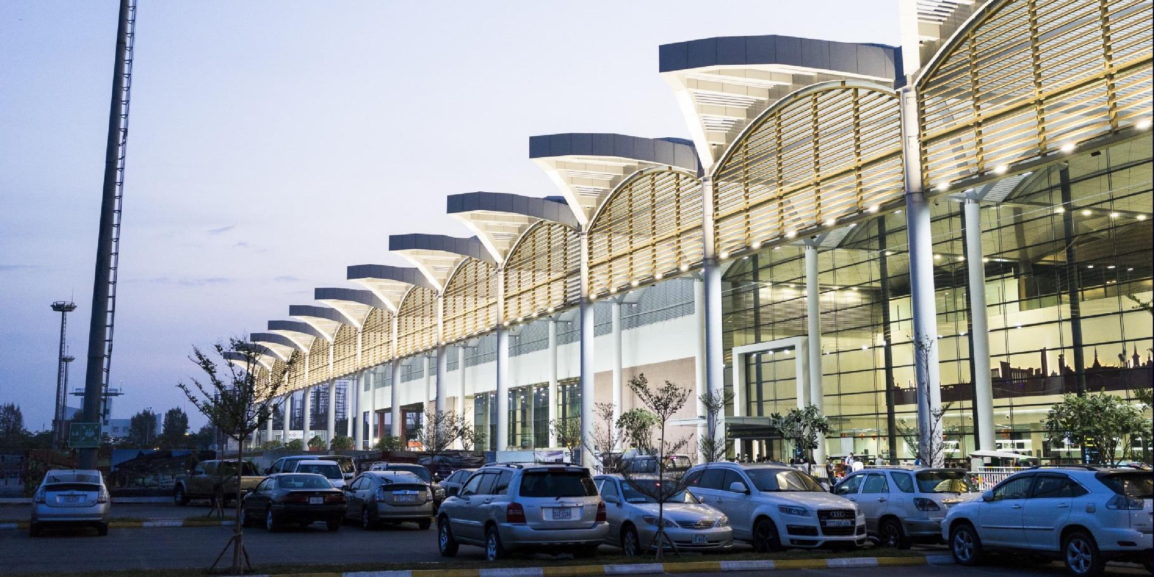
Advertising Opportunities
@Phnom Penh International Airport

Slide 2
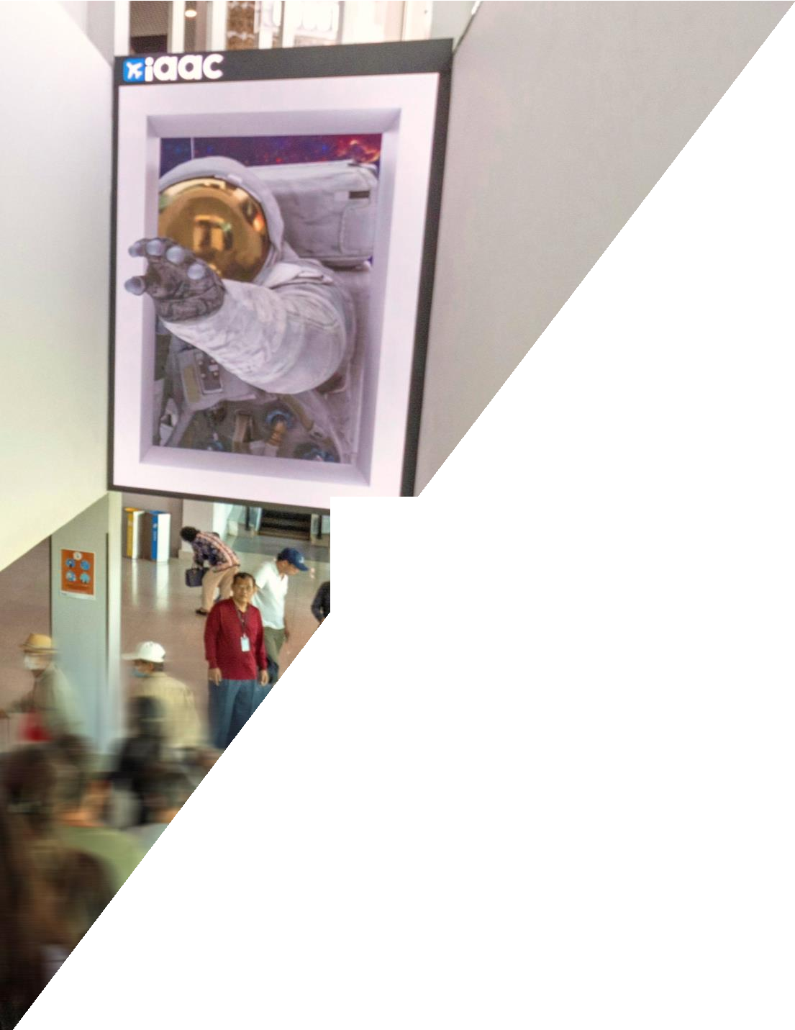
WHY IT
WORKS
BEYOND
BOUNDARIES
Amplify campaign impact wi outreach
GLOBAL REACH
Airports connect people fro allowing premium automotiv their products to a diverse i
HIGH-END TARGET AUDIENCES
Airports attract affluent individuals, making it a prime location to reach potential customers of premium automotive brands.
th OOH + Digital
CAPTIVE AUDIENCE
Passengers spend significant time at airports, creating an opportunity for brands to engage with potential customers through impactful advertisements.
m around the world,
e brands to showcase
nternational audience.

Slide 3
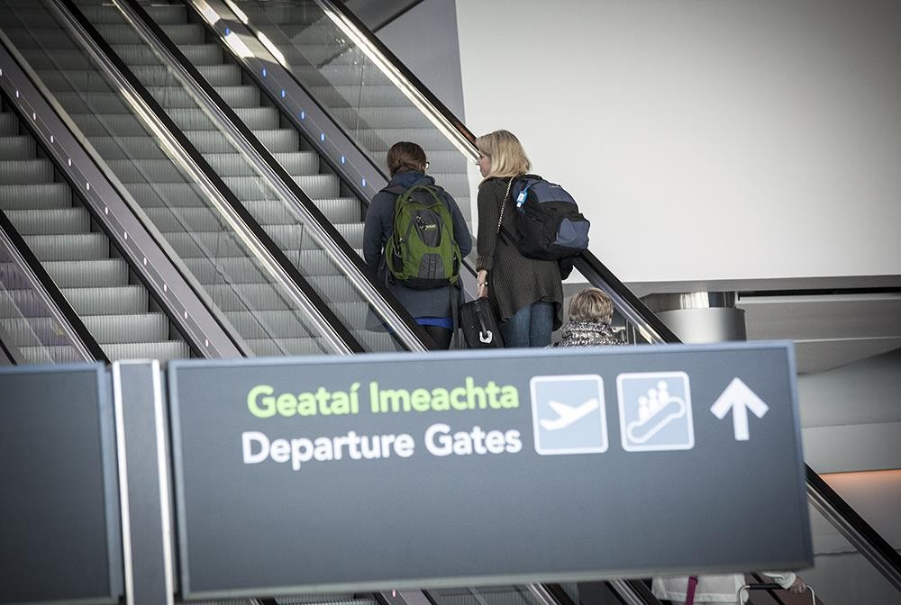
TARGET - DEPARTURES

Slide 4
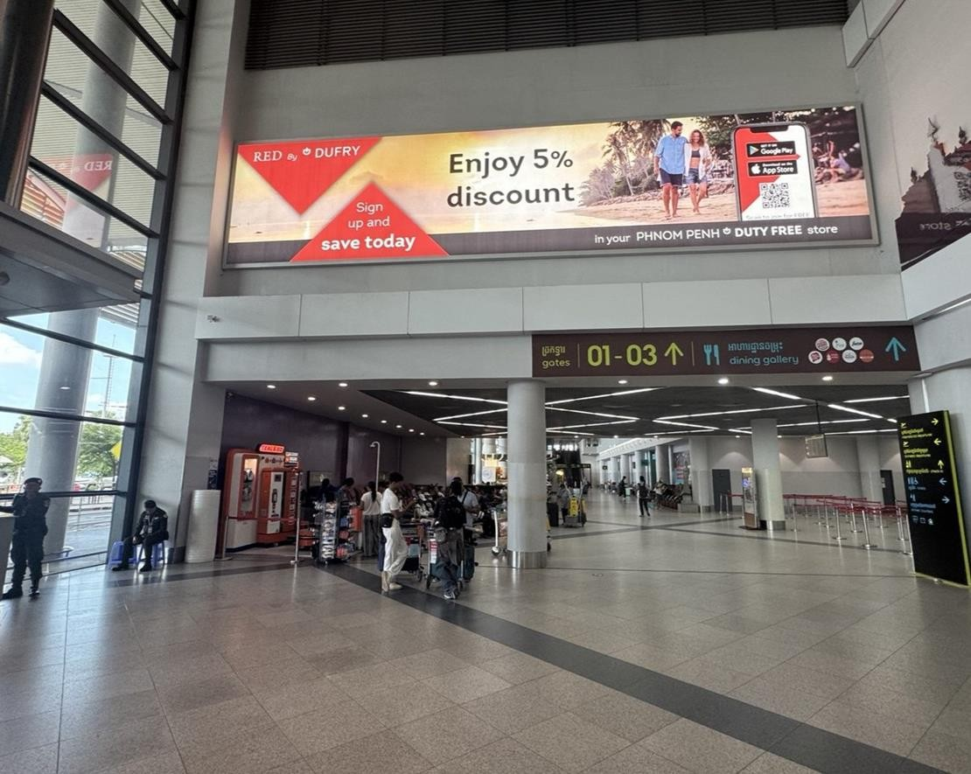
DEPARTURE IMPACT
Why this could be great ?
An immense static banner prominently positioned in the left corner of the check- in hall at Phnom Penh airport. This
advertising space will be visible to all departing passengers as they enter the airport and proceed to passport control after check-in. This unit is specifically designed for brands aiming for a
significant impact.
Format: Backlight No. units: 1 (PVC) Size : 1.4 m x 3 m
MONTHLY COST : $5,500 + VAT
*** Minimum 3-month purchase

Slide 5
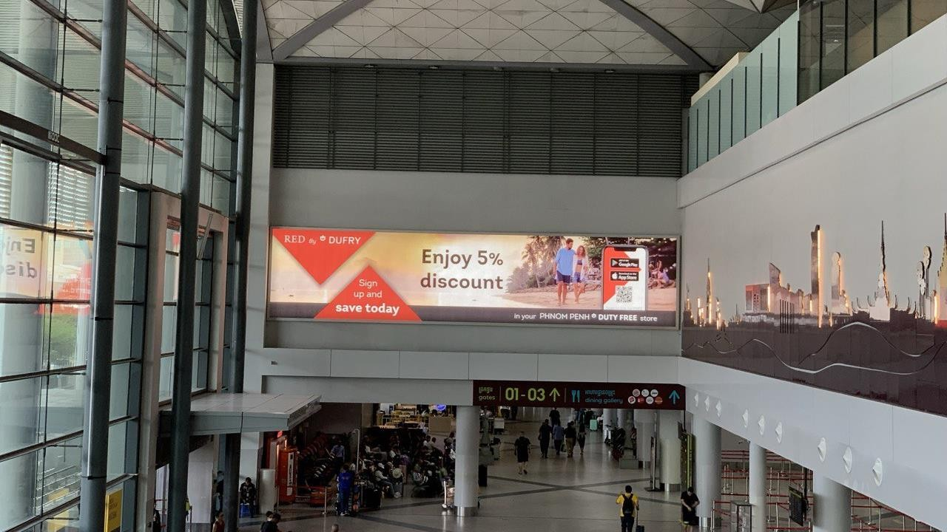

Slide 6
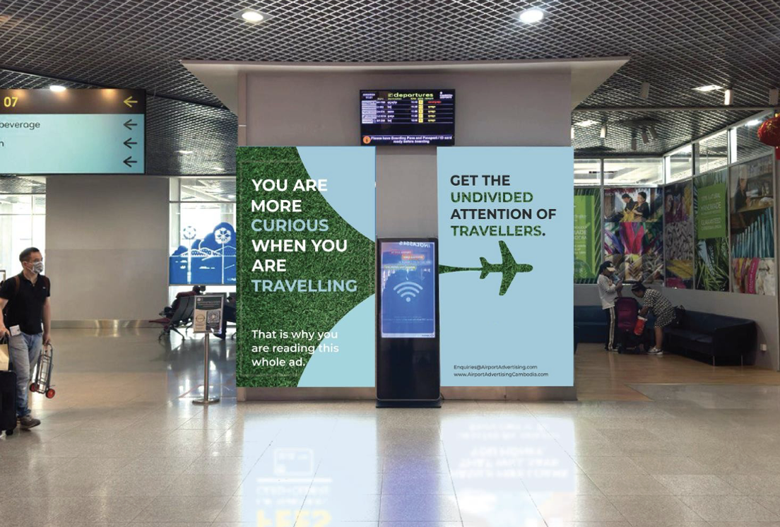
DEPARTURE DUO
Why this could be great ?
The first advertising units visible to
passengers as they make their way out of the duty-free store into the main departure and gate area. This pair of advertising units are positioned so they have 100% shar of voice thereby ensuring maximum impact over all passengers.
Format: Backlight No. units: 2
Size : 2.7 m x 1.5 m
ANNUAL COST : $110,000 + VAT
*** Minimum 6-month purchase

Slide 7
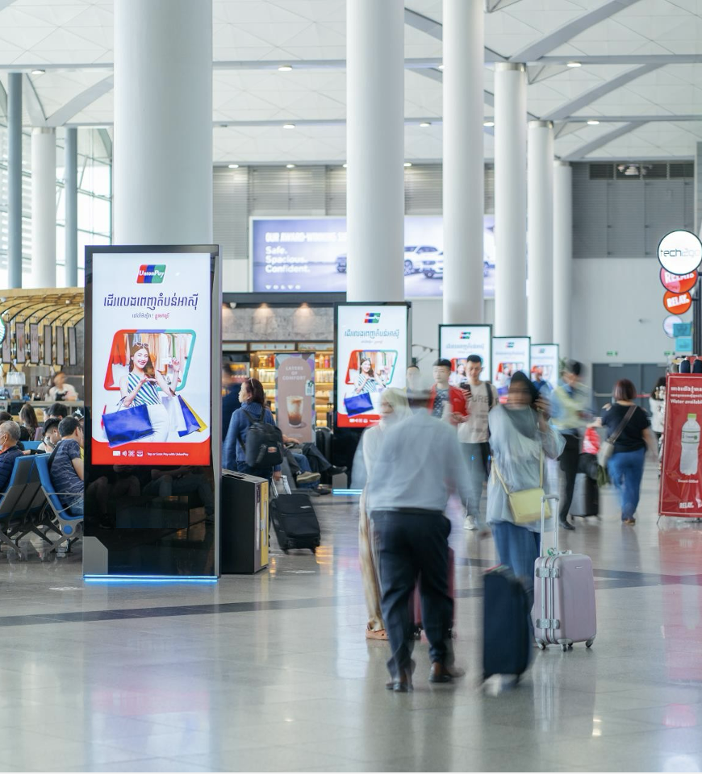
DIGITAL DEPARTURES
Why this could be great ?
The perfect advertising platform for companies seeking to develop brand awareness whilst also needing to communicate more details about their products.
Visible to 100% of passengers departing from Phnom Penh International airport, the Digital Departures Network can run messaging in multiple languages with the opportunity to change the content throughout the day to target different audiences
Format: LCD Screens No. units: 11
Max advertisers - 6
Your ad shown: 1080 times per day
MONTHLY COST : $11,000 + VAT

Slide 8
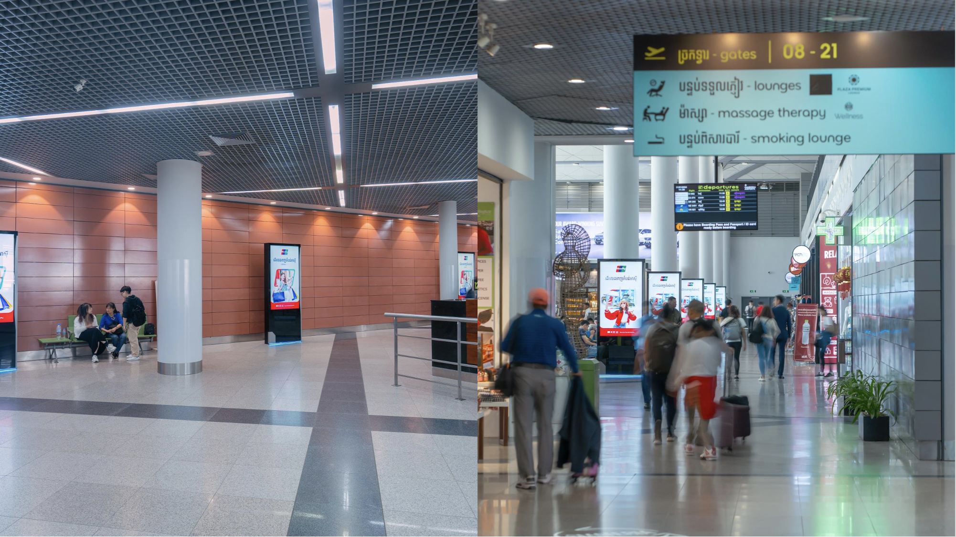

Slide 9
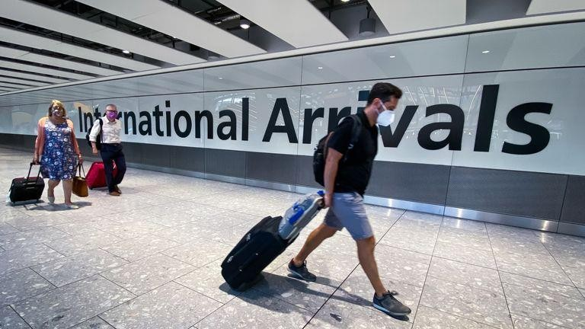
TARGET - ARRIVALS

Slide 10
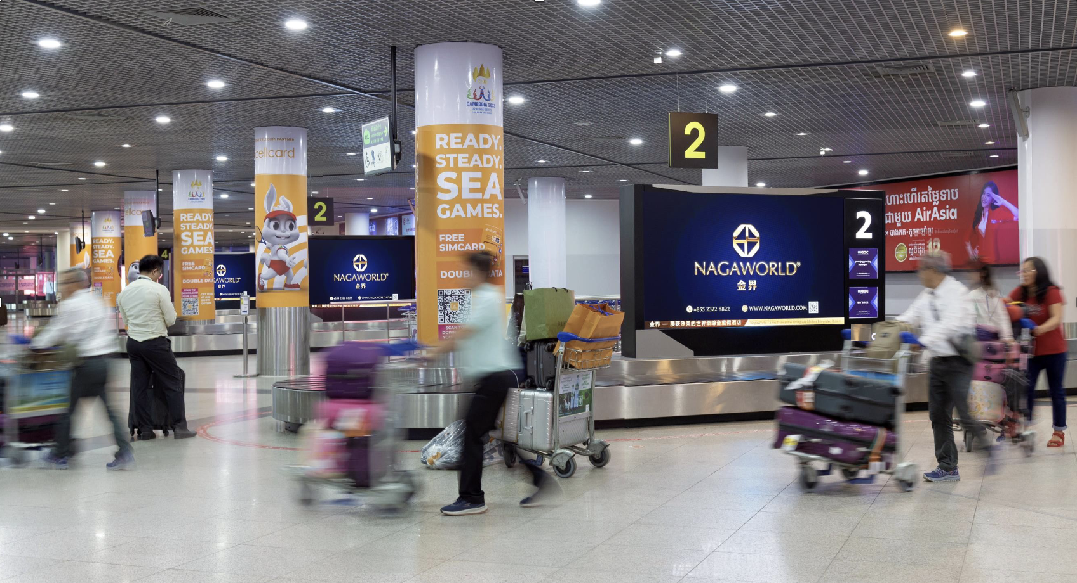
DIGITAL ARRIVALS
Why this could be great?
The perfect platform for brands seeking
to engage arriving passengers at Phnom Penh Airport, the Digital arrivals network is located on the baggage carousels making it visible to 100% of arriving passengers. Each advertiser’s content will appear on all 12 screens for 15 seconds before moving to the next advertiser on a 3-minute loop. With passengers waiting at least 15m for luggage each ad will be seen at least 5 times by passengers.
No. units: 12 (2.8m x 1.4m)
Format: Digital LED
Location: Baggage Carousels Ad spots: 12 (15 sec length) No spots per day: 360
MONTHLY COST : $11,000 + VAT

Slide 12
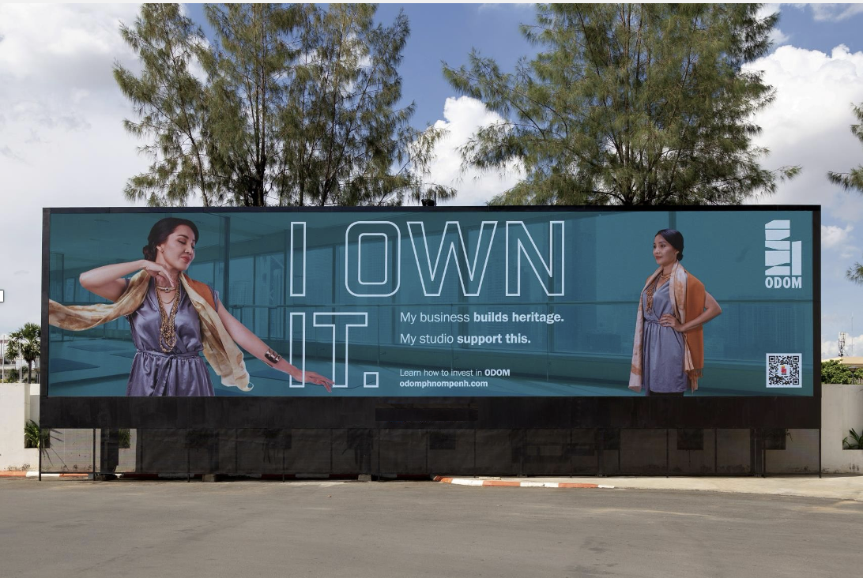
DIGITAL ARRIVALS
Why this could be great?
Designed to be the last message seen by passengers before they leave the airport, this giant screen will capture the attention of every passengers arriving at Phnom Penh International Airport, making it the perfect opportunity for property, telco, automotive, insurance and many other brands.
No. units: 1 (20m x 5m) Format: Digital LED
Location: Exit gate from the airport Ad spots: 4 (15 sec length)
Ad shown per day: 1260 times
MONTHLY COST : $17,600 + VAT

Slide 13
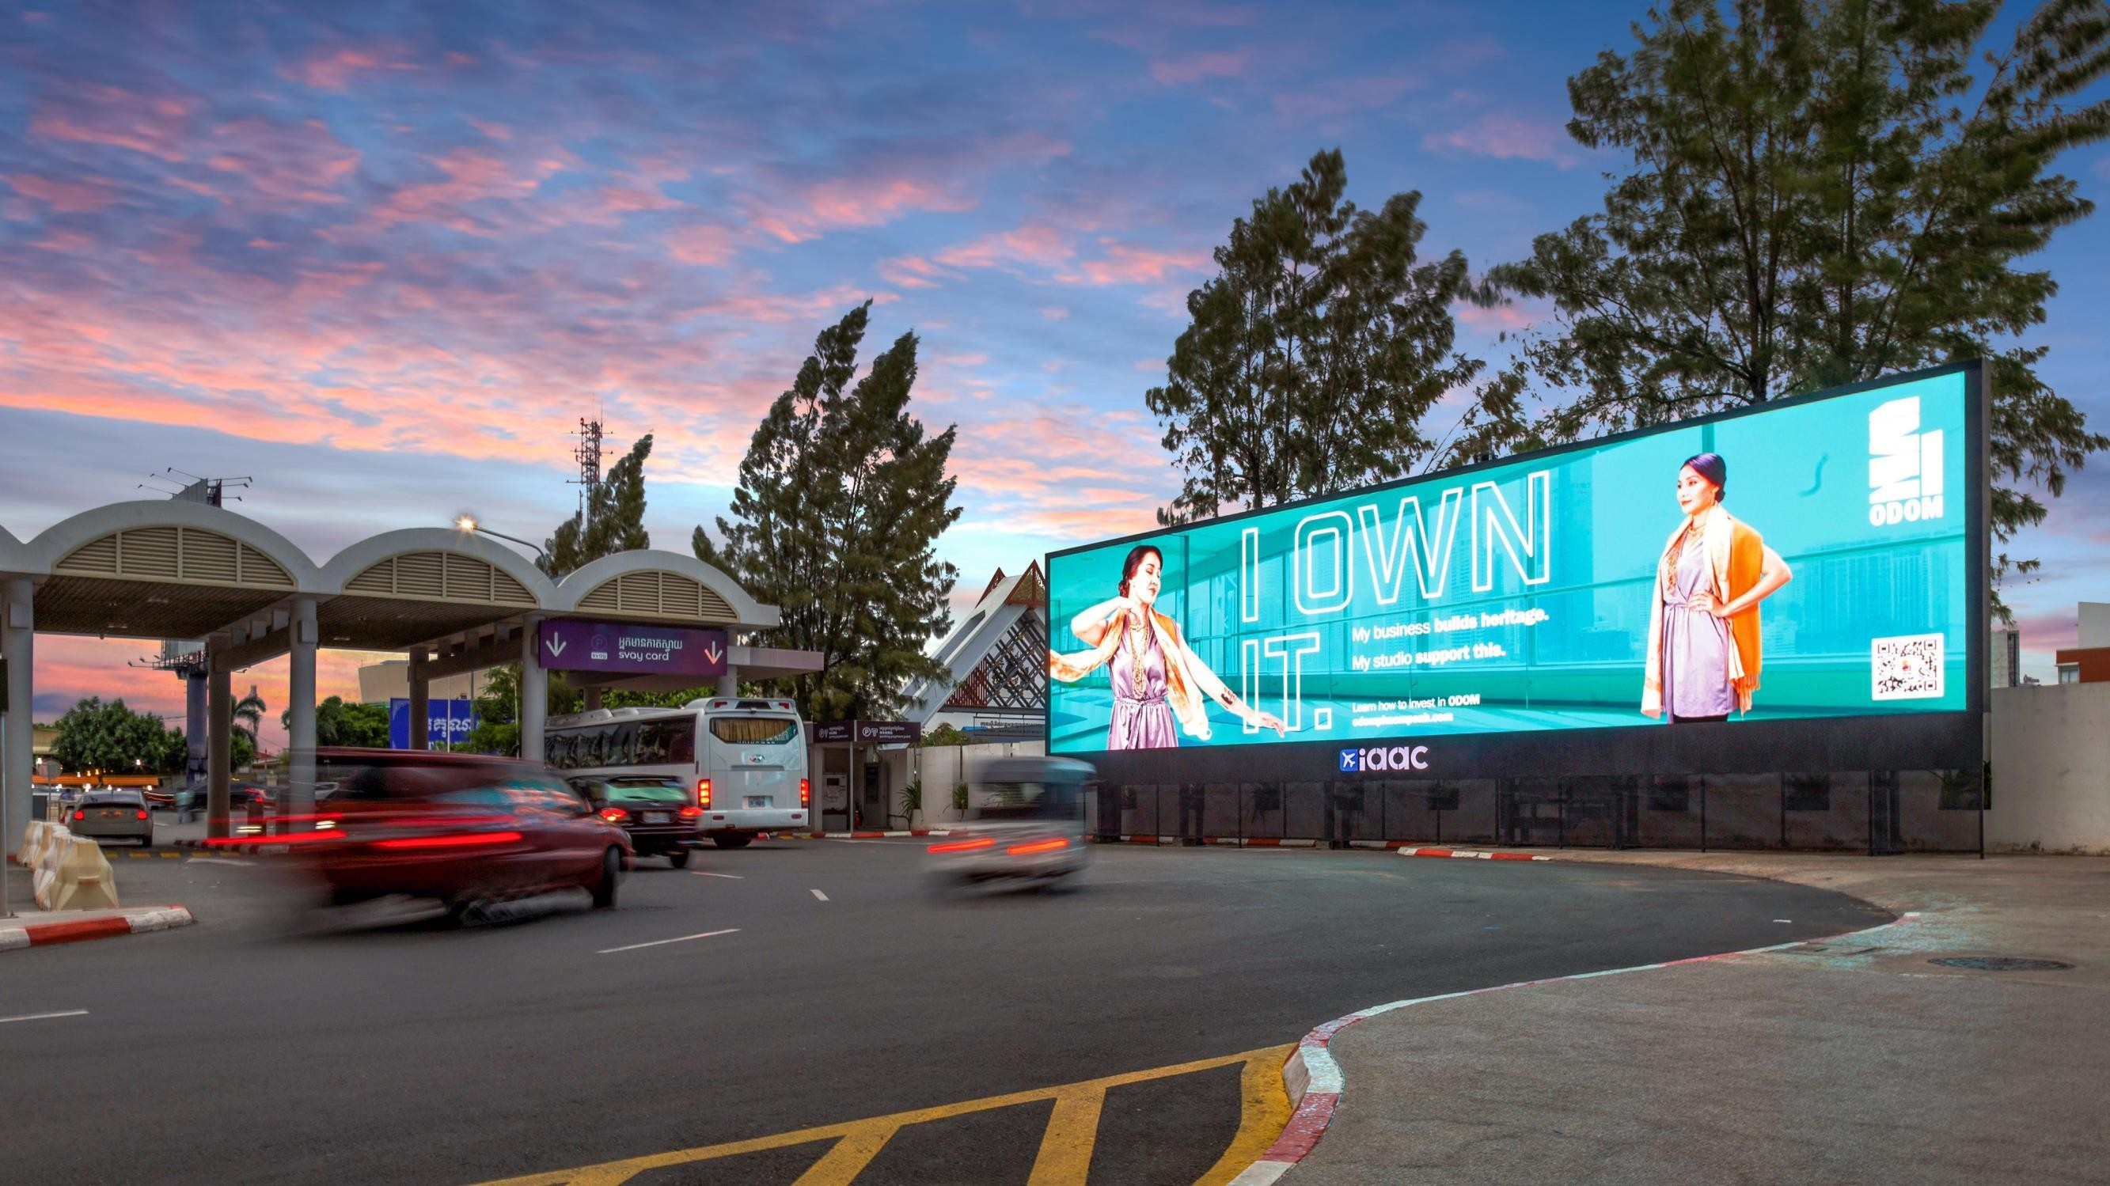

Slide 14
Passenger traffic @ Phnom Penh Airport
01 Jan 2024 – 30 Sep 2024
Last updated on 08 October 2024 (Source: Cambodia Airports)
396,558
405,639
407,262
389,202
377,285
385,746
361,017
371,217
364,869
Jan-24
Feb-24
Mar-24
Apr-24
May-24
Jun-24
Jul-24
Aug-24
Sep-24
Total Traffic
Arrivals Departures
~1.8M
Total Arrivals
01-Jan to 30 Sep 2024
~3.5M
Total traffic
01-Jan to 30 Sep2024
384K
Avg monthly passenger traffic 01-Jan to 30 Sep 2024
~1.7M
Total Departures 01-Jan to 30 Sep 2024

